Slide 1
SAE Monopoly
Choosing the right SAE for you!

Slide 2
SAE Monopoly Game Play
Each person will draw two “Property Cards.”
Choose one and discard the other.
Using SAE Idea Cards, write down an SAE idea for that student on your worksheet in Spot 1.
Repeat for Spots 2 and 3.
When you finish Spot 3, STOP.
The goal is to complete as many property matches as you can.

Slide 3

Chance Time!
As a small group, draw a chance card and discuss the question on your group’s card.
On your worksheet, write at least three different ideas to answer the question.

Slide 4
SAE Monopoly Game Play
Each person will draw two “Property Cards.”
Choose one and discard the other.
Using SAE Idea Cards, write down an SAE idea for that student on your worksheet in Spot 4.
Repeat for Spots 5 and 6.
When you finish Spot 6, STOP.
The goal is to complete as many property matches as you can.

Slide 5

Community Chest!
As a small group, draw a community chest card and discuss the question on your group’s card.
On your worksheet, write at least three different ideas to answer the question.

Slide 6
SAE Monopoly Game Play
Each person will draw two “Property Cards.”
Choose one and discard the other.
Using SAE Idea Cards, write down an SAE idea for that student on your worksheet in Spot 7.
Repeat for Spots 8 and 9.
When you finish Spot 9, STOP.
The goal is to complete as many property matches as you can.

Slide 7
Chance Time!
As a small group, draw a chance card and discuss the question on your group’s card.
On your worksheet, write at least three different ideas to answer the question.

Slide 8
SAE Monopoly Game Play
Each person will draw two “Property Cards.”
Choose one and discard the other.
Using SAE Idea Cards, write down an SAE idea for that student on your worksheet in Spot 10.
Repeat for Spots 11 and 12.
When you finish Spot 12, STOP.
The goal is to complete as many property matches as you can.

Slide 9
Community Chest!
As a small group, draw a community chest card and discuss the question on your group’s card.
On your worksheet, write at least three different ideas to answer the question.

Slide 10
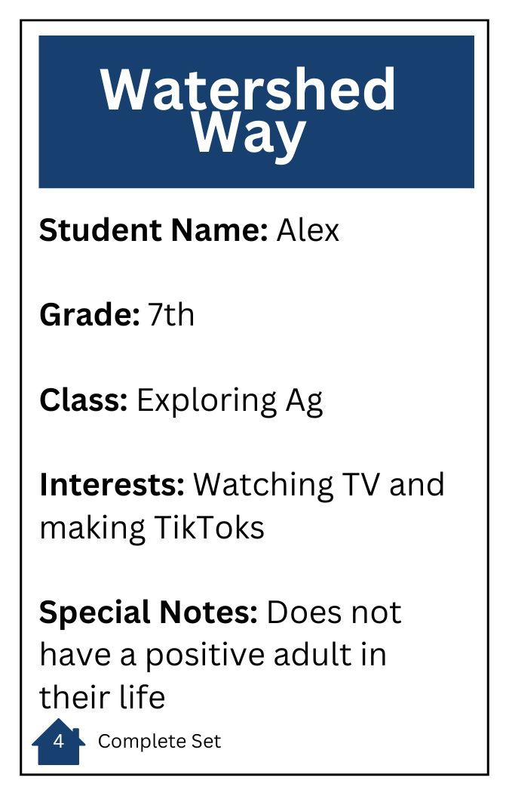
Small Group Discussion
As a small group, discuss what students you chose and what SAEs you developed for them.
Was this easy or hard to do? Why?

Slide 11

Large Group Discussion

