Slide 1



Get involved!

Slide 2
Supervised Agricultural Experience (SAE) Programs
An SAE is a year-round program made up of projects or enterprises where you apply agricultural skills and knowledge learned in the classroom.

Slide 3
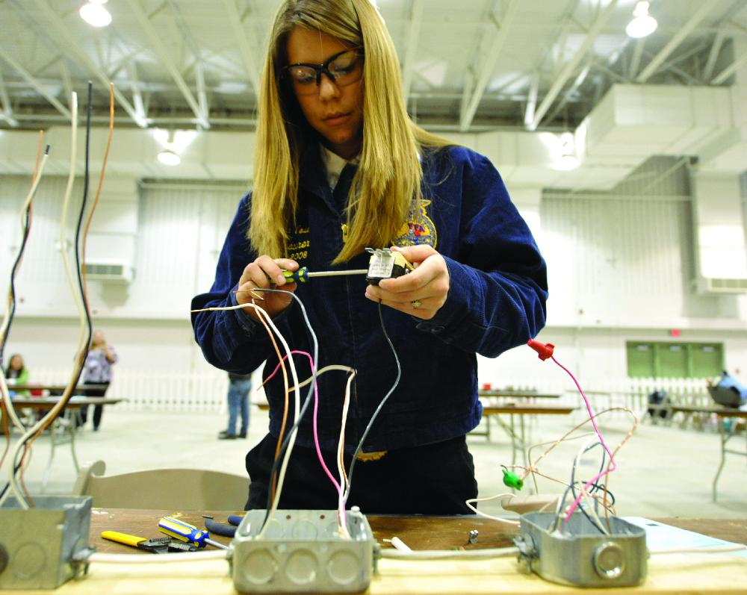

Four types of SAEs
  1. Entrepreneurship
  2. Placement
  3. Agriscience Research and Experimentation
  4. Exploratory

Slide 4
Parts of an SAE Program
Investigate
Plan
Coordinate
Program Improvement
Keep Records

Slide 5
Parts of an SAE Program
As you start to design your own SAE program, think about these things and you’ll be well on your way to a great SAE:
  1. Investigate: Explore possibilities and weigh the pros and cons of various SAE ideas.
  2. Plan: Decide what to do and how you will get it done. Set your goals high! Remember, you likely won’t accomplish everything in a day, a week or even a year.

Slide 6
Parts of an SAE Program
  3. Coordinate: Communicate with your FFA advisor, supervisor/employer and parents to get your program in motion.
  4. Keep Records: Track your achievements over time.

Slide 7
Parts of an SAE Program
  5. Program Improvement:
    Improve or update your business, worksite or community by making it more attractive, efficient or valuable.
    The National FFA Organization provides more than 45 proficiency awards to students who excel in their SAE programs.
      Students are recognized for their excellence and receive plaques, cash, scholarships for further education, and even international travel opportunities.

Slide 8
Career Development Events

Slide 9
Career Development Events
Career development events, or CDEs, build on what you learn in your agricultural education classes and FFA.
They let you practice making decisions and experience both teamwork and competition.
CDEs provide opportunities to develop skills today that you can use in your future career.

Slide 10
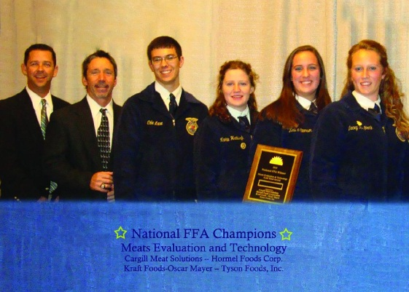
Team Events
Agricultural Communications
Agricultural Issues Forum
Agricultural Mechanics
Agricultural Sales
Agricultural Research
Agronomy
Dairy Cattle Evaluation
Dairy Foods
Environmental and Natural Resources
Farm Business Management
Floriculture
Food Science and Technology
Forestry
Horse Evaluation
Livestock Evaluation
Marketing Plan
Meats Evaluation and Technology
Nursery/Landscape
Parliamentary Procedure
Poultry Evaluation

Slide 11
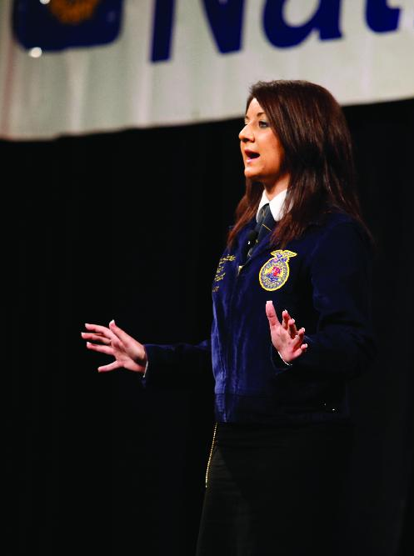
Individual Events and Activities
Individual Events
Creed Speaking
Extemporaneous Public Speaking
Job Interview
Prepared Public Speaking
Individual Activity
Dairy Cattle Handlers’ Activity

