Slide 1
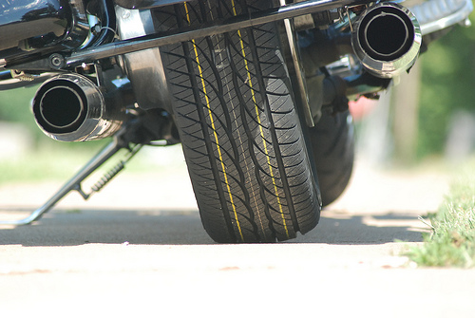
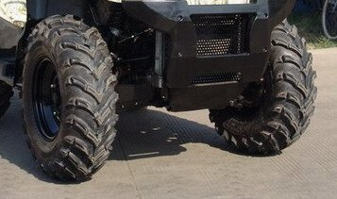
STARs Program Slide
Road Tire
Off-Road Tire
Can you see the difference?

Slide 2
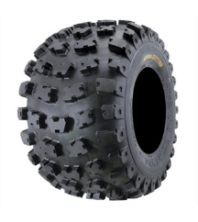
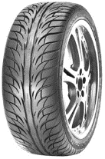
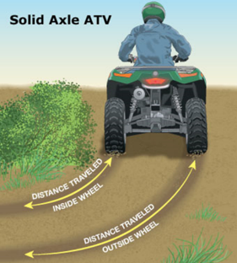
ATVs Are Not Designed For Roadway Use
Roadway
ATV
High center of gravity
Tires
  Roadway tires designed to grip and release the road.
  ATV tires designed to grab and not easily release.
  Under inflated tires react to bumps and ruts.
No rear differential
vs.
Notes:
The first main reason is that ATVs in general are not designed for roadway use. This is due to the design of the vehicle.
1 - As I mentioned earlier, ATVs have knobby, low pressure tires which grab pavement and can launch the vehicle if you hit potholes, ruts, etc.
2 – ATVs have a fixed rear axel, allowing the wheels to rotate in unison and keep wheel positions steady under heavy stress. This is different than passenger cars which have split axles to allow the left and right wheels to be driven at different speeds as the car turns, improving traction. But this fixed rear axel makes it difficult to execute 90 degree turns.
3 – The high center of gravity and narrow wheel base increases the danger of rollovers at roadway speeds.
Lastly, ATVs have a fixed rear axel, allowing the wheels to rotate in unison and keep wheel positions steady under heavy stress. This is different than passenger cars which have split axles to allow the left and right wheels to be driven at different speeds as the car turns, improving traction.
Car tires made for grip release, grip release.

Slide 3
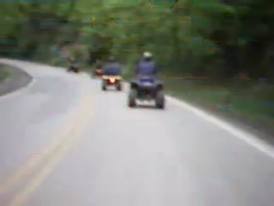
ATVs Are Not Designed For Roadway Use

Slide 4
Paved And Unpaved Roads Are Unsafe
58%
23 states had half or more of their fatalities on unpaved roads.
42%
Percent of Roadway Fatalities
Consumer Product Safety Commission ATV Fatality Data (1982-2012)

Slide 5
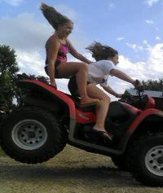
Speed Adds To Risk On Roadways And Other Terrains
Sport models on the market can travel as fast as 90 mph.
Utility ATVs can travel over 60 mph.
In order to reach peak speeds, many drivers take their ATVs on roads.
Outcomes:
  Higher speeds mean more severe injuries, including brain injuries.

Slide 6
There Are No Safe Roads
Paved roads are not safe!
Unpaved roads are not safe!
Low traffic roads are not safe!
Rural roads are not safe!
Notes:
The first main reason is that ATVs in general are not designed for roadway use. This is due to the design of the vehicle.
1 - As I mentioned earlier, ATVs have knobby, low pressure tires which grab pavement and can launch the vehicle if you hit potholes, ruts, etc.
2 – ATVs have a fixed rear axel, allowing the wheels to rotate in unison and keep wheel positions steady under heavy stress. This is different than passenger cars which have split axles to allow the left and right wheels to be driven at different speeds as the car turns, improving traction. But this fixed rear axel makes it difficult to execute 90 degree turns.
3 – The high center of gravity and narrow wheel base increases the danger of rollovers at roadway speeds.
Lastly, ATVs have a fixed rear axel, allowing the wheels to rotate in unison and keep wheel positions steady under heavy stress. This is different than passenger cars which have split axles to allow the left and right wheels to be driven at different speeds as the car turns, improving traction.
Car tires made for grip release, grip release.

Slide 7
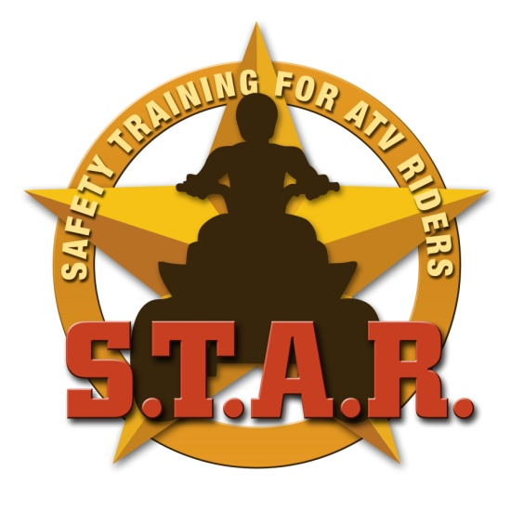
The Ten STARs
1
Always wear your helmet
One person at a time
Ride the right size machine
Always wear your protective gear
Never ride on the road
Take a safety course
Tell someone where you are going
Respect private property
Never use alcohol or drugs
Always obey the rules
2
3
4
5
6
7
8
9
10

Slide 8
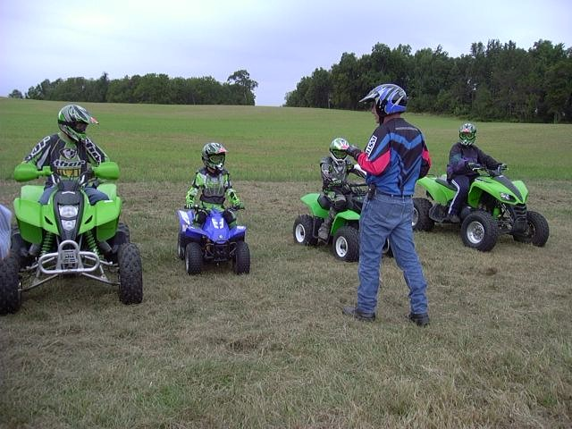
STARs Program Slide
Notes:
How long it is, it required for who? Interactive, who to contact if you want a class

Slide 9
The Ten STARs
1
Always wear your helmet
One person at a time
Ride the right size machine
Always wear your protective gear
Never ride on the road
Take a safety course
Tell someone where you are going
Respect private property
Never use alcohol or drugs
Always obey the rules
2
3
4
5
6
7
8
9
10

Slide 10
STARs Program Slide
Hey mom, I’m going out on the ATV to meet up with Scott. We are going to ride on the trails for an hour then I’ll be home for dinner. Oh, and YES I will wear my helmet!
Notes:
Talk about the story of the snowmobiler for this winter.
Always need to tell someone:
Where you are going
Who you will be with
How long you anticipate being gone
And always…that you have your safety gear.

Slide 11
The Ten STARs
1
Always wear your helmet
One person at a time
Ride the right size machine
Always wear your protective gear
Never ride on the road
Take a safety course
Tell someone where you are going
Respect private property
Never use alcohol or drugs
Always obey the rules
2
3
4
5
6
7
8
9
10

Slide 12
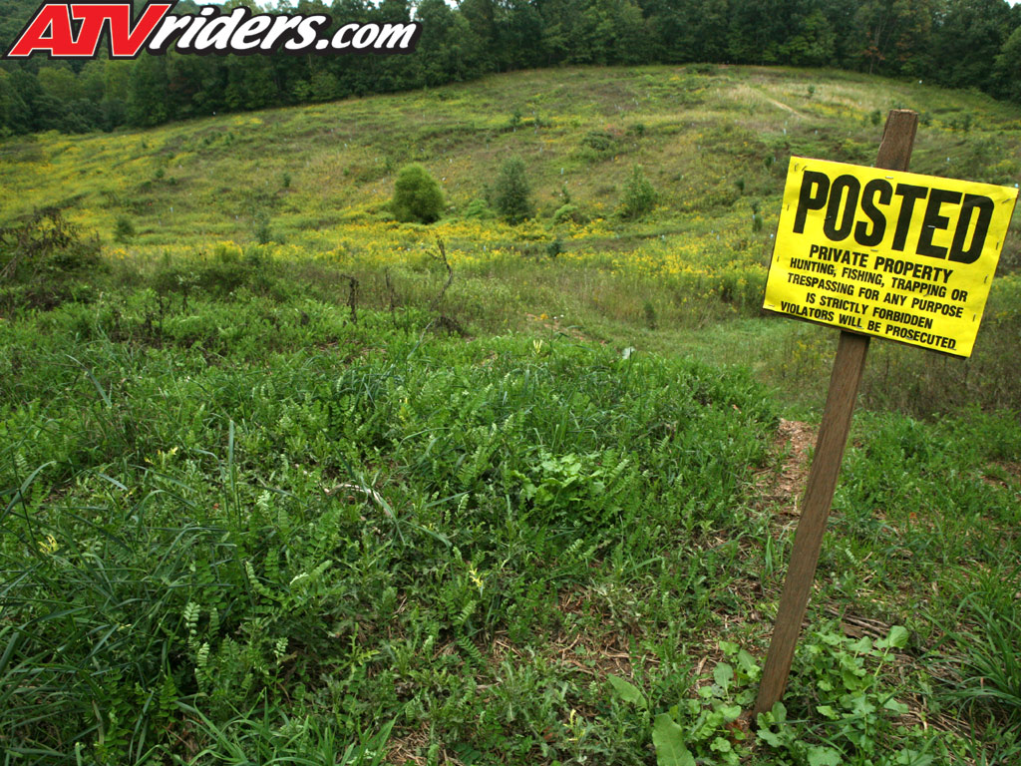

STARs Program Slide
Notes:
Natural resources are for all to enjoy
Erosion problem
You don’t want someone in your locker at school, why would you want them on your property
Safety – hunting season, fences you are not aware of, unknow terrain.

Slide 13
The Ten STARs
1
Always wear your helmet
One person at a time
Ride the right size machine
Always wear your protective gear
Never ride on the road
Take a safety course
Tell someone where you are going
Respect private property
Never use alcohol or drugs
Always obey the rules
2
3
4
5
6
7
8
9
10

Slide 14
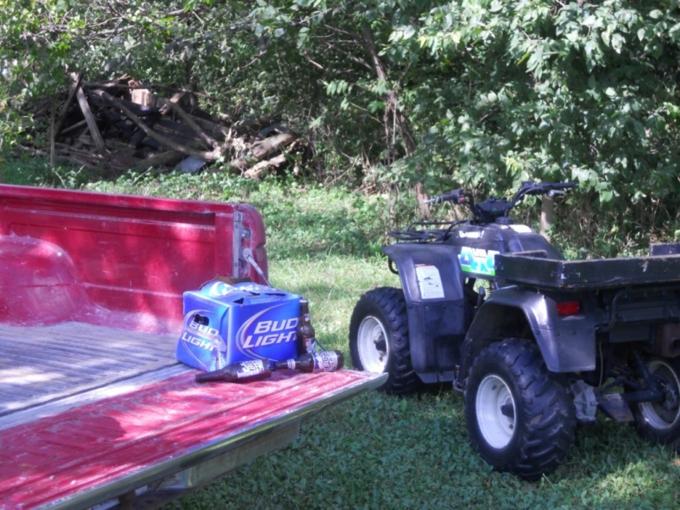
STARs Program Slide
Alcohol and ATVs DON’T mix!
All drugs can impact your ability to operate an ATV…
Notes:
A typical drink consists of a 12-oz can of beer, a 4-oz glass of wine, or 1.5oz shot. Each drink contains approximately one-half ounce of alcohol an dALL of them can impair your faculties. A thimble full of alcohol under young tongue can be detected from a blood draw in 7 seconds!
Beer in not less intoxicating then other form of liquor – it all depends on how many drinks you have, how much you weigh, whether you have food in your stomach, and whether you are male or female. In general, the less a person weighs, the more he or she will be affected by a give amount of alcohol.
Effects of drugs and alcohol?
Impair judgement
Affect coordination
Slow reflexes
Impair vision
Over the counter

Slide 15
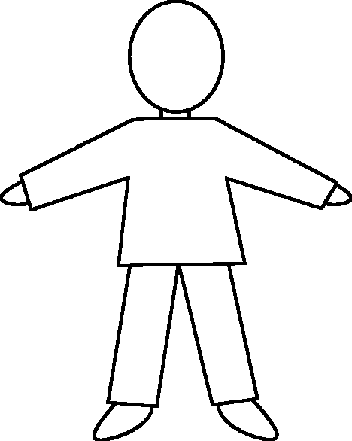
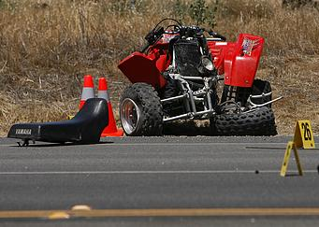
Alcohol Contributes to Teen ATV Crashes
Alcohol
Crashes on roadways are more likely to involve alcohol than crashes off-road.
One out of five fatal crashes with 16-17 year old operators involve alcohol.

Slide 16
The Ten STARs
1
Always wear your helmet
One person at a time
Ride the right size machine
Always wear your protective gear
Never ride on the road
Take a safety course
Tell someone where you are going
Respect private property
Never use alcohol or drugs
Always obey the rules
2
3
4
5
6
7
8
9
10

Slide 17
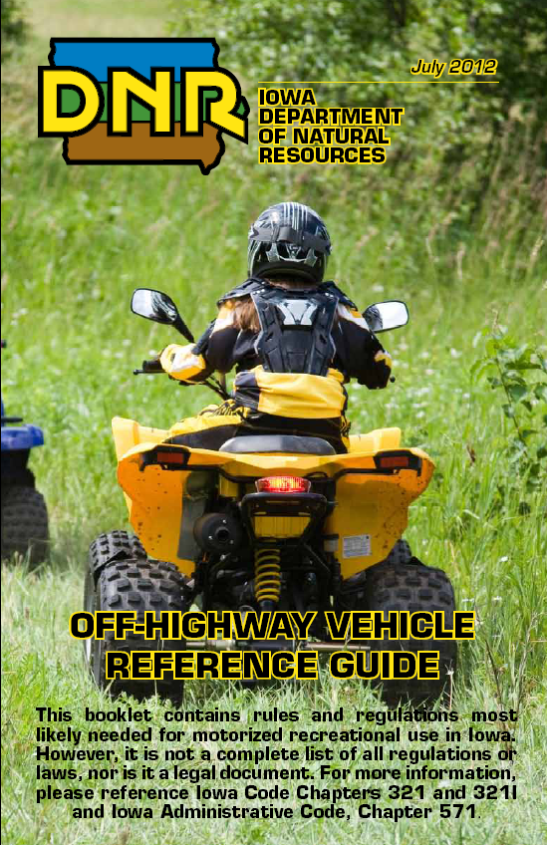
STARs Program Slide

Slide 18
Youth are Engaging in Multiple Unsafe Riding Behavior

Slide 19
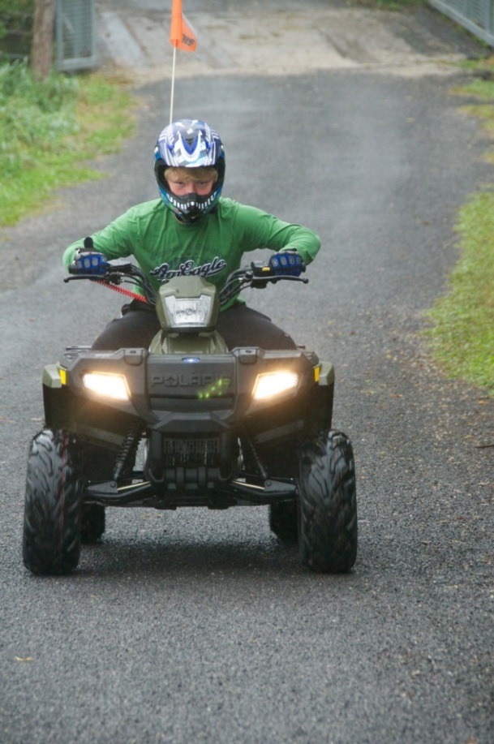
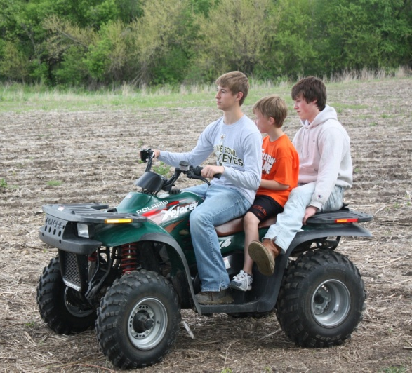
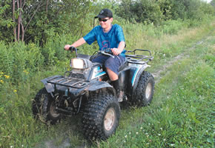
Our Three Measures of Unsafe Riding Behaviors
Multiple Riders
Riding on Roads
Riding Without a Helmet
Determined Combinations of Unsafe Behaviors

Slide 20
Riders Often Engage in Multiple Unsafe Behaviors
None = 2%
Unsafe Behaviors
Multiple riders
Riding on public roads
Not wearing a helmet
9%
All = 60%
31%

Slide 21
STARs Impact on Knowledge
and Behavior

Slide 22
Short-Term Knowledge Gain
Most ATVs are made to carry how many people?
1
2
3
More than 3
I don’t know
Incorrect
48%
Correct
52%
Pre-test
Incorrect
2%
Post-test
Correct
98%
Notes:
Helmets should be worn EVERY time you take an ATV ride
Helmets reduce the risk of death by 42%
Helmets reduce the risk of non-fatal injury by 60%
Proper fit is very important
Should be approved by:
1. Department of Transportation (DOT)
2. American National Standards Institute (ANSI)
3. Snell Memorial Foundation (Snell)

Slide 23
Short-Term Knowledge Gain
According to guidelines, what is the largest ATV engine size recommended for use by 12-15 year olds?
Under 70cc
90cc
200cc
300cc
I don’t know
Correct
25%
Pre-test
Incorrect
75%
Incorrect
18%
Post-test
Correct
82%
Notes:
Helmets should be worn EVERY time you take an ATV ride
Helmets reduce the risk of death by 42%
Helmets reduce the risk of non-fatal injury by 60%
Proper fit is very important
Should be approved by:
1. Department of Transportation (DOT)
2. American National Standards Institute (ANSI)
3. Snell Memorial Foundation (Snell)

Slide 24
Short-Term Knowledge Gain
According to Iowa law, when can someone ride an ATV on a public road?
When it is a gravel road
For farming purposes
You can never operate an ATV on public roads
I don’t know
Pre-test
Incorrect
57%
Correct
43%
Incorrect
24%
Post-test
Correct
76%
Notes:
Helmets should be worn EVERY time you take an ATV ride
Helmets reduce the risk of death by 42%
Helmets reduce the risk of non-fatal injury by 60%
Proper fit is very important
Should be approved by:
1. Department of Transportation (DOT)
2. American National Standards Institute (ANSI)
3. Snell Memorial Foundation (Snell)

Slide 25
1-Year Follow Up Knowledge
Q2. According to manufacturers guidelines, what is the largest ATV engine size recommended for use by 12-15 year olds?
Q3. According to Iowa law, when can someone ride an ATV on a public road?
Q1. Most ATVs are made to carry how many people?
90%
81%
79%
69%
54%
50%
% Correct
40%
34%
25%

Slide 26
Likelihood of Using STARs
Likely/Very Likely | 48%
Undecided | 20%
Not Likely/Unlikely | 32%
Less frequent rider = more likely to use
More unsafe behaviors practiced = less likely to use

Slide 27
Behavior Changes: 1-Year Later
Matching School and Class
No change in helmet use ☹
No change in riding with passengers ☹
But before riding on roads was 62% …..
1-year later riding on roads was 44% ☺
Also, having had a crash in past 12 mos initially was 34%....
1-year later crashes in past 12 mos was 20%☺

Slide 28
The STARs Trainer Toolkit

Slide 29
Toolkit Contents
Toolkit contains:
Lesson plan with slides
Safety materials
Other fun resources
A video of a session and the Powerpoint presentation is also available.

Slide 30
Questions?

