Slide 1



FFA Scholarships and Awards

Slide 2

National FFA Scholarships
The National FFA Organization and its supporters have more than $2 million in college scholarships.
Qualification requirements for the various scholarships are diverse; scholarships are given for a wide variety of experiences, career goals and higher education plans.
FFA scholarship applications will be looked at in their entirety – including your community service, your FFA involvement, your leadership skills and your supervised agricultural experience program.
How to apply: The online scholarship application is available each year on Nov. 15 at www.ffa.org/scholarships.

Slide 3
Proficiencies
Once your supervised agricultural experience program is up and running, what comes next?
Proficiencies can help you:
  define the focus of your SAE
  set goals for the future of your SAE
  record your work toward accomplishing those goals.
By applying for an award in one or more of the current proficiency areas, you have the opportunity to earn recognition and possibly even cash!
For the most up-to-date listing of proficiencies offered, check out www.ffa.org/proficiency

Slide 4
Placement vs. Entrepreneurship
Proficiencies
Placement proficiencies are for members who work for an individual or business (for pay or as a volunteer) for their SAE.
Entrepreneurship proficiencies are for members who own and operate one or more agricultural production or agribusiness enterprises for their SAE.
Some proficiencies offer both placement and entrepreneurship options while others may offer just one option.
Visit www.ffa.org/proficiency for the SAE alphabetical listing tool to see where your SAE fits.

Slide 5

FFA Star Awards
The FFA recognizes FFA members who rise to the top at each degree level.
These members have gone above and beyond in their attitude, chapter involvement, community service and supervised agricultural experience.

Slide 6
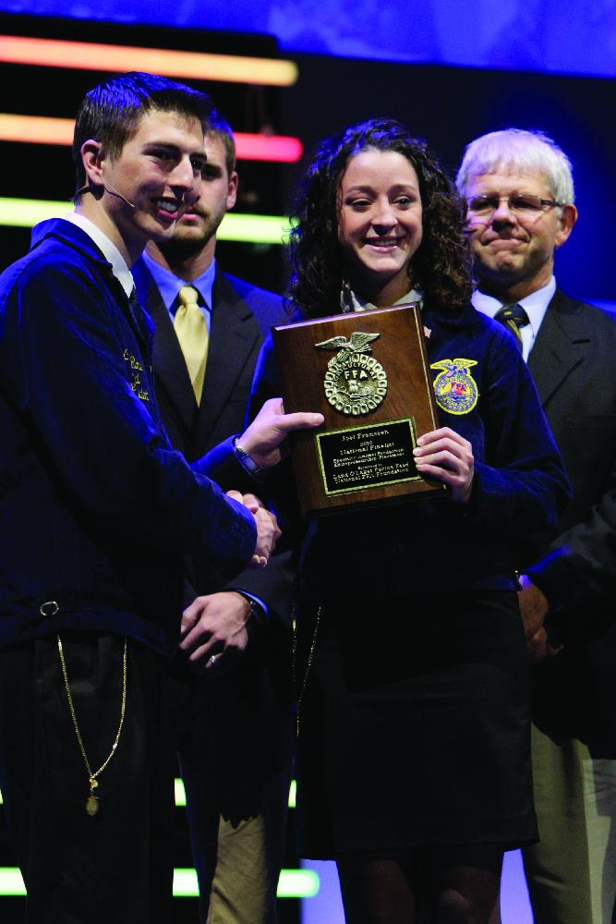
Star Awards at the Chapter Level
Star Discovery
Star Greenhand
Chapter Star Farmer

Slide 7
Star Awards at the State Level
State Star Farmer
State Star in Agribusiness
State Star in Agricultural Placement
State Star in Agriscience

Slide 8
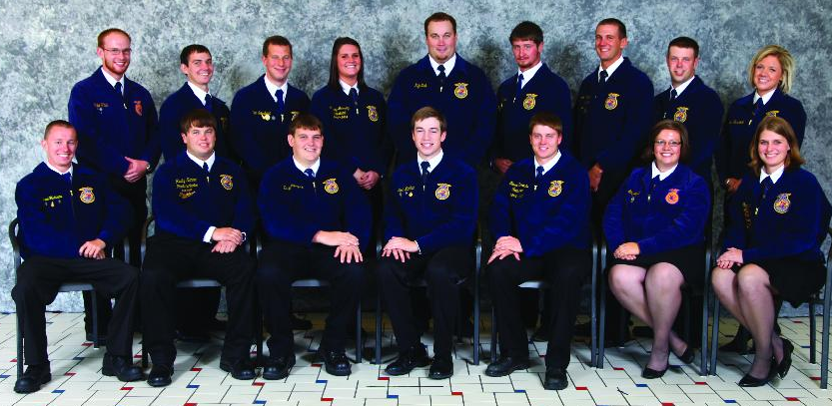
Star Awards at the National Level
American Star Farmer
American Star in Agribusiness
American Star in Agricultural Placement
American Star in Agriscience

Slide 9
National Chapter Award Categories
State Superior Chapter Award − Earned by chapters that complete and document at least one activity related to each of the 15 quality standards.
State Gold, Silver and Bronze Awards − Earned by chapters that supply additional information about three activities in each division. State judges score these activities to determine the exact award level.
National Gold Level Award – Chapters that receive the State Gold Award advance for national judging.

Slide 10
National Chapter Award Categories (cont.)
Model of Innovation Awards – Presented to the 10 top-scoring Three-Star Gold finalists in each division. The top-rated middle school chapter is also recognized.
Model of Excellence Awards – The top ten chapters for each division are selected through an interview and judging process. A national winner is chosen from these finalists. A middle school chapter is also chosen.

Slide 11
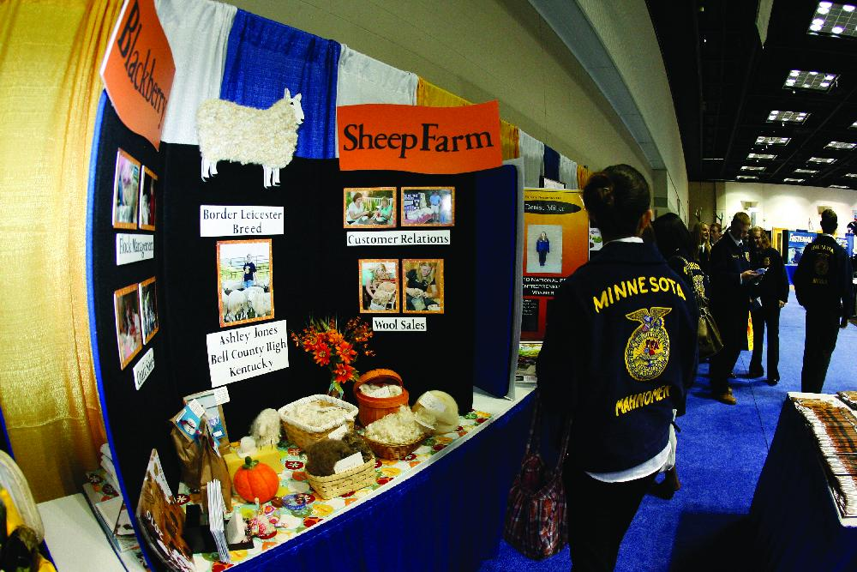
Agriscience Fair
Six Categories of Agriscience
Animal Systems
Environmental Services/National Resource Systems
Food Products and Processing Systems
Plant Systems
Power, Structure and Technical Systems
Social Systems
Agriscience Student Recognition Program
Based on the experiences gained through their research, FFA members who decide to pursue a career in agricultural sciences can receive significant college scholarships through this program.

Slide 12
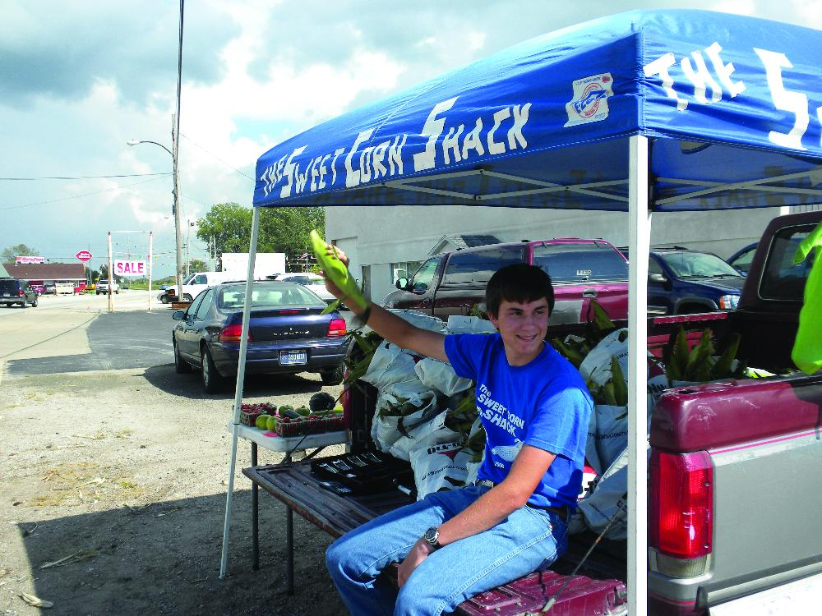
Agri-Entrepreneurship Awards
If the idea of starting your own business and being your own boss appeal to you?
The Agri-Entrepreneurship Awards program can help you get a jump-start on creating the business of your future – and you could win $1,000 in the process.
Check it out on ffa.org

