Slide 1

Understanding Healthy Eating Habits
What foundational skills do I need for leadership?
MS 16
Stage One of Development ME

Slide 2
Healthy Eating
Watch what you eat, avoid fats and salt, and do not overdo sweets.
  Eat 2 to 3 servings of meat, poultry, and fish per day.
    Include fat-free and low-fat milk products, fish, legumes (beans), skinless poultry, and lean meats.
    Trim away all the fat you see, and remove the skin from poultry.
    Avoid frying meat.
Objective 1
MS 16 TM A1

Slide 3
Healthy Eating
Watch what you eat, avoid fats and salt, and do not overdo sweets.
  Eat a variety of 2 to 4 servings of fruits and 3 to 5 servings of vegetables per day.
Objective 1
MS 16 TM A2

Slide 4
Healthy Eating
Watch what you eat, avoid fats and salt, and do not overdo sweets.
  Eat a variety of grain products, including whole grains, for 6 to 11 servings per day.
Objective 1
MS 16 TM A3

Slide 5
Healthy Eating
Watch what you eat, avoid fats and salt, and do not overdo sweets.
  Choose fats and oils with 2 grams or less saturated fat per tablespoon, such as liquid and tub margarines, canola oil, and olive oil.
Objective 1
MS 16 TM A4

Slide 6
Healthy Eating
Watch what you eat, avoid fats and salt, and do not overdo sweets.
  Eat 2 to 3 servings of milk, cheese, or yogurt per day.
Objective 1
MS 16 TM A5

Slide 7
Healthy Living
Balance the number of calories you eat with the number you use each day.
Maintain a level of physical activity that keeps you fit and matches the number of calories you eat.
Limit your intake of foods high in calories or low in nutrition, including soft drinks and candy.
Objective 1
MS 16 TM B

Slide 8
Healthy Living
I. Limit foods high in saturated fat, trans fat, and cholesterol, such as full-fat milk products, fatty meats, tropical oils, partially hydrogenated vegetable oils, and egg yolks.
j. Eat less than 6 grams of salt per day
Objective 1
MS 16 TM B

Slide 9
The Number of
Calories You Need Each Day
To find the number of calories, multiply the number of pounds you weigh now by 15 calories.
2. This represents the average number of calories used in one day if you are moderately active.
Objective 1
MS 16 TM C

Slide 10
The Number of
Calories You Need Each Day
3. If you get very little exercise, multiply your weight by 13 instead of 15.
4. Less active people burn fewer calories.
Objective 1
MS 16 TM C

Slide 11
Maintaining a Healthy Weight
Maintaining a healthful weight throughout life is a key to personal success.
  Most women can lose an average of one to two pounds a week by consuming 1,200-1,500 calories a day.
Objective 2
MS 16 TM D1

Slide 12
Maintaining a Healthy Weight
Maintaining a healthful weight throughout life is a key to personal success.
  Most men can lose an average of one to two pounds per week by consuming 1,500-1,800 calories a day. A weight loss of no more than one to two pounds a week is the ideal.
Objective 2
MS 16 TM D2

Slide 13
Maintaining a Healthy Weight
  Losing weight requires a combination of reducing calories and increasing physical activity.
    To lose one pound, a person needs to burn 3,500 calories more than is taken in, or run a calorie deficit.
    Reducing caloric intake by 500 calories per day—seven days times 500 calories equals 3,500 calories equals one pound.
Objective 2
MS 16 TM D3

Slide 14
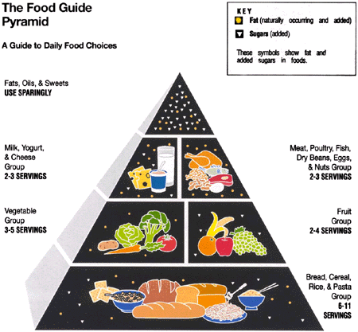
Objective 1
MS 16 TM E

