Slide 1
Student Handbook
Section 2: Premier Leadership

Slide 2
Part 1:
The Basics

Slide 3
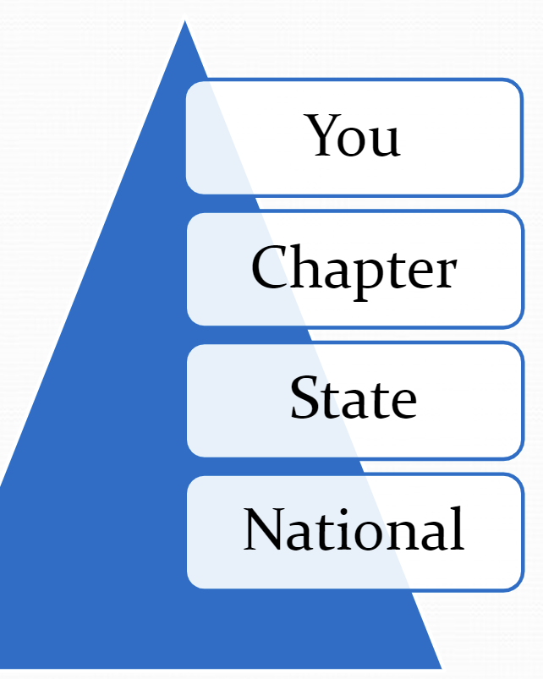
Our Structure
Similar to the U.S. government, the National FFA Organization has three significant levels to its structure — local, state and national. All three levels work together to provide FFA members with opportunities to experience premier leadership, personal growth and career success.

Slide 4

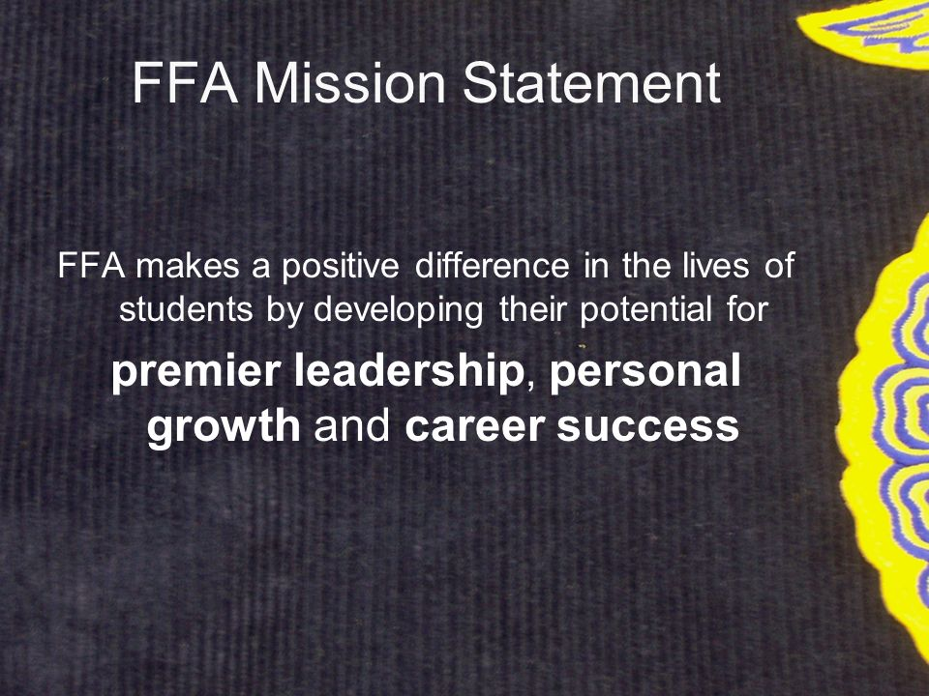
The Basics
FFA Salute: the Pledge of Allegiance
FFA Colors: national blue for the blue field of our nation’s flag and corn gold for the golden fields of ripened corn
FFA Motto: Learning to Do, Doing to Learn, Earning to Live, Living to Serve

Slide 5



The Emblem
Words signify the combination of learning and leadership necessary for progressive agriculture
Cross section of an ear of corn represents “unity”
Rising sun signifies “progress”

Slide 6



The Emblem
Eagle symbolizes “freedom”
Owl represents “knowledge”
Plow signifies “labor and tillage of the soil”

Slide 7
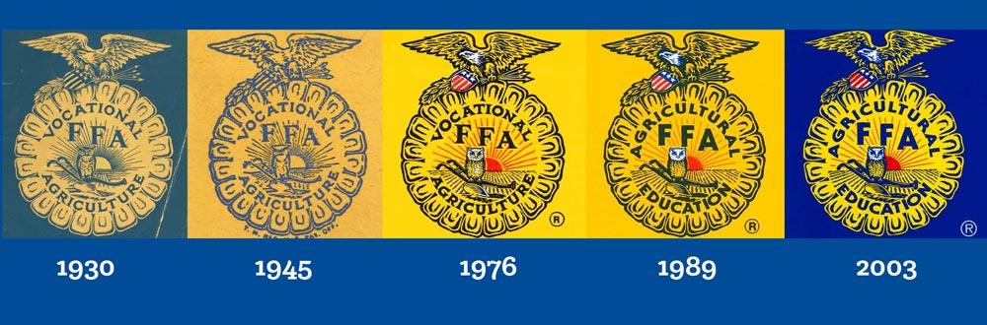

The Emblem

Slide 8
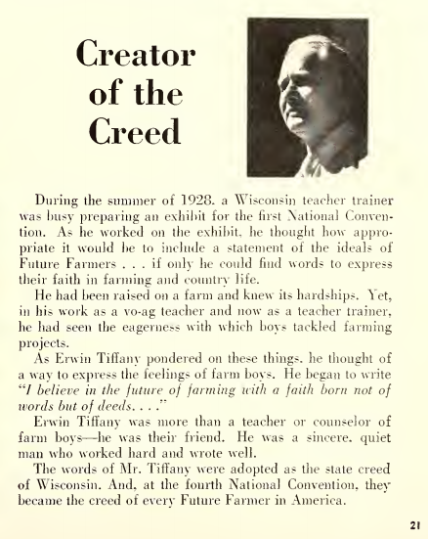
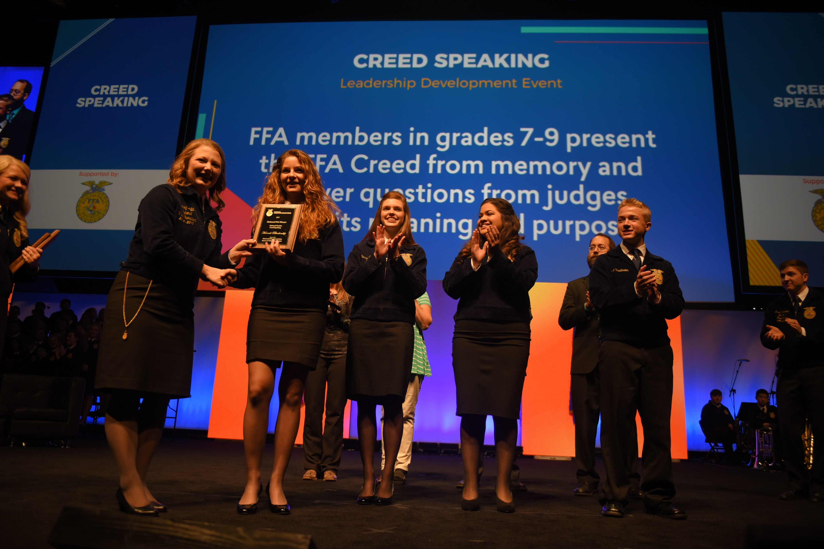
FFA Creed
Fun Facts
5 paragraphs
6 sentences
6 “I believes”
Written by E.M. Tiffany
Adopted: At the 3rd national convention
Revised: 38th and 63rd national conventions

Slide 9
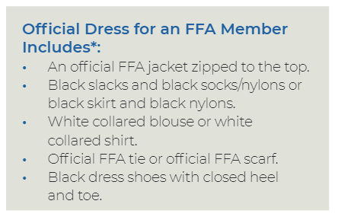
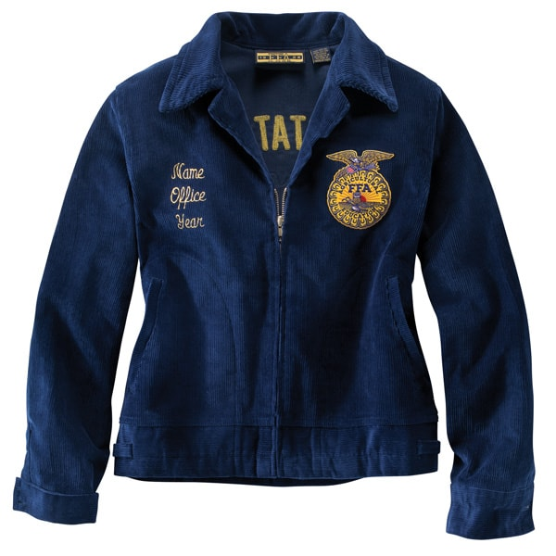
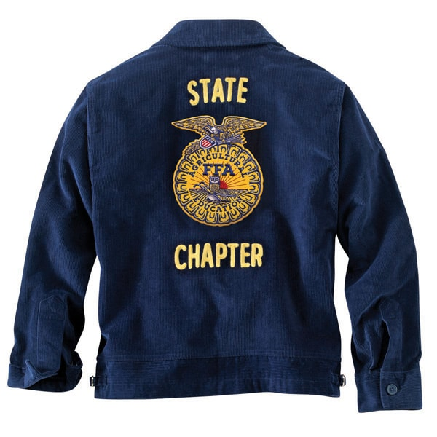
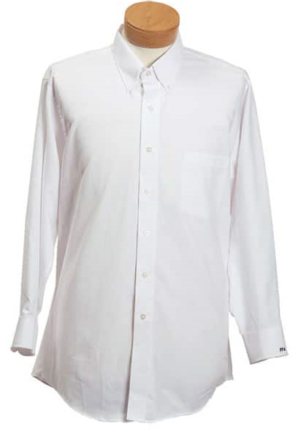
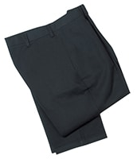
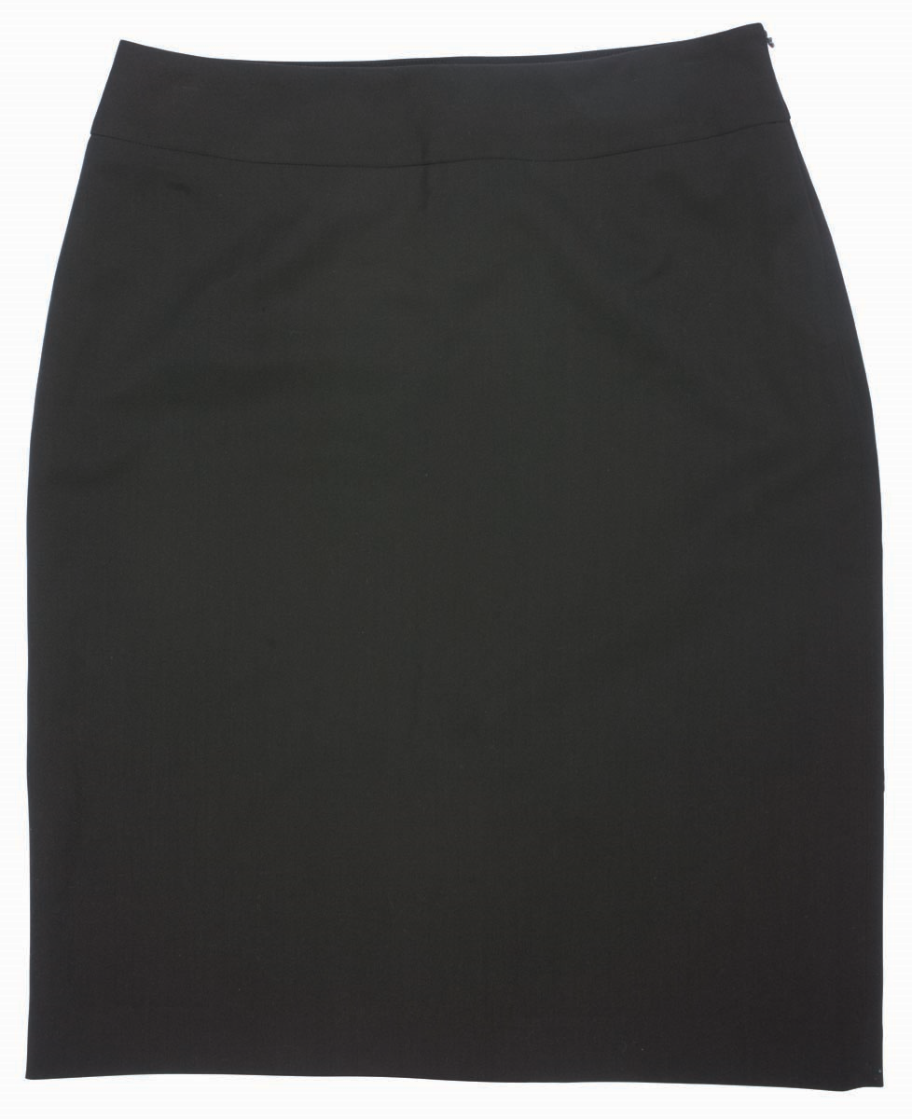
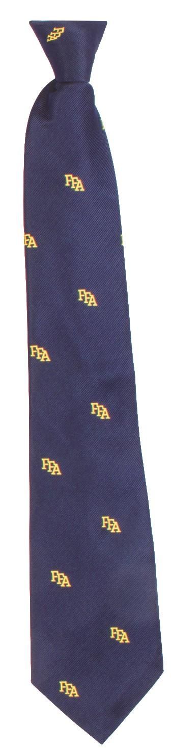
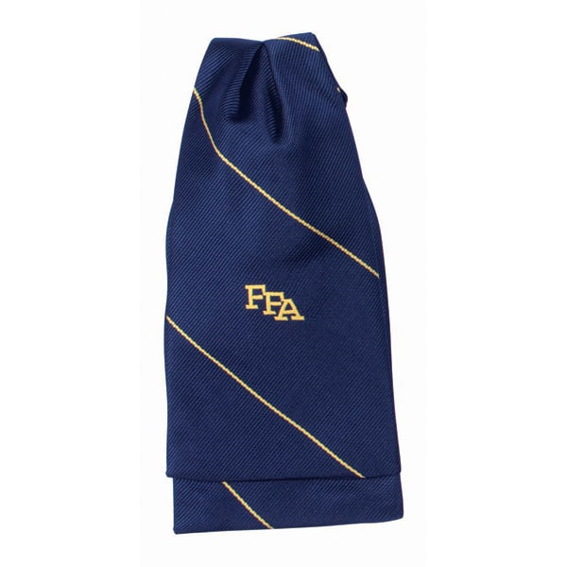
FFA Official Dress

Slide 10

FFA Official Dress
Give the Gift of Blue Program
The FFA corduroy jacket is an article of honor and pride that unifies members in a long-standing tradition. The jacket reminds them they are part of something bigger. Less than 50% of FFA members do not have a jacket to call their own, but this program provides jackets for members that may not be able to afford one themselves.
Since 2014, more than 14,000 jackets have been gifted through this program.

Slide 11
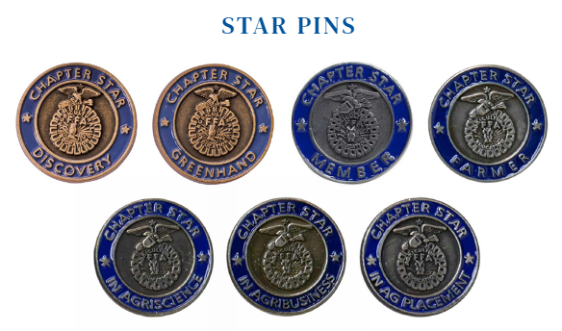
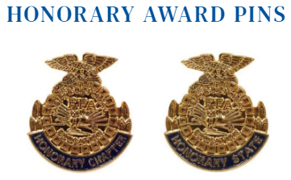
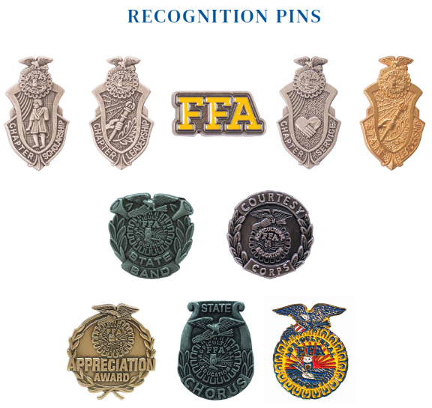
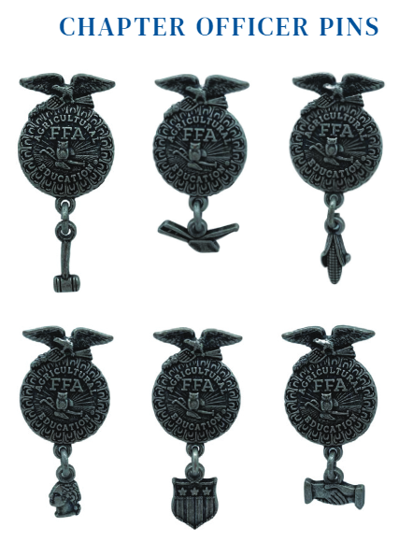
FFA Official Dress

Slide 12
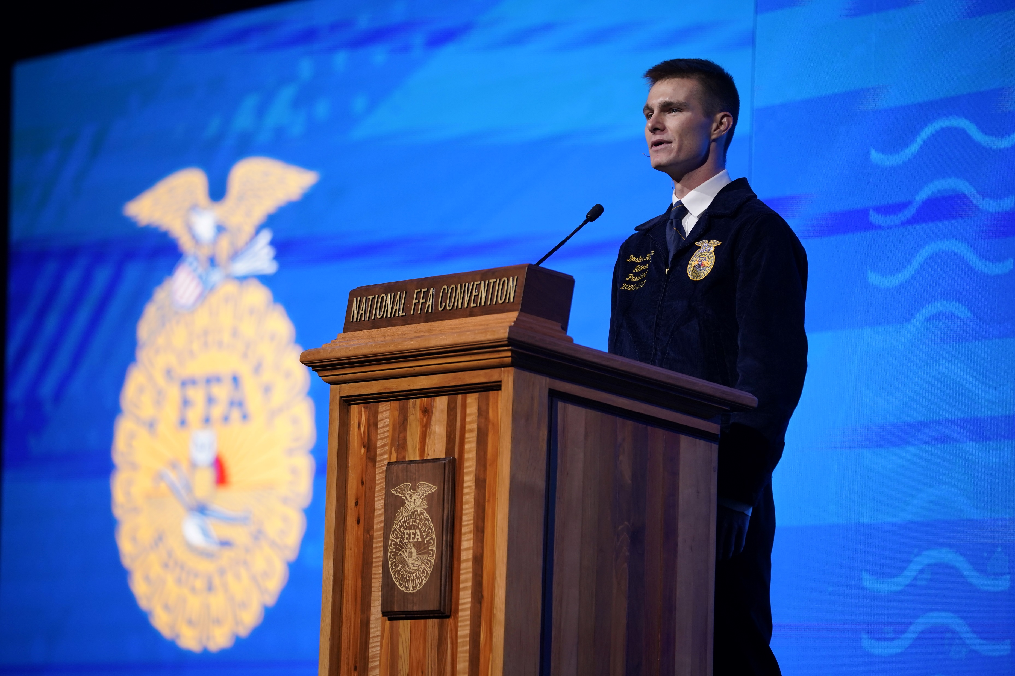
FFA Code of Ethics
1.
Develop my potential for premier leadership, personal growth and career success.
2.
Make a positive difference in the lives of others.
3.
Dress neatly and appropriately for the occasion.

Slide 13
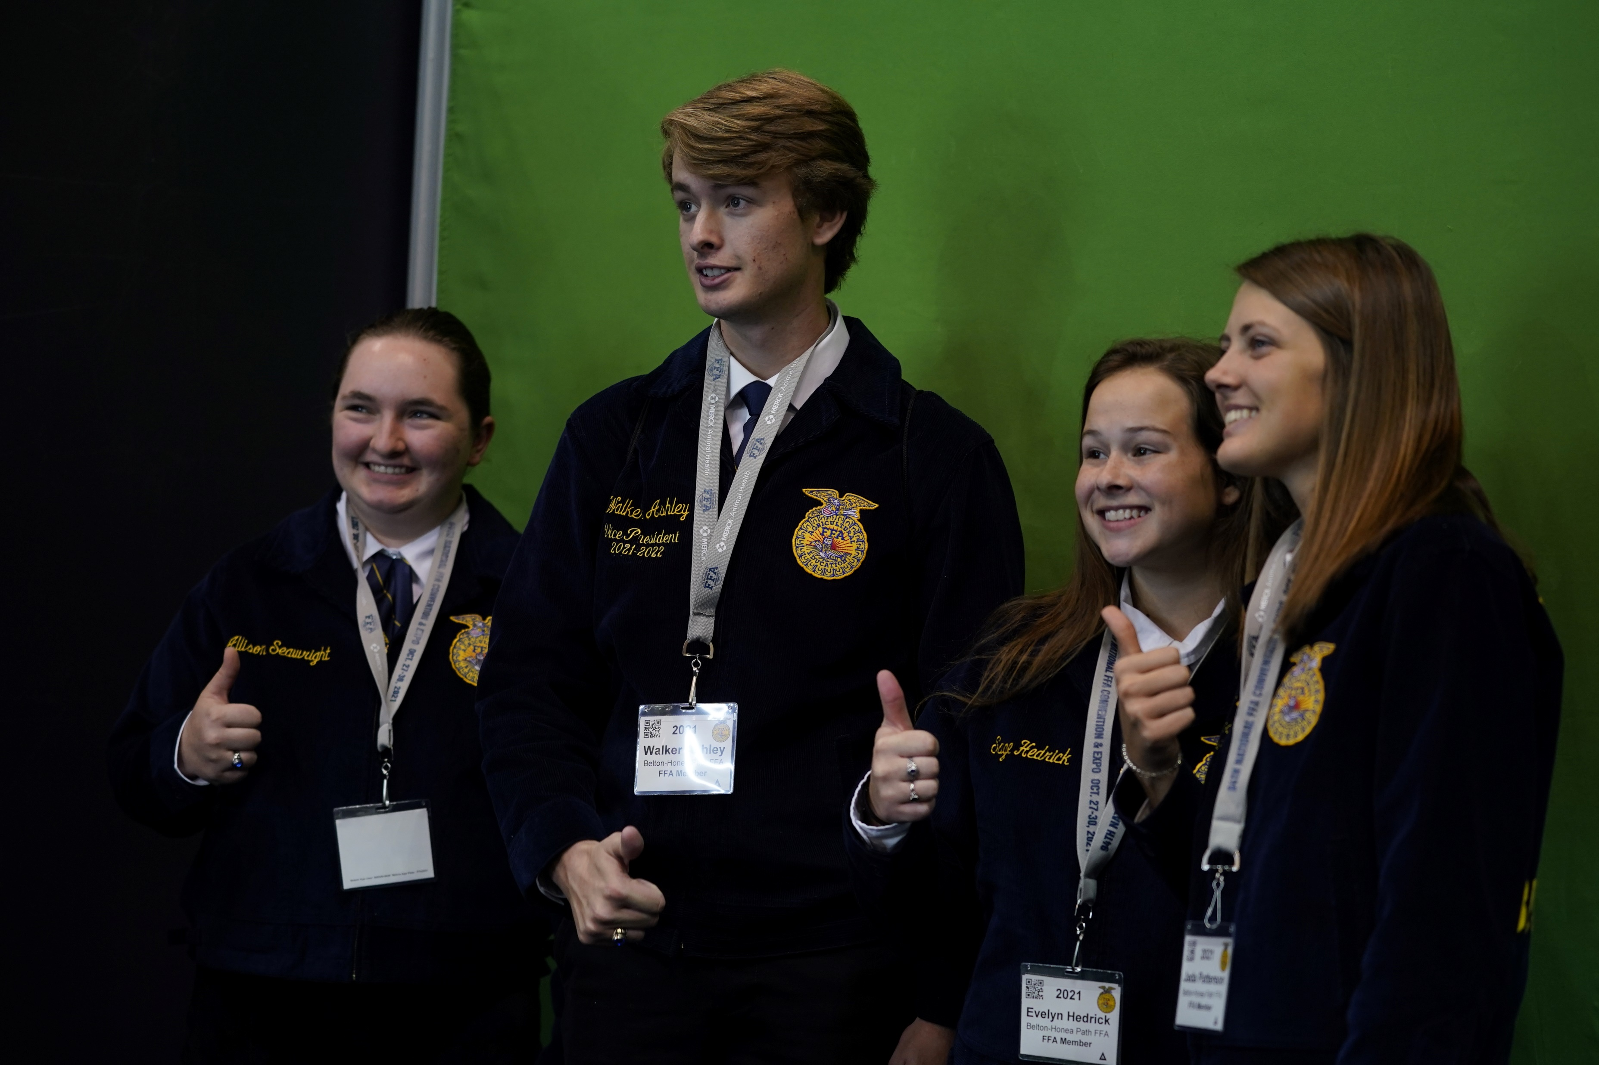
FFA Code of Ethics
4.
Respect the rights of others and their property.
5.
Be courteous, honest and fair with others.
6.
Communicate in an appropriate, purposeful and positive manner

Slide 14
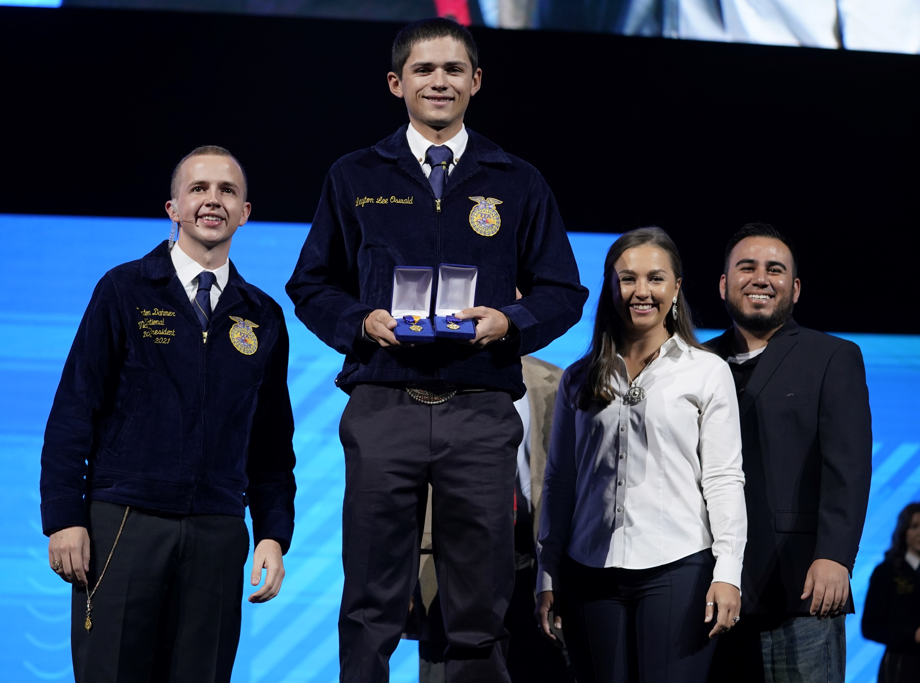
FFA Code of Ethics
7.
Demonstrate good sportsmanship by being modest in winning and generous in defeat.
8.
Make myself aware of FFA programs and activities and be an active participant.

Slide 15
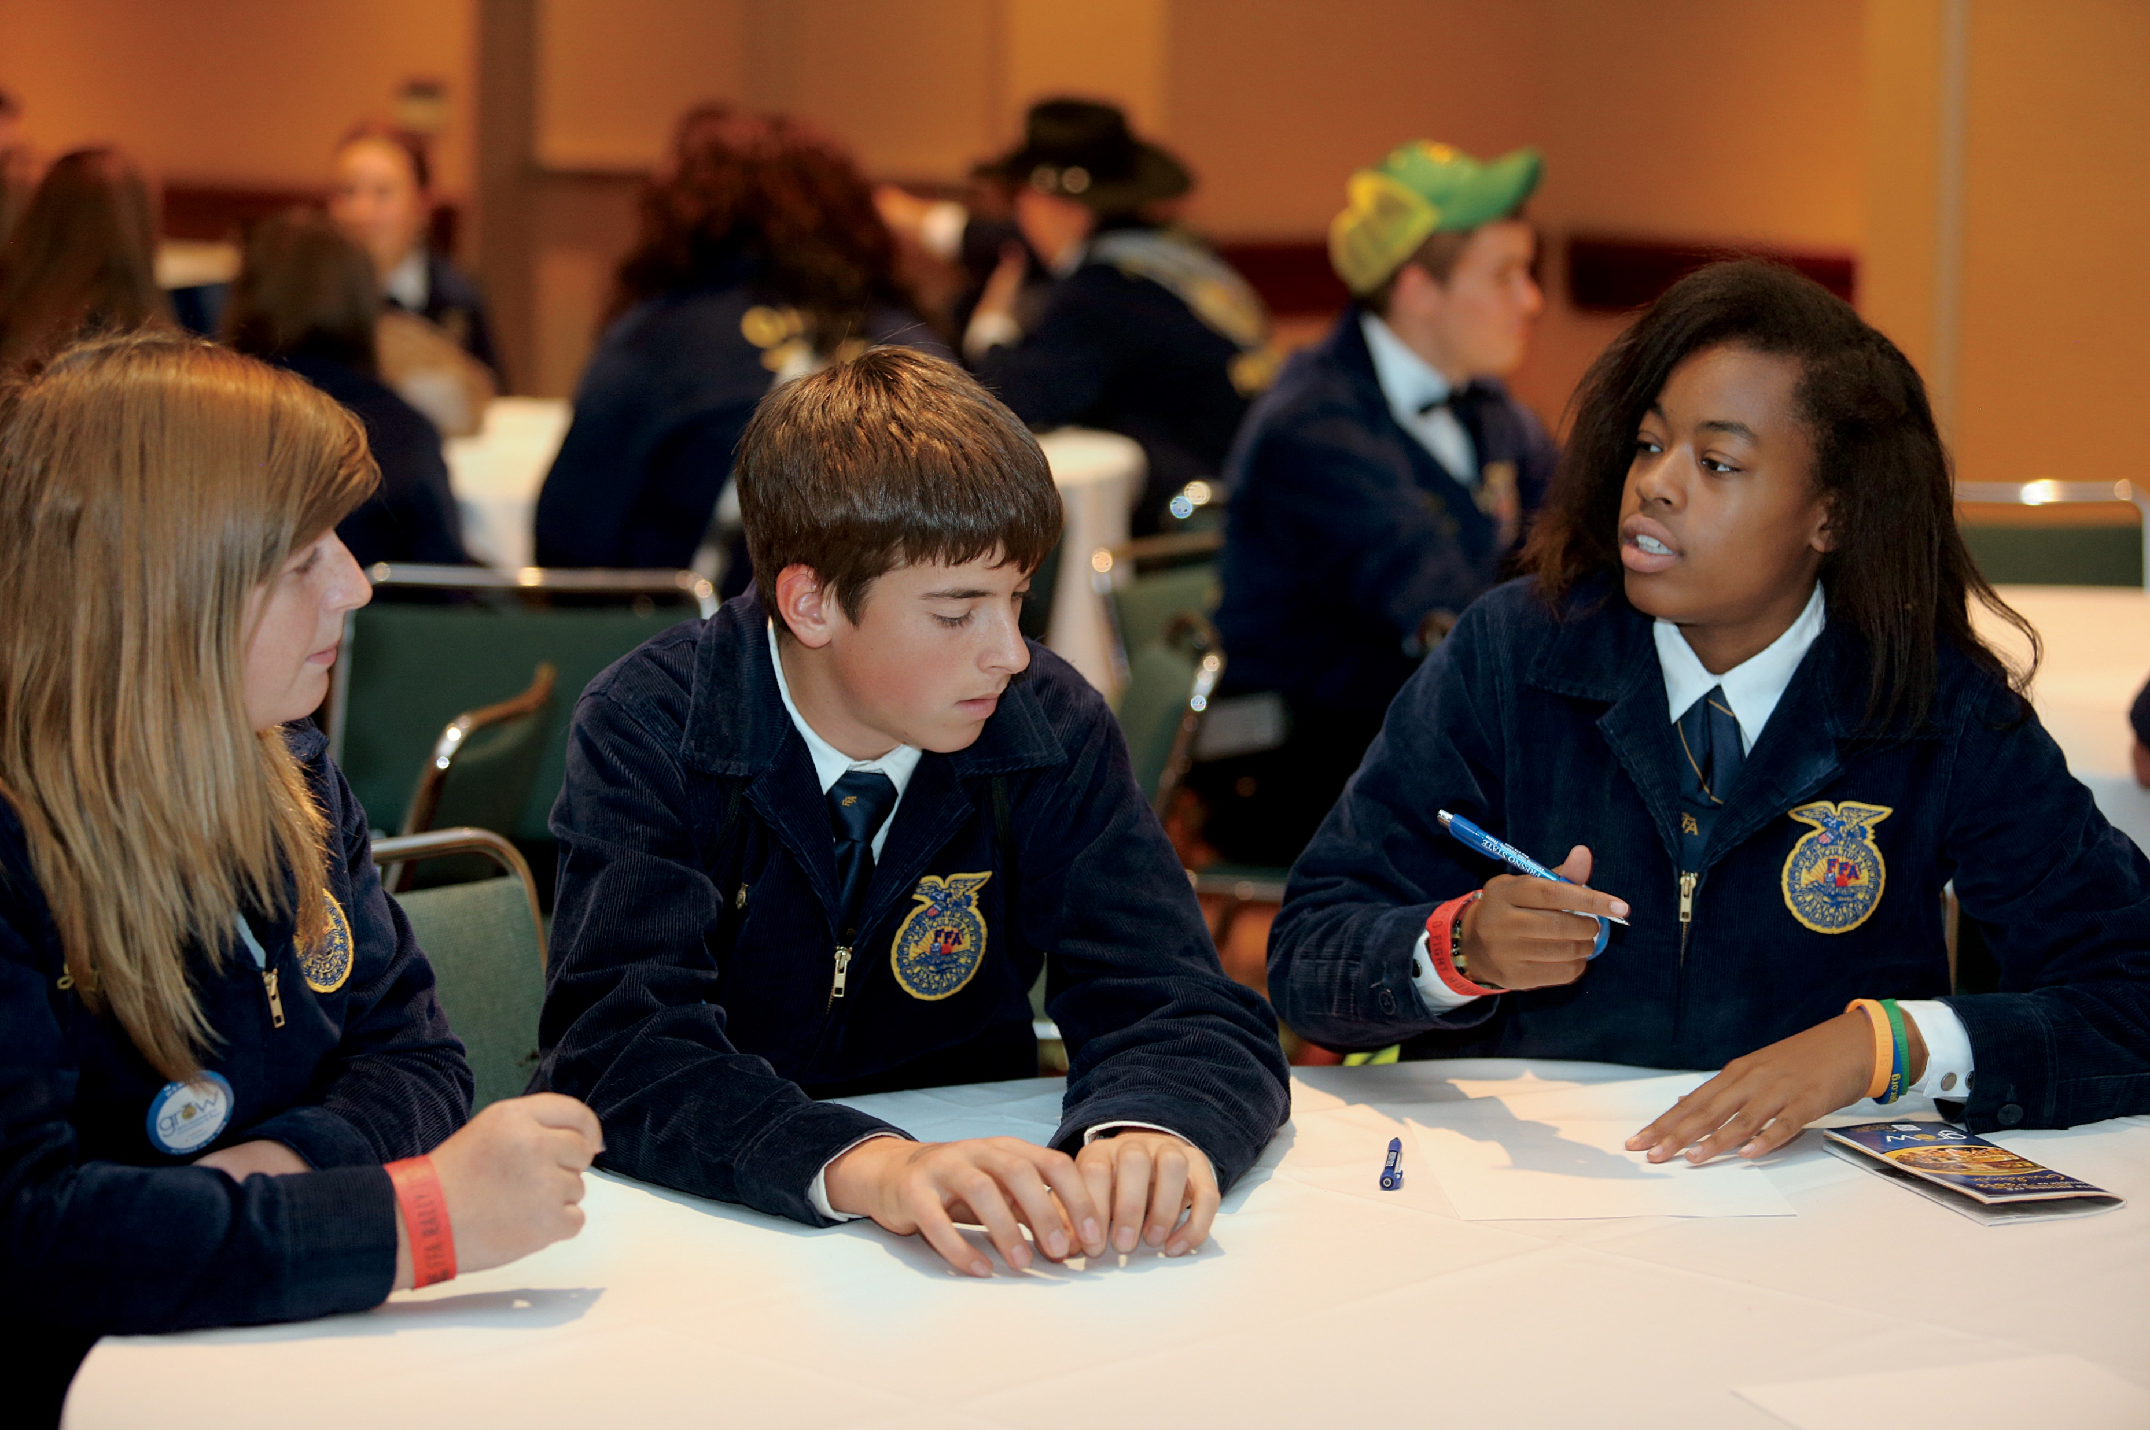
FFA Code of Ethics
9.
Conduct and value a supervised agricultural experience program.
10.
Strive to establish and enhance my skills through agricultural education in order to enter a successful career.
11.
Appreciate and promote diversity in our organization.

Slide 16
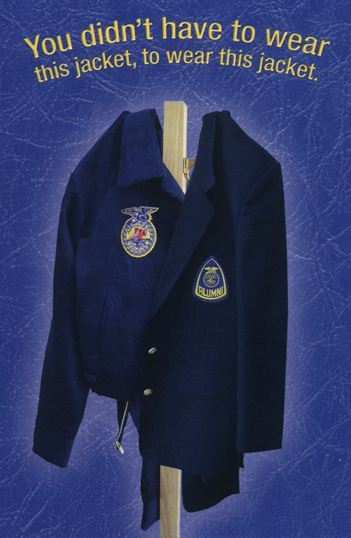
Types of Membership
Active: FFA members are enrolled in an agriculture course and have paid their membership dues.
Adult: Is open to former student members and other FFA supporters

Slide 17
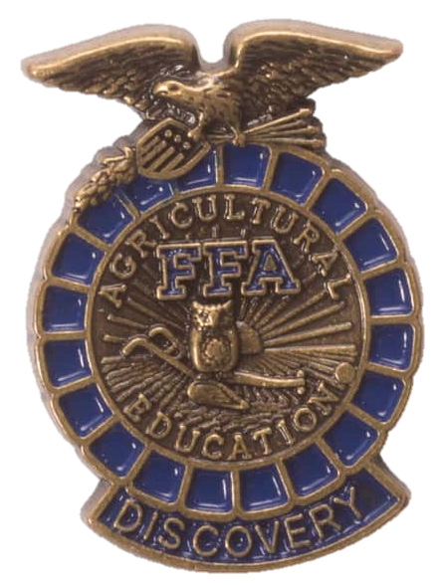
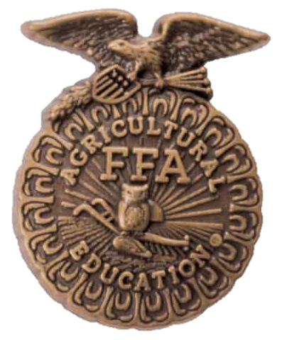
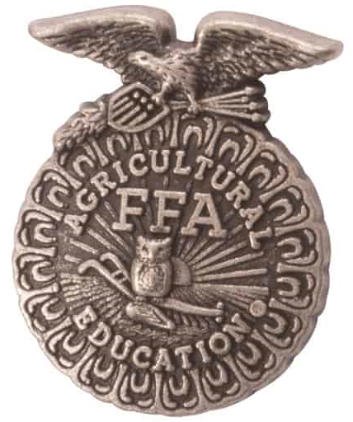
FFA Degrees
Chapter
Received the Greenhand Degree
Completed 180 hours of ag education at or above the 9th Grade
Greenhand
1st-year high school member
Active member
Discovery
7th and 8th graders
Active member

Slide 18
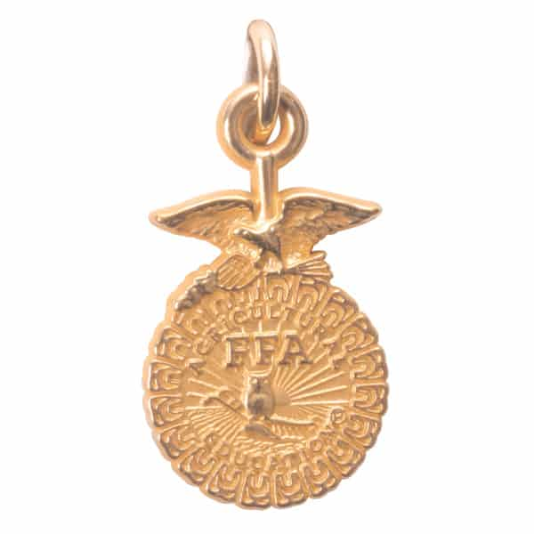
FFA Degrees
State
Earned the Chapter Degree
Active FFA member for at least two years and completed at lest 360 hours of ag education at or above the 9th grade
SAE requirements

Slide 19

FFA Degrees
American
Earned the State Degree
Active FFA member for at least three years
Participated in chapter and state activities
At least three years of ag education
Graduated high school
SAE requirements
Completed at least 50 hours community service

Slide 20
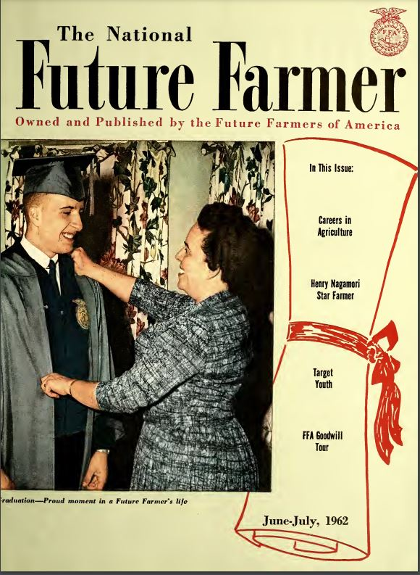
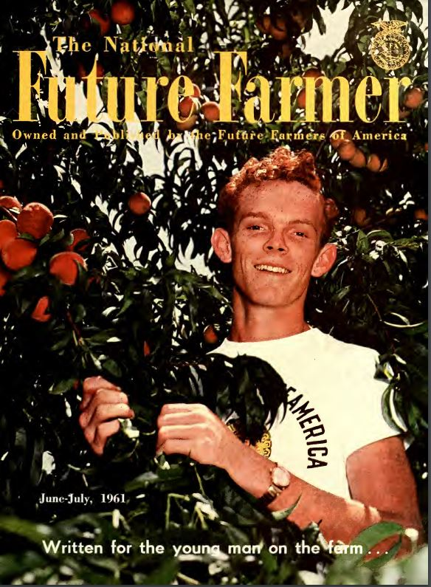

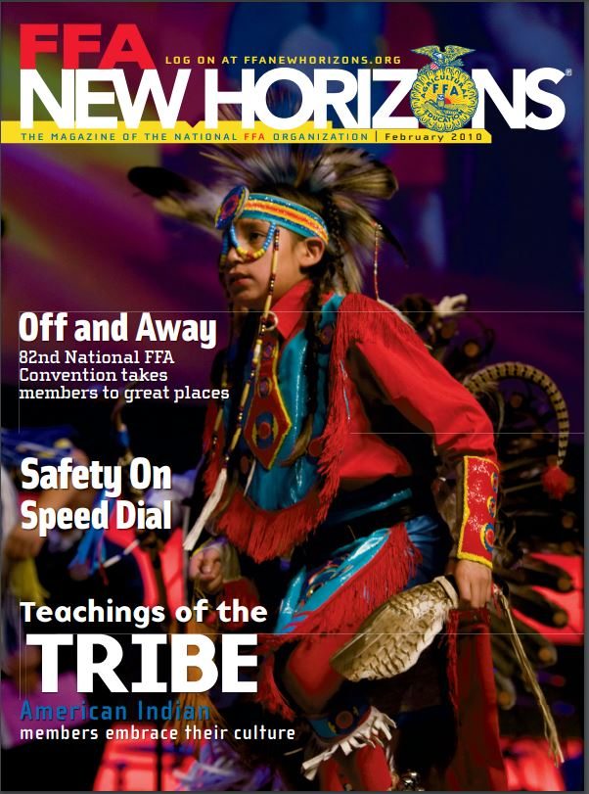
FFA New Horizons
The official National FFA magazine
Launched October 1952
Called The National Future Farmer
First subscription price was $.25 per year or $1.00 for five years
Mailed four times a year
In 1956, it moved from quarterly to bimonthly publication.
When members pay dues, they automatically subscribe to FFA New Horizons,
Now published twice a year

Slide 21
Part 2:
Chapter

Slide 22
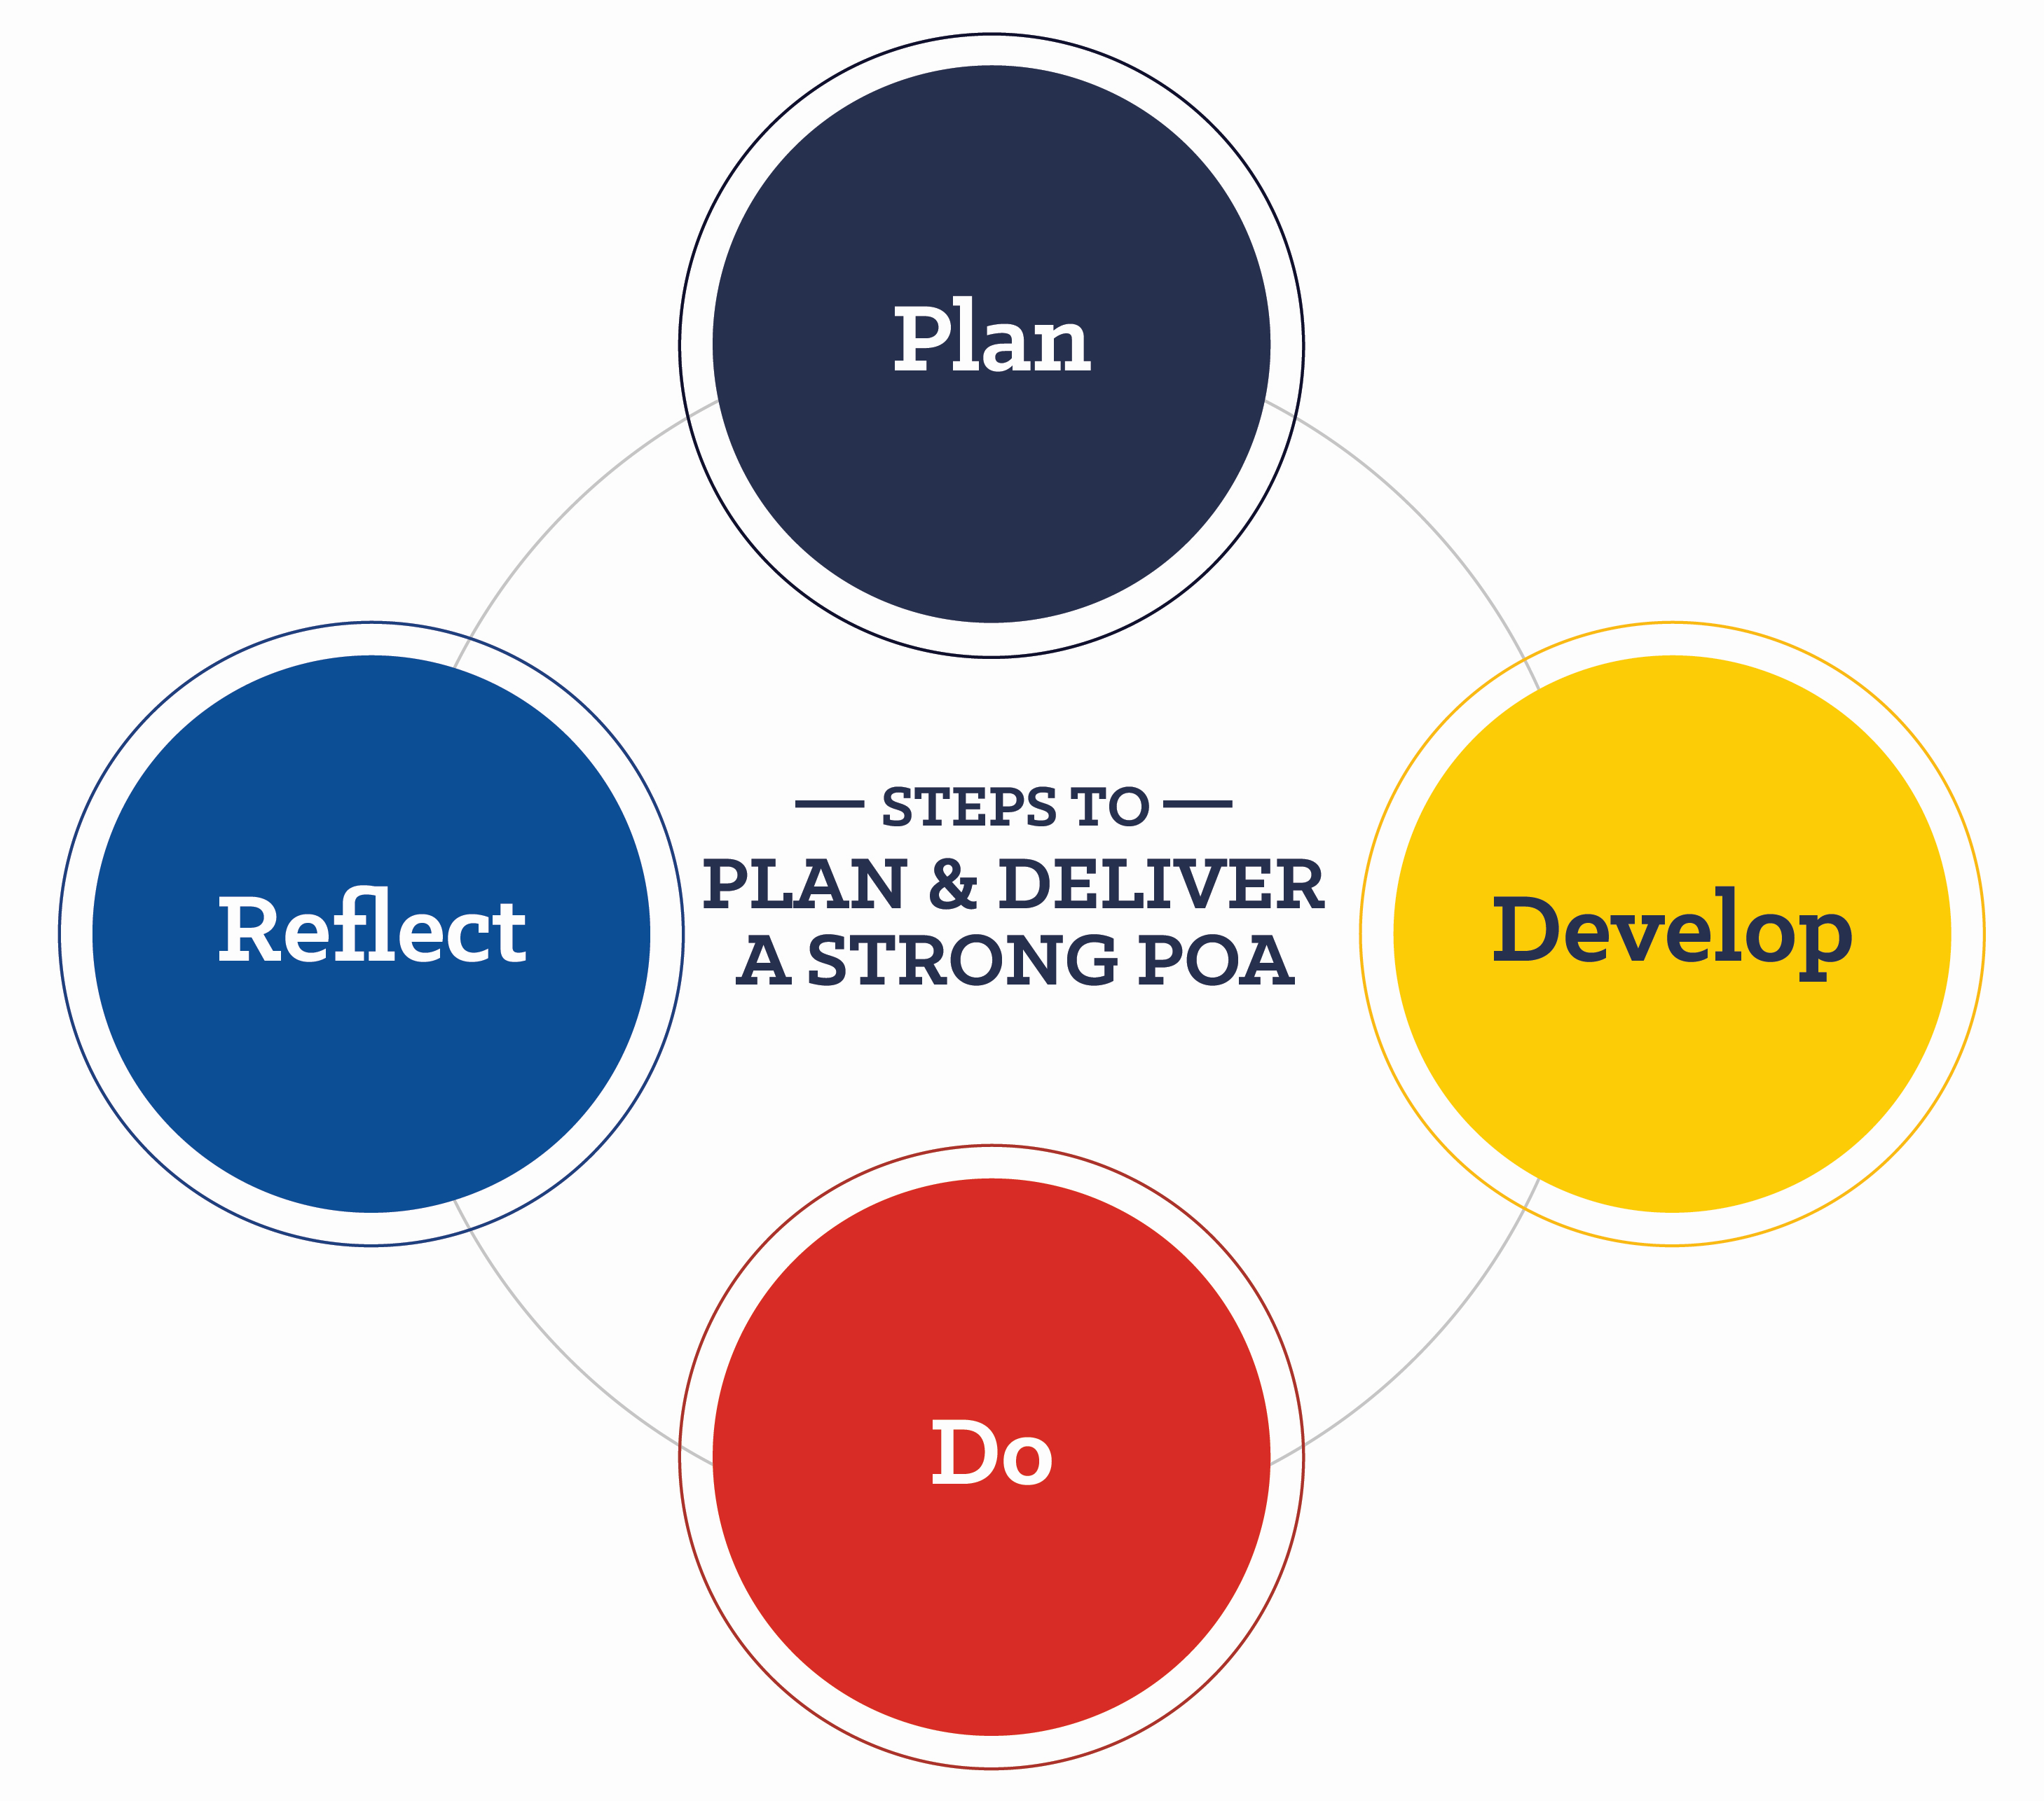
Program of Activities
Defines chapter goals, outlines steps needed to meet those goals and acts as a written guide to provide a calendar of events the chapter will follow in the year ahead
How is a POA organized?
Each chapter builds its POA around three divisions that focus on the types of activities a chapter conducts. The three divisions:
Growing Leaders
Building Communities
Strengthening Agriculture

Slide 23
Program of Activities
Leadership
Healthy Lifestyle
Scholarship
Personal Growth
Career Success
Growing
Leaders

Slide 24
Program of Activities
Environmental
Human Resources
Citizenship
Stakeholder Engagement
Economic Development
Building
Communities

Slide 25
Program of Activities
Support Group
Chapter Recruitment
Safety
Agricultural Advocacy
Agricultural Literacy
Strengthening
Agriculture

Slide 26
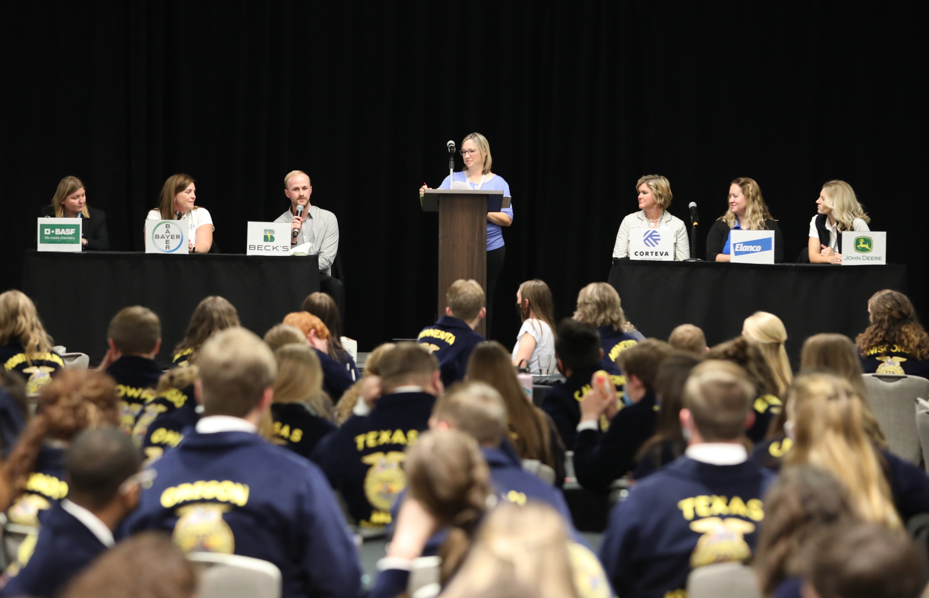
Chapter Activities
Service Learning and Community Service Projects
Fundraising
Partnerships
Partners and Stakeholders

Slide 27
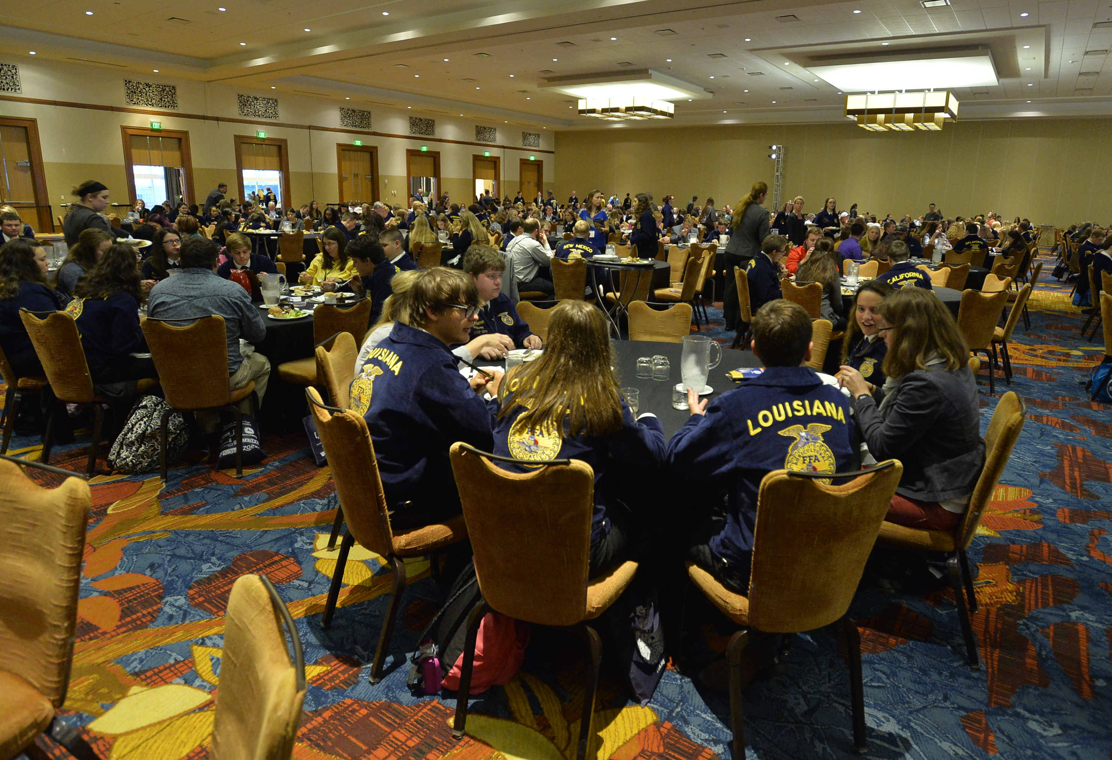
Chapter Activities
National FFA Week
National FFA Convention
State Convention
State Conferences
Chapter Banquet

Slide 28
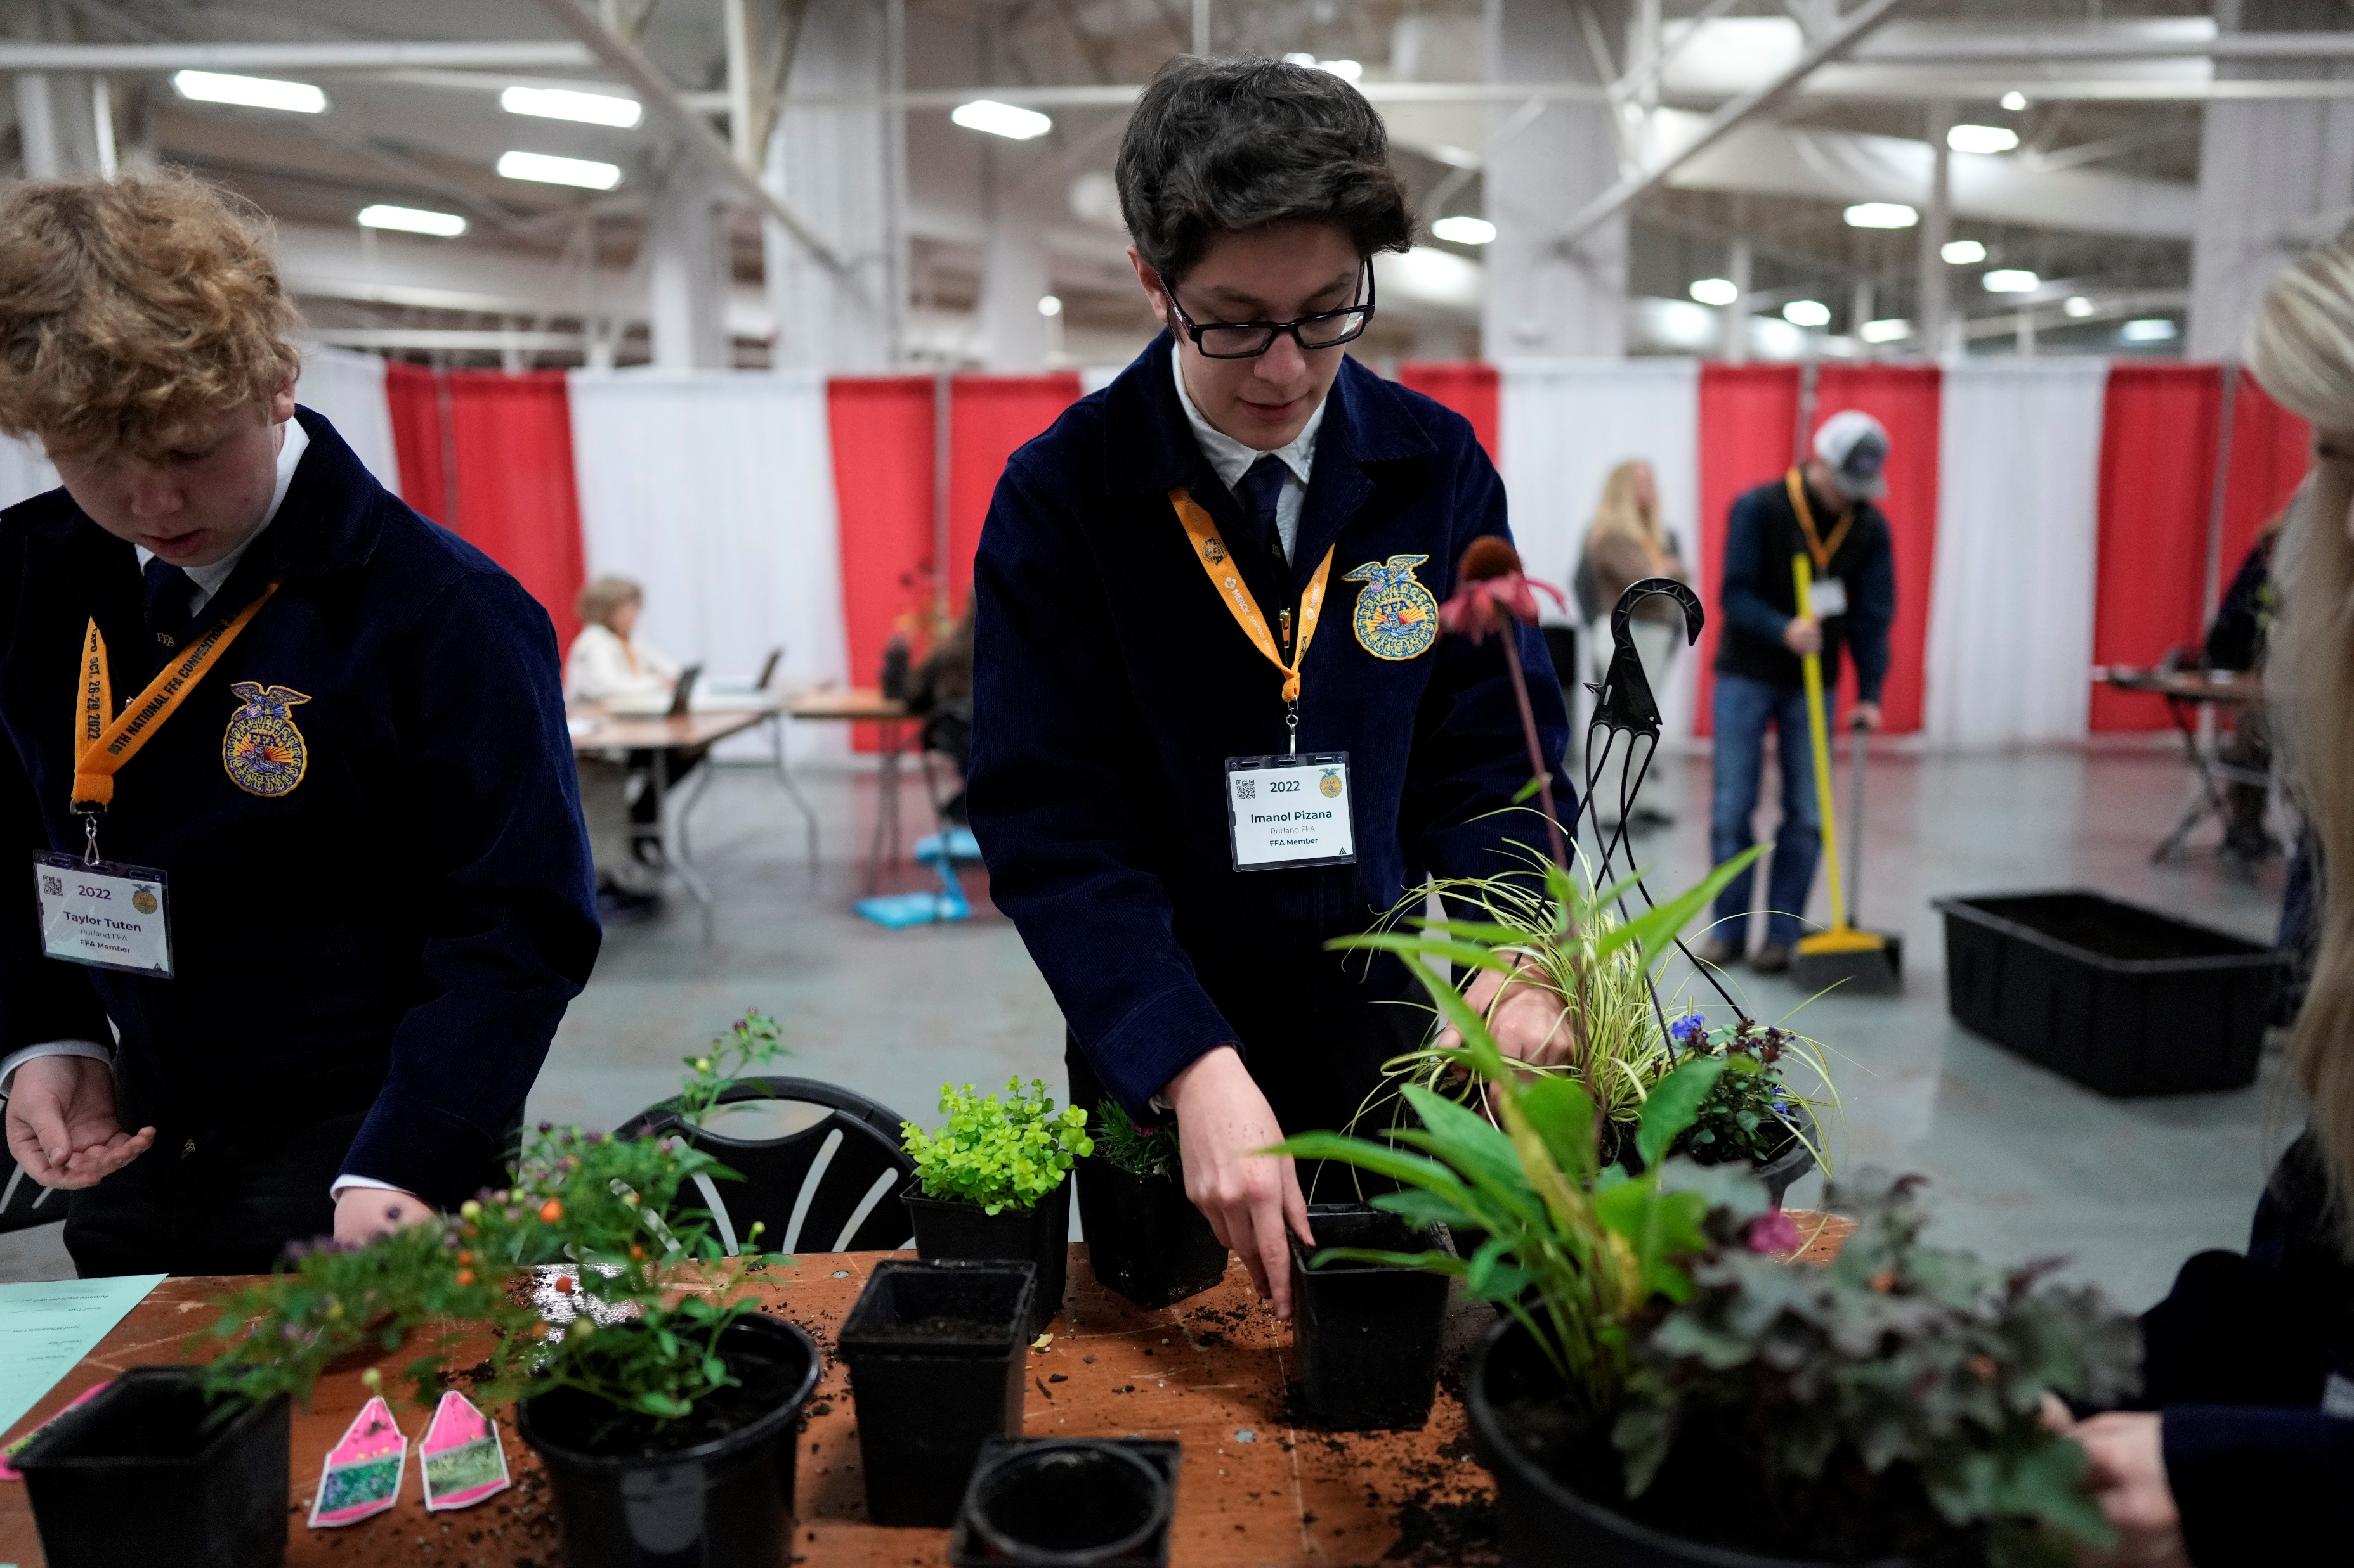
Competitive Events
CDE Teams
LDEs
SAEs and Proficiency Awards

Slide 29
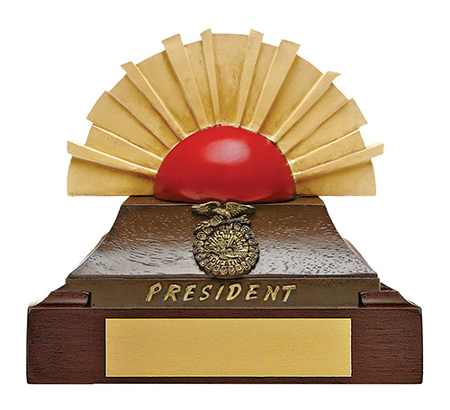
Chapter Officers
President
Presides over meetings
Appoints committees
Coordinates the activities of the chapter
Evaluates the progress of the POA
Represents the chapter in public relations and at official functions

Slide 30
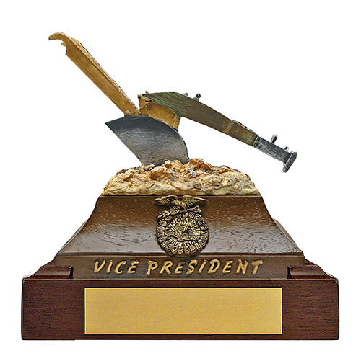
Chapter Officers
Vice President
Assumes all duties of the president if necessary
Develops the POA
Coordinates all committee work
Works closely with the president and FFA advisor to assess progress of the POA

Slide 31
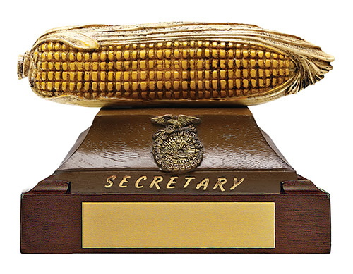
Chapter Officers
Secretary
Prepares and posts the agenda for chapter meetings
Prepares and presents the minutes of each chapter meeting
Places all committee reports in the secretary’s file
Responsible for chapter correspondence
Maintains member attendance and activity records

Slide 32
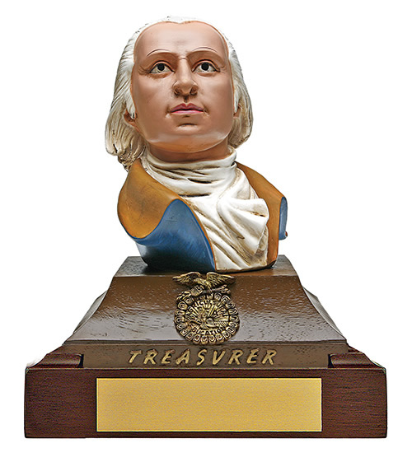
Chapter Officers
Treasurer
Receives, records and deposits FFA funds and issues receipts
Presents monthly treasurer reports
Collects dues
Maintains a neat and accurate treasury record
Prepares and submits membership roster and dues with secretary
Serves as finance committee chair

Slide 33
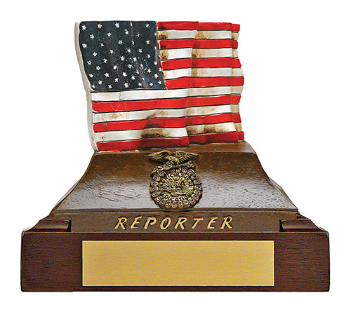
Chapter Officers
Reporter
Serves as public relations committee chair
Plans public information programs with local media to tell the FFA story
Releases news and information to local/regional news outlets
Publishes a chapter newsletter or website
Prepares and maintains chapter scrapbook
Serves as chapter photographer

Slide 34
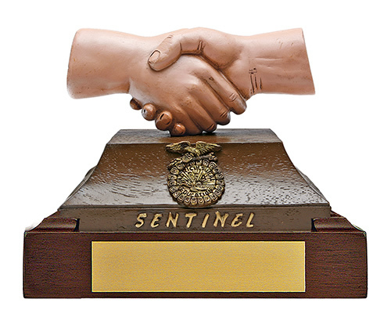
Chapter Officers
Sentinel
Assists the president in maintaining order
Keeps the meeting room, chapter equipment and supplies in proper condition
Welcomes guests and visitors
Keeps meeting room comfortable
Takes charge of candidates for degree ceremonies
Assists with special features and refreshments

Slide 35
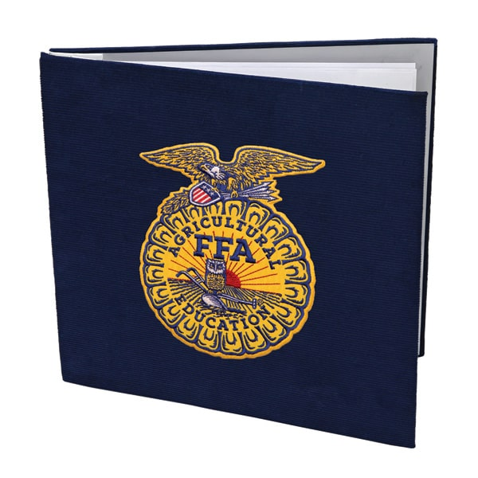
Additional Chapter Officers
Historian
Develops and maintains a scrapbook to record chapter history
Researches and prepares items of significance in the chapter’s history
Prepares displays of chapter activities
Assists the reporter with chapter photography and news releases

Slide 36
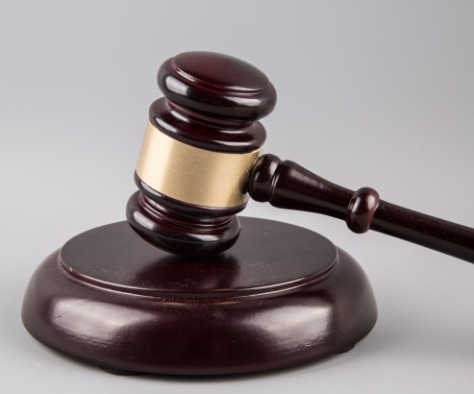
Additional Chapter Officers
Parliamentarian
Is proficient with parliamentary procedure
Rules on all questions of parliamentary conduct at chapter meetings
Serves as a participant on the parliamentary procedure team
Conducts parliamentary procedure workshops for the chapter

Slide 37

Additional Chapter Officers
Chaplain
Presents the reflections at banquets and other functions
Conducts reflections services at summer camps and conferences

Slide 38
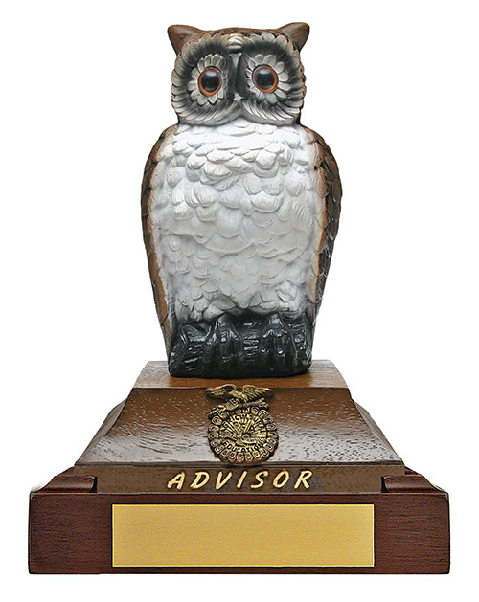
Adult Leaders
Advisor
Supervises chapter activities year-round
Informs prospective students and parents about FFA
Instructs students in leadership and personal development
Builds school and community support for the program
Encourages involvement of all chapter members in activities
Prepares students for involvement in career and leadership development events and leadership programs

Slide 39
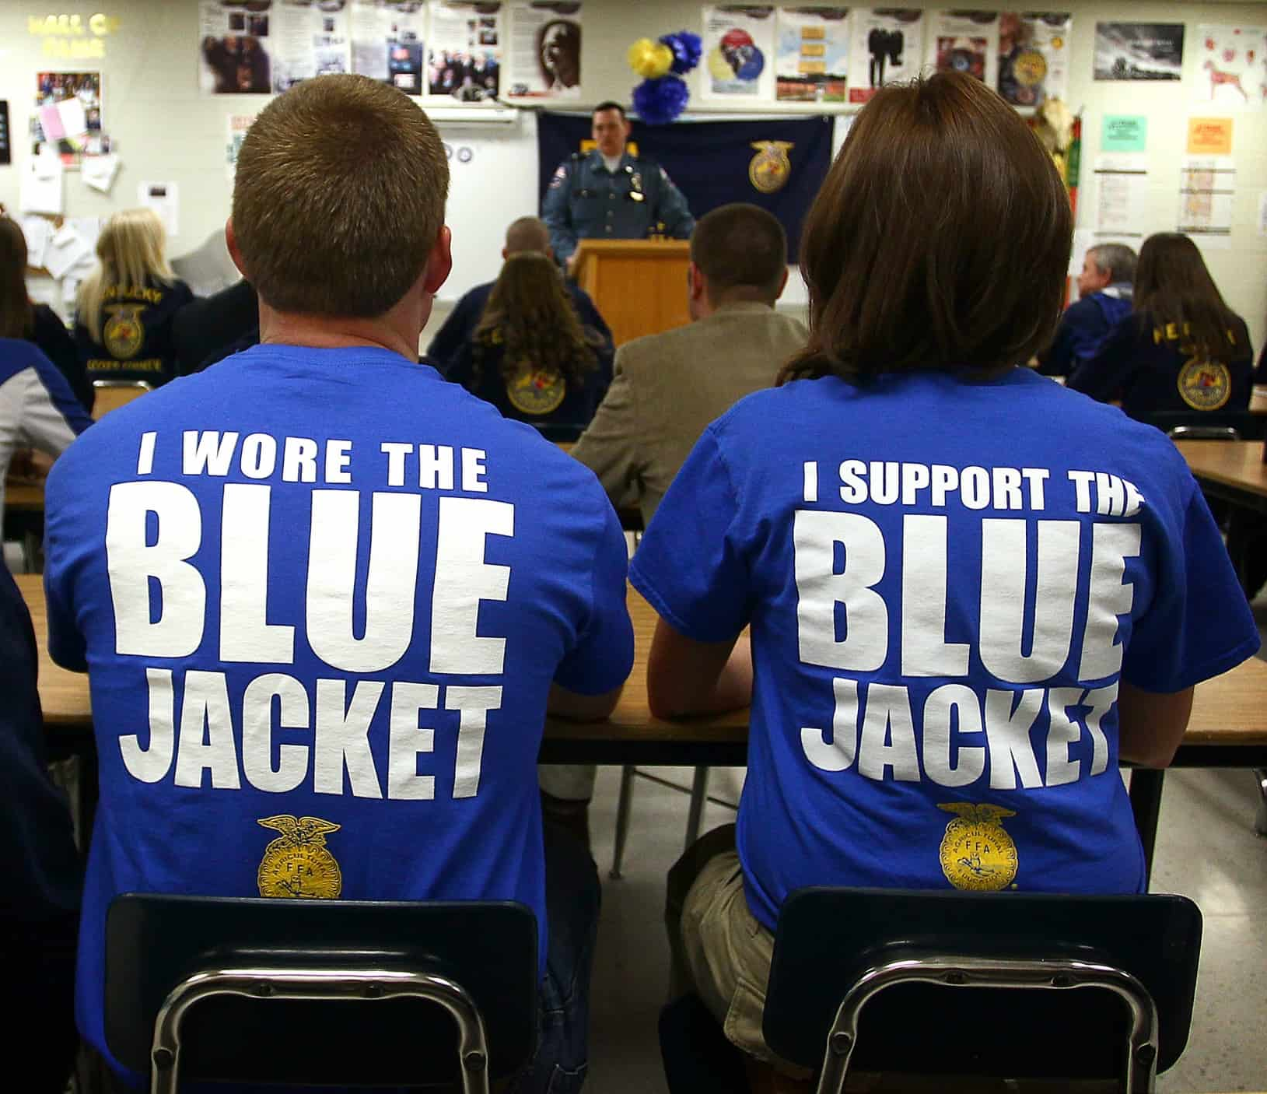
Adult Leaders
Alumni and Supporters
Support FFA events as judges and volunteers
Provides financial assistance through fundraisers
Give guidance to members as mentors and project advisors

Slide 40
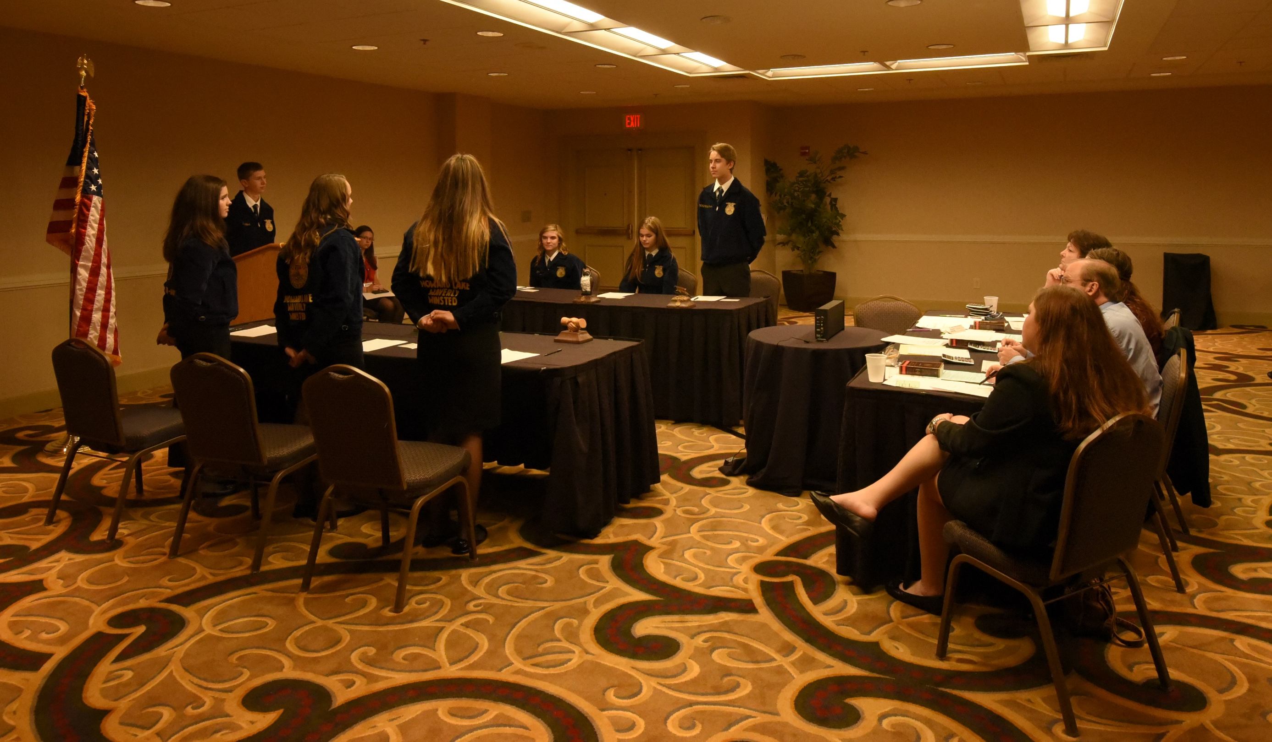
Chapter Meetings
Planning is critical for an effective chapter meeting.
Must have an order of business (agenda)
The purpose of an FFA chapter meeting is to conduct chapter business and make decisions.

Slide 41
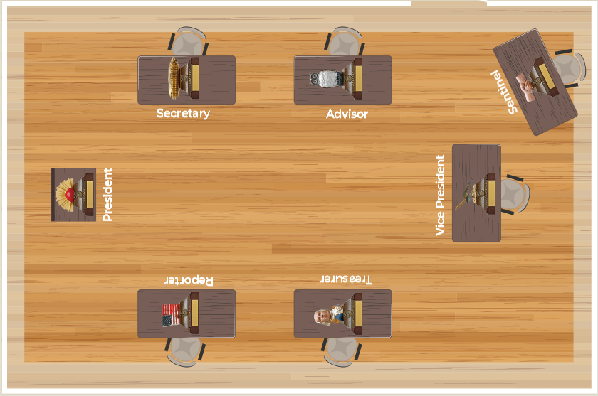
Chapter Meetings
A properly arranged meeting room adds dignity and order to the event.
Here is the correct room arrangement:

Slide 42
Chapter Meetings
Meeting Agenda
Call to Order
Reports
Old Business
New Business
Adjourn
The order of business is also known as the agenda.
This is a written list that helps to ensure all items that need to be discussed are addressed.

Slide 43
Chapter Meetings
Vice President
Assumes presidential duties if president leaves or steps down
Serves as nonvoting member for all committees
Roles of Officers for Meetings
President
AKA the chair
Presides but does not direct
Cannot discuss items
Cannot vote, except to break a tie
Secretary
Prepares agenda for each meeting
Keeps accurate record of the actions taken
Treasurer
Prepares financial report for each meeting
Reporter
Obtains publicity for the chapter
Submits related newspaper articles and updates the chapter website
Sentinel
Prepares the meeting room
Greets guests

Slide 44
Part 2A:
Chapter Toolbox

Slide 45
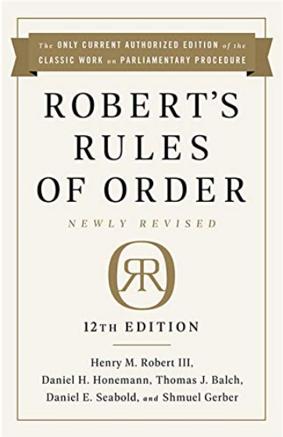
Parliamentary Procedure
A set of rules from the book Robert’s Rules of Order
Helps conduct all types of orderly business meetings, including FFA chapter meetings

Slide 46
Parliamentary Procedure
Four Main Objectives of Parliamentary Procedure
FOCUS ON ONE THING AT A TIME
EXTEND COURTESY TO EVERYONE
OBSERVE THE RULE OF THE MAJORITY
PROTECT THE RIGHTS OF THE MINORITY

Slide 47
Parliamentary Procedure
Use of the Gavel
A symbol of authority
One Tap:
  Follows the announcement of adjournment
  Follows the completion of a business item
  Tells members to be seated
Two Taps:
  Calls the meeting to order
Three Taps:
  A signal for all members to stand in unison
Series of Sharp Taps:
  Used to restore order at a meeting

Slide 48
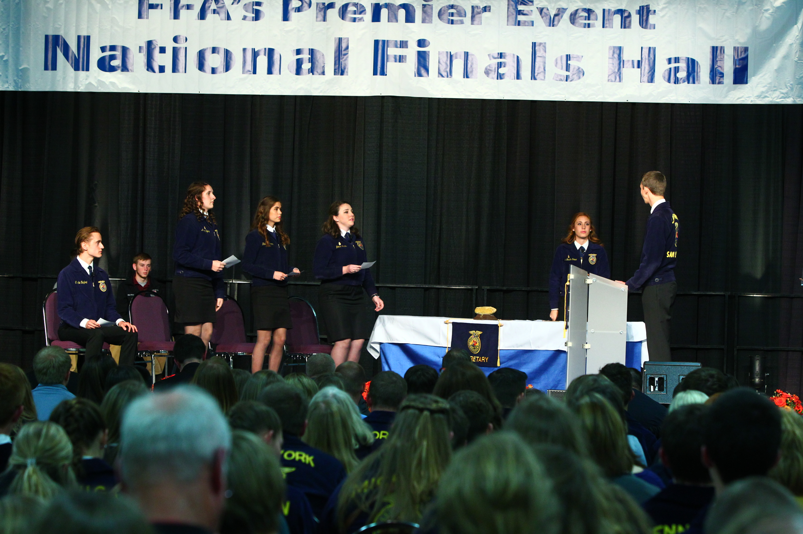
Parliamentary Procedure
Voting
Four common methods on voting:
  Voice vote: saying “aye” or “no”
  Rising vote: either by standing or by a show of hands
  Secret Ballot: a written vote
  Roll Call: each member speaking their vote when the secretary calls their name
Quorum: the number of members that must be present before official business can be transacted

Slide 49
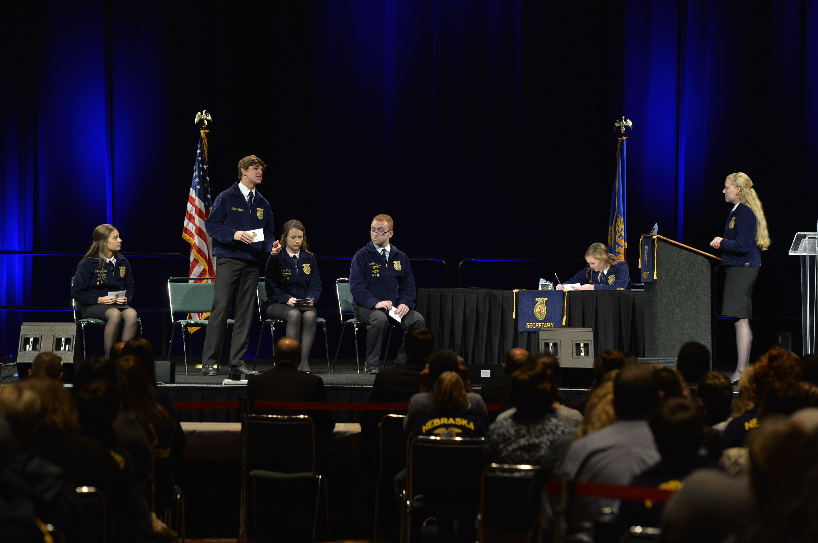
Parliamentary Procedure
Voting
Simple majority: most votes require this and is based on the number of people voting; more than half of the voters must be in favor
Ties: the president may cast the deciding vote
Two-thirds vote: required when a motion will limit the rights of a member or members; approximately 67% of voters must be in favor

Slide 50
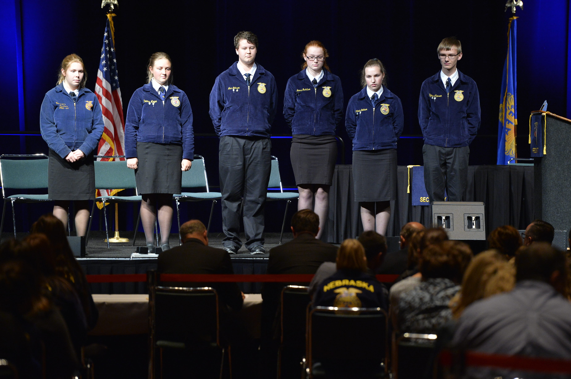
Parliamentary Procedure
Motions
The main tool of parliamentary procedure
A proposal that requires a decision by the voting members
Four motion classifications:
  Privileged: motions concerned with the rights of members
  Incidental: motions that arise out of the business being conducted
  Subsidiary: motions that help dispose of a main motion
  Unclassified: motions that bring a question before an assembly again

Slide 51
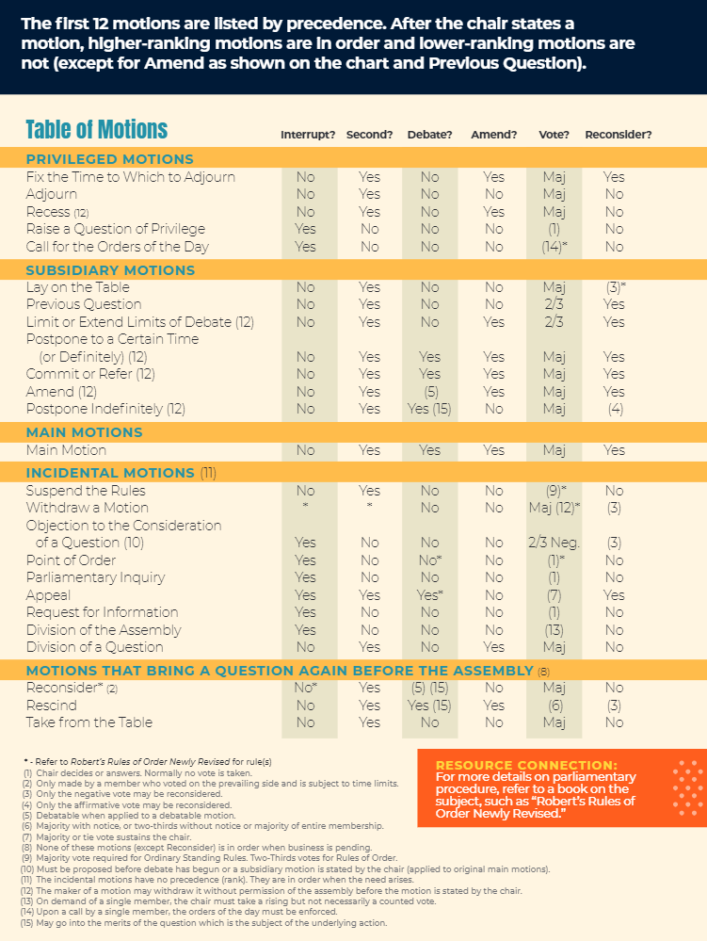
Parliamentary
Procedure
Motions
There is a table of motions in the National FFA Student Handbook on page 74.

Slide 52
Parliamentary Procedure
Step 4
The main motion is then open for discussion. Every member has the right to be heard by obtaining the floor. No other item of business can be brought up during discussion.
Main Motions: Used to bring new business before a group
Use the following procedure:
Step 1
Member rises and addresses the chair by saying “Mr./Mdm./Office (Last Name).”
Step 5
When there is no further discussion, the president calls for a vote.
Proper form to use:
Presiding officer: “All those in favor of the motion to ____ signify by saying aye.”
(Members respond.)
“All opposed, say no.”
(Members respond.)
“The motion is carried/defeated.”
*Tap gavel once.*
Step 2
When recognized by the chair, member begins their motion with these words: “I move to …”
Step 3
A second is needed, so an interested member should say “I second the motion.”
If there is a second, chair will announce the motion. If no second, the motion dies from lack of a second.

Slide 53
Parliamentary Procedure
Amendments
If a member believes the main motion can be improved, it can be changed or modified through a motion to amend.
Three common ways to present amendments:
  By inserting or adding
  By striking out
  By a combination of striking out and inserting
Requires a second and a vote
Refer to Committee
This motion is used to gather more information before making a final decision.
“I move to refer this motion to a committee to report at our next meeting.”
Motion can specify the number of members on committee and who appoints them as well as indicate when the committee reports back

Slide 54
Parliamentary Procedure
Postpone Definitely
This motion is used when you think the chapter is not ready to vote on it right then.
Postponing definitely allows a group to hold off on voting and set a specific time to revisit.
“I move to postpone action on this motion until our next regular meeting.”
Requires a second and a vote
Lay on the Table
Allows you to postpone action or a motion if something urgent comes up
Once tabled, it requires a motion and vote to take from the table at the same or next meeting.
“I move to lay this motion on the table.”
“I move to take from the table the motion to _____ tabled at our previous meeting.”

Slide 55
Parliamentary Procedure
Point of Order
A tool commonly used to return a meeting to order
It is used any time you believe a parliamentary error has been made.
You would immediately say “Point of order.”
President: “State your point.”
You: State the error that has been presented.
President: Accepts or denies the error
Adjourn
A popular motion to use
Used when it is time to close the meeting
Stand, be recognized by the chair and say “I move to adjourn.”
Requires a second and a vote, no discussion is allowed
If passed, the meeting ends immediately.

Slide 56

Official Ceremonies
Discovery FFA Degree Ceremony
Page 77
Used to award members their Discovery FFA Degrees
Official Opening Ceremony
Page 75
Used at the beginning of an FFA event or meeting
Greenhand FFA Degree Ceremony
Page 78
Used to award members their Greenhand FFA Degrees
Official Closing Ceremony
Page 76
Used at the end of an FFA event or meeting
Chapter FFA Degree Ceremony
Page 79
Used to award members their Chapter FFA Degrees
Honorary Degree Ceremony
Page 81
Used to award honorary members with their FFA degrees

Slide 57

National FFA Week Ideas
National FFA Week gives members a chance to educate the public about agriculture. During the week, chapters host teacher appreciation breakfasts, conduct Ag Olympics competitions, speak to the public about agriculture, volunteer for community service projects and more!
Resource Connection:
https://FFA.pub/NationalFFAWeek

Slide 58
National FFA Week Ideas
Host social events for chapter members: dance, pizza party, movie night, bowling, karaoke.
Volunteer at a local food bank, at a community event or for a family in need.
Develop a petting zoo, pedal tractor pull or coloring contest for elementary students.
Visit local farmers, extension agents, agribusiness owners and managers.
Visit nursing homes and hospitals — take flowers and plants to interact with residents.
Read announcements over the PA system at school.
Collect clothes, toys, school supplies, etc. to donate to local shelters.
Have an Official Dress Day, casual FFA clothes day, blue and gold day and/or an agribusiness apparel day.
Work with local newspapers, radio and TV stations to highlight chapter activities or fun facts.
Have the local mayor and other town officials sign a National FFA Week proclamation.
Host a special meal during the week such as a pancake breakfast or barbeque.
Hold a prize day with giveaways such as FFA-themed pens, notepads, bags, etc. at school entrances.

Slide 59

National FFA Delegate Work
The National FFA Delegate Experience ensures that the National FFA Organization remains a grassroots organization that serves students at the local level. The delegate process is an opportunity for members to direct the work of FFA.
475 student leaders from each of the 52 state associations

Slide 60

Local Engagement Programs
Local engagement programs were developed to offer opportunities for chapters and members to cultivate and strengthen connections with local businesses that would last and be mutually beneficial:
  Automotive dealers
  Tractor dealers
  Agricultural retailers
  Seed growers
  Restaurants
  Manufacturers

Slide 61
Awards Available in the National Chapter Award Program
State Level Awards
State Superior Chapter Award: earned by chapters that complete and document at least one activity related to each of the quality standards
State Gold, Silver or Bronze Awards: earned by chapters that supply additional information about three activities in each division
National Level Awards
National 3-, 2- and 1-Star Awards: chapters that receive the State Gold Award advance for national judging
Premier Chapter Awards: presented to the top 10 chapters with innovative activities in each of the three divisions
Models of Excellence: the top 10 high school chapters that exhibit exemplary qualities in all three categories
Middle School Models of Excellence: the top five middle school chapters that exhibit exemplary qualities in all three categories

Slide 62
Part 3:
State

Slide 63

State-Level Opportunities
Camps and Leadership Conferences
State FFA Convention
State FFA Officers
State Competitive Events
State Advocacy Days
State Fair Opportunities

Slide 64

State FFA Officers
Each state association has a team of state officers. These officers are peer-elected and serve for a year. Duties of state officers:
  Recruiting and retaining FFA members
  Helping state staff set direction for state FFA programming
  Encouraging and motivating students to take advantage of the organization’s many opportunities
  Advocating for agriculture, FFA, agricultural education, and career and technical education

Slide 65
Part 4:
National

Slide 66


National Opportunities
FFA Member Leadership Series
  This series covers topics like self-discovery, personal growth, teamwork and making an impact.
  Content rotates yearly.
Washington Leadership Conference
  Held in Washington, D.C., each summer
  Helps members become changemakers who can make a measurable positive difference in their communities

Slide 67


National Opportunities
Next Generation Conferences
  A launch pad for members to discover more about the agricultural career focus areas
  Each conference focuses on a specific career focus area such as animal systems, plant systems or agribusiness systems.
New Century Farmer Conference
  Focused on production agriculture
  For members ages 18 to 24
  Meet with agriculture producers and industry experts.

Slide 68

National Opportunities
National FFA Convention & Expo
  Held every fall for over 65,000 FFA members, advisors, educators, supporters and guests
  Includes sessions, competitive events, career success and educational tours, student and teacher workshops, exposition, shopping mall and service projects
  Four-day event held in Indianapolis until 2031

Slide 69

National Opportunities
National FFA Convention & Expo Courtesy Corps
  Members selected from each state to help ensure the annual convention is a success
  These members assist program staff in fulfilling responsibilities in areas including career and leadership development events, Shop FFA mega store, the rodeo, and more.

Slide 70


National Opportunities
National FFA Band, Chorus and Talent
  If music is your passion, showcase your skills at the annual National FFA Convention & Expo.
  Nearly 250 members are selected from across the country to play in the band, sing in the chorus or perform in the talent program.

Slide 71

National Opportunities
National FFA Expo
  Held during the annual National FFA Convention & Expo
  Showcases more than 350 exhibits that represent agricultural companies, industries, colleges and universities
Workshops
  Leadership and personal growth workshops are held during the annual National FFA Convention & Expo

Slide 72

National Opportunities
National Days of Service
  Members attending the annual National FFA Convention & Expo can volunteer for local service projects.
  Members not in attendance can participate in the virtual National Days of Service in their own communities.
National FFA Officers
  Six students selected to represent the National FFA Organization
  Must have their American Degree
  Will travel over 100,000 miles during their year of service

Slide 73
Part 5:
Beyond High School

Slide 74

Scholarships
The National FFA Organization and its supporters offer more than $2 million in college scholarships to members.
Scholarships are available for a variety of experiences, career goals and higher education plans.
Scholarship recipients are not selected based on just grades or GPA, but by including all community service, FFA involvement, leadership skills and SAEs.
Scholarship applications are online, and there is only one application to complete.

Slide 75

National FFA Alumni and Supporters
For parents, friends, supporters, past FFA members and anyone wanting to support FFA, agricultural education and agriculture
Types of Membership
  Annual: one-year membership that is renewed annually
  Life: one-time investment for lifetime membership
  Associate: student FFA members receive an automatic, free five-year membership upon high school graduation

Slide 76

National FFA Foundation
An independent nonprofit organization
The National FFA Foundation builds partnerships with industry, education, government, other foundations and individuals to secure financial resources.
Governed by a board of trustees comprised of educators, business leaders, individual donors and FFA alumni
82% of every dollar earned by the foundation supports FFA members and agricultural education opportunities.

