Slide 1
Student Handbook
Section 3: Personal Growth

Slide 2
Part 1:
Me

Slide 3
Beyond the FFA Mission
We are all unique and have different things to offer. The National FFA Organization’s mission is to help you build your skills, talents and abilities.
Premier Leadership
Personal Growth
Career Success

Slide 4
Premier Leadership
Definition: Influence
Action: Do you have the skills and competencies needed to achieve the desired results?
Relationships: Can you build constituency through listening, coaching, understanding and appreciating others?
Vision: Have you set a clear image of what the future should be?
Character: Do you possess a collection of virtues by which to live your life?
Awareness: Do you have a quest for purposeful understanding?
Continuous Improvement: Have you shown a pursuit of learning and growth?

Slide 5
Personal Growth
Definition: The positive evolution of the whole person
Physical Growth: Are you striving to remain healthy by understanding, respecting and managing your body’s needs?
Social Growth: Can you have successful interactions that respect the differences of a diverse and changing society?
Professional Growth: Do you have an awareness and application of skills necessary for career success?
Mental Growth: Are you developing the effective application of reasoning, thinking and coping?
Emotional Growth: Have you experienced the development of healthy responses to your feelings?
Spiritual Growth: Do you have the reflective inner strength to allow you to define your personal beliefs, values, principles and sense of balance?

Slide 6
Career Success
Definition: Continuously demonstrating those qualities, attributes and skills necessary to succeed in, or further prepare for, a chosen profession while effectively contributing to society
Communications: Have you developed the oral, written and verbal means whereby interactions take place?
Decision Making: Do you have the ability to analyze a situation and execute an appropriate course of action?
Flexibility/Adaptability: Do you have the traits that allow you to be capable of and willing to change?
Technical/Functional Skills in Agriculture: Do you have the knowledge and skills needed for a career in agriculture and related industries?

Slide 7
Part 2:
We

Slide 8
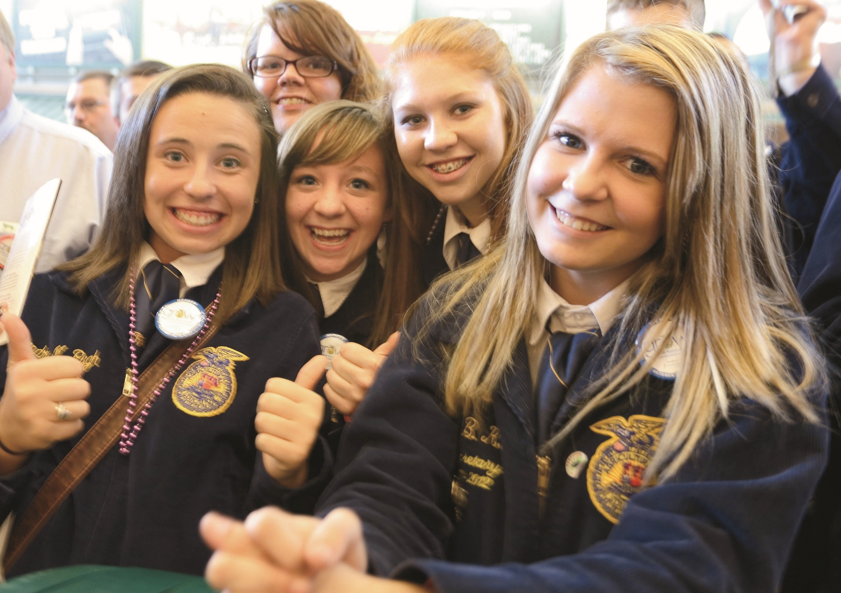
Moving From Me to We
How to Build, Strengthen and Maintain Relationships
Take time out. Make time for the people that matter most to you.
Do the little things that matter most. Send notes, make phone calls, and stay in touch with friends and family.
Attend activities and events together. Spend time doing mutual hobbies such as watching movies or listening to music.
Have meaningful conversations. Dare to discuss world issues, religion and traveling.

Slide 9
Moving from Me to We
Strategies to Include Others on Teams
Know the individual.
Create a shared vision.
Define team roles.
Create a team identity.
Participate in team-building activities.
Create a sense of ownership.
Communicate with everyone involved.
Focus on continual improvement.

Slide 10
Part 3:
Do

Slide 11
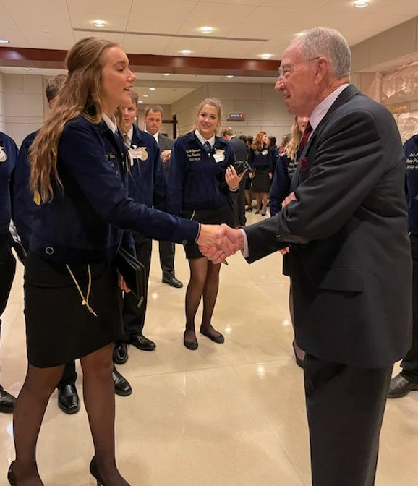
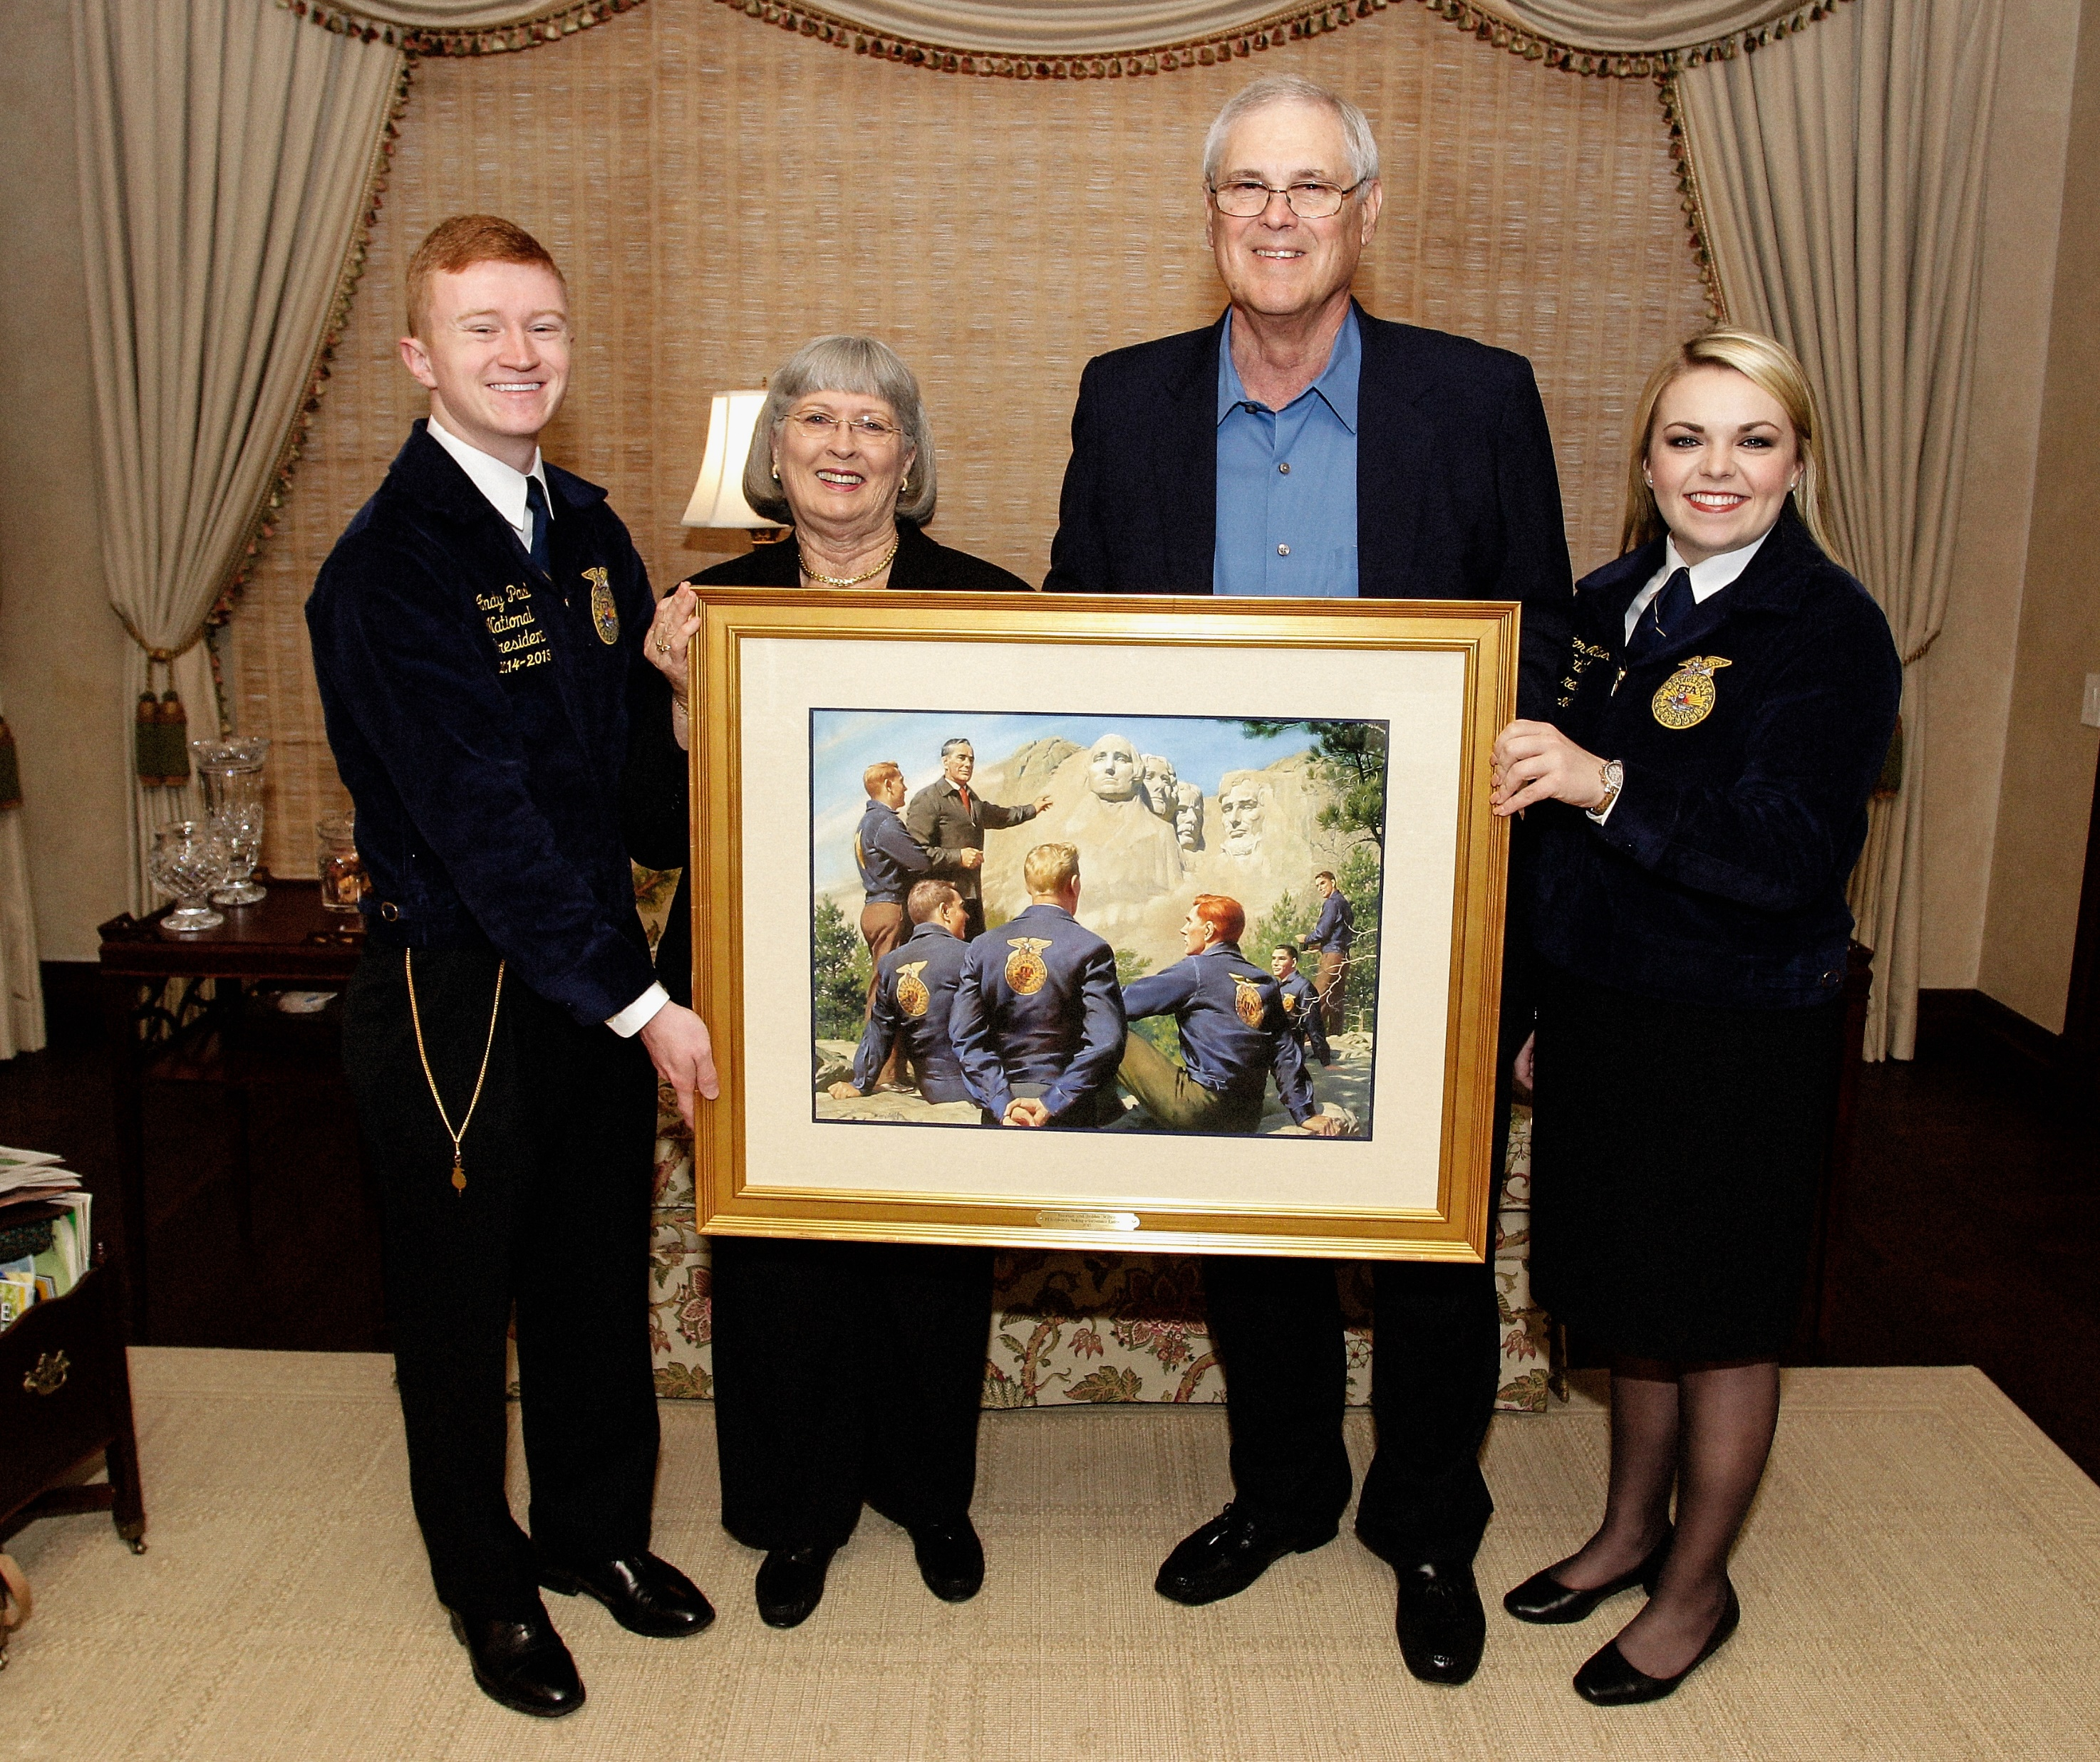
Agricultural Literacy and Advocacy
Telling the story of agriculture is critical. FFA members are not only consumers but will also be powerful influencers of consumer awareness.

Slide 12
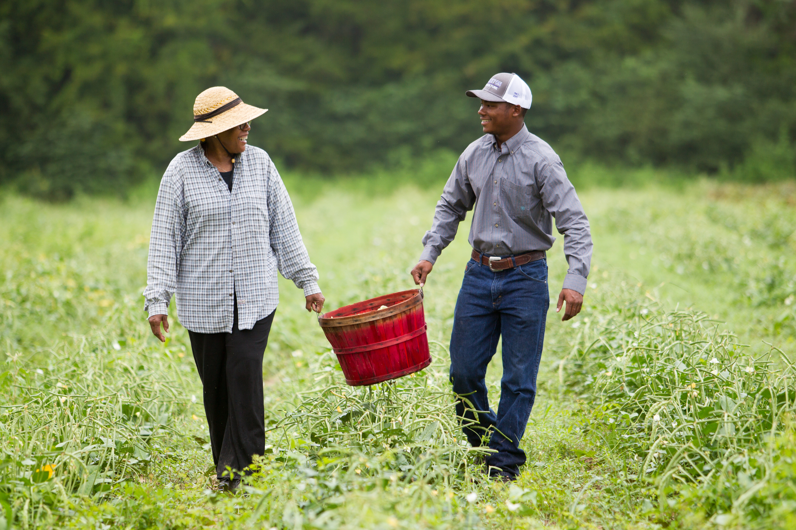
Agricultural Literacy and Advocacy
What are the skills of advocates?
Think Critically. Approach decisions with an open mind and calculated thought.
Grow a Broadened Perspective. Allow yourself to see different cultures, educations and experiences.
Effectively Analyze and Use Resources. Information is abundant and diverse.
Brainstorm Solutions. Opportunities for innovation and experiences in advocacy can empower you to envision a sustainable future.
Collaborative Conversation — Have educated and balanced conversations with consumers.

Slide 13
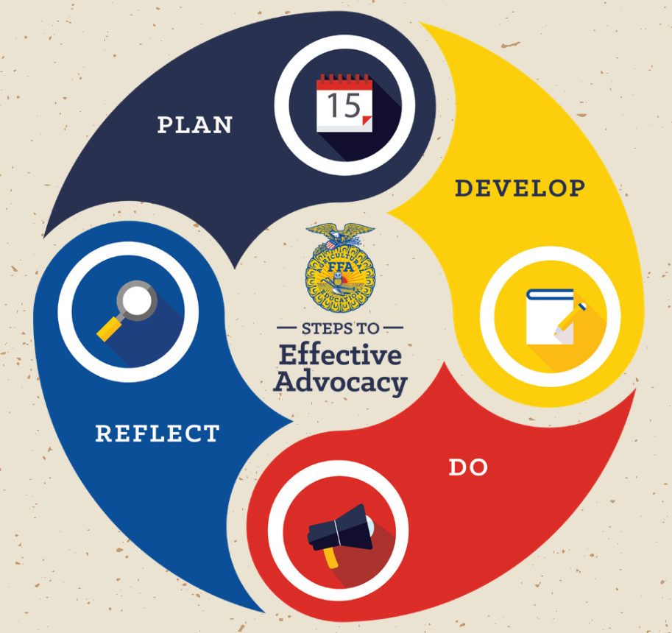

Slide 14


Agricultural Literacy and Advocacy
PLAN
The first step of advocacy is planning.
Define the issue: What is the challenge we are facing?
Analyze: What is the vital information we need to know, and where can I find it?
Understand our audience: Who are we trying to influence?

Slide 15


Agricultural Literacy and Advocacy
DEVELOP
The second step of advocacy is developing.
Objectives: What do we want to accomplish?
Key Message: What are our important talking points for our defined audience?
Develop Plan: What steps do we need to take to achieve our objectives?

Slide 16


Agricultural Literacy and Advocacy
DO
The third step of advocacy is delivering your message.
Collaborate: How can we partner with others to strengthen advocacy efforts?
Execute: How are we using what we know?
Raise Awareness: How do we promote our advocacy efforts and gain support?

Slide 17


Agricultural Literacy and Advocacy
REFLECT
The fourth step of advocacy is reflecting on the outcomes.
Monitor: What information can we collect that will demonstrate impact?
Review: How well did I achieve my objectives?
Adapt: What changes can I make to improve?

Slide 18
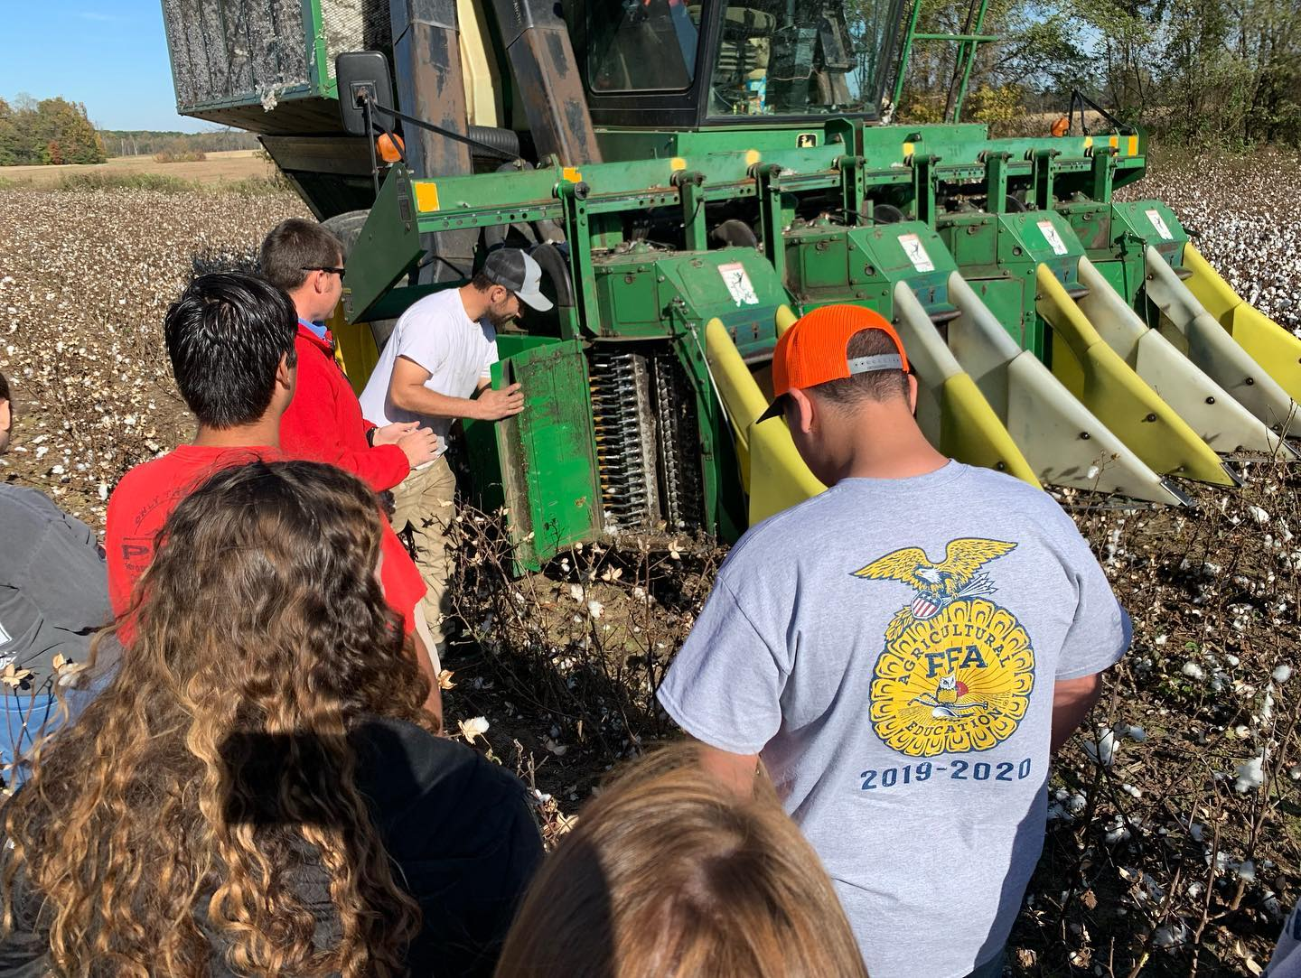
How can you advocate today?
After researching a topic, respectfully respond to a blog post with your stance.
FOR YOURSELF …
Share an ag-related news article or blog on social media.
Post on social media using #SpeakAg
Write a paper for one of your class assignments on an agricultural topic.
Host an SAE visit day.
Attend a local or state forum on agriculture.

Slide 19
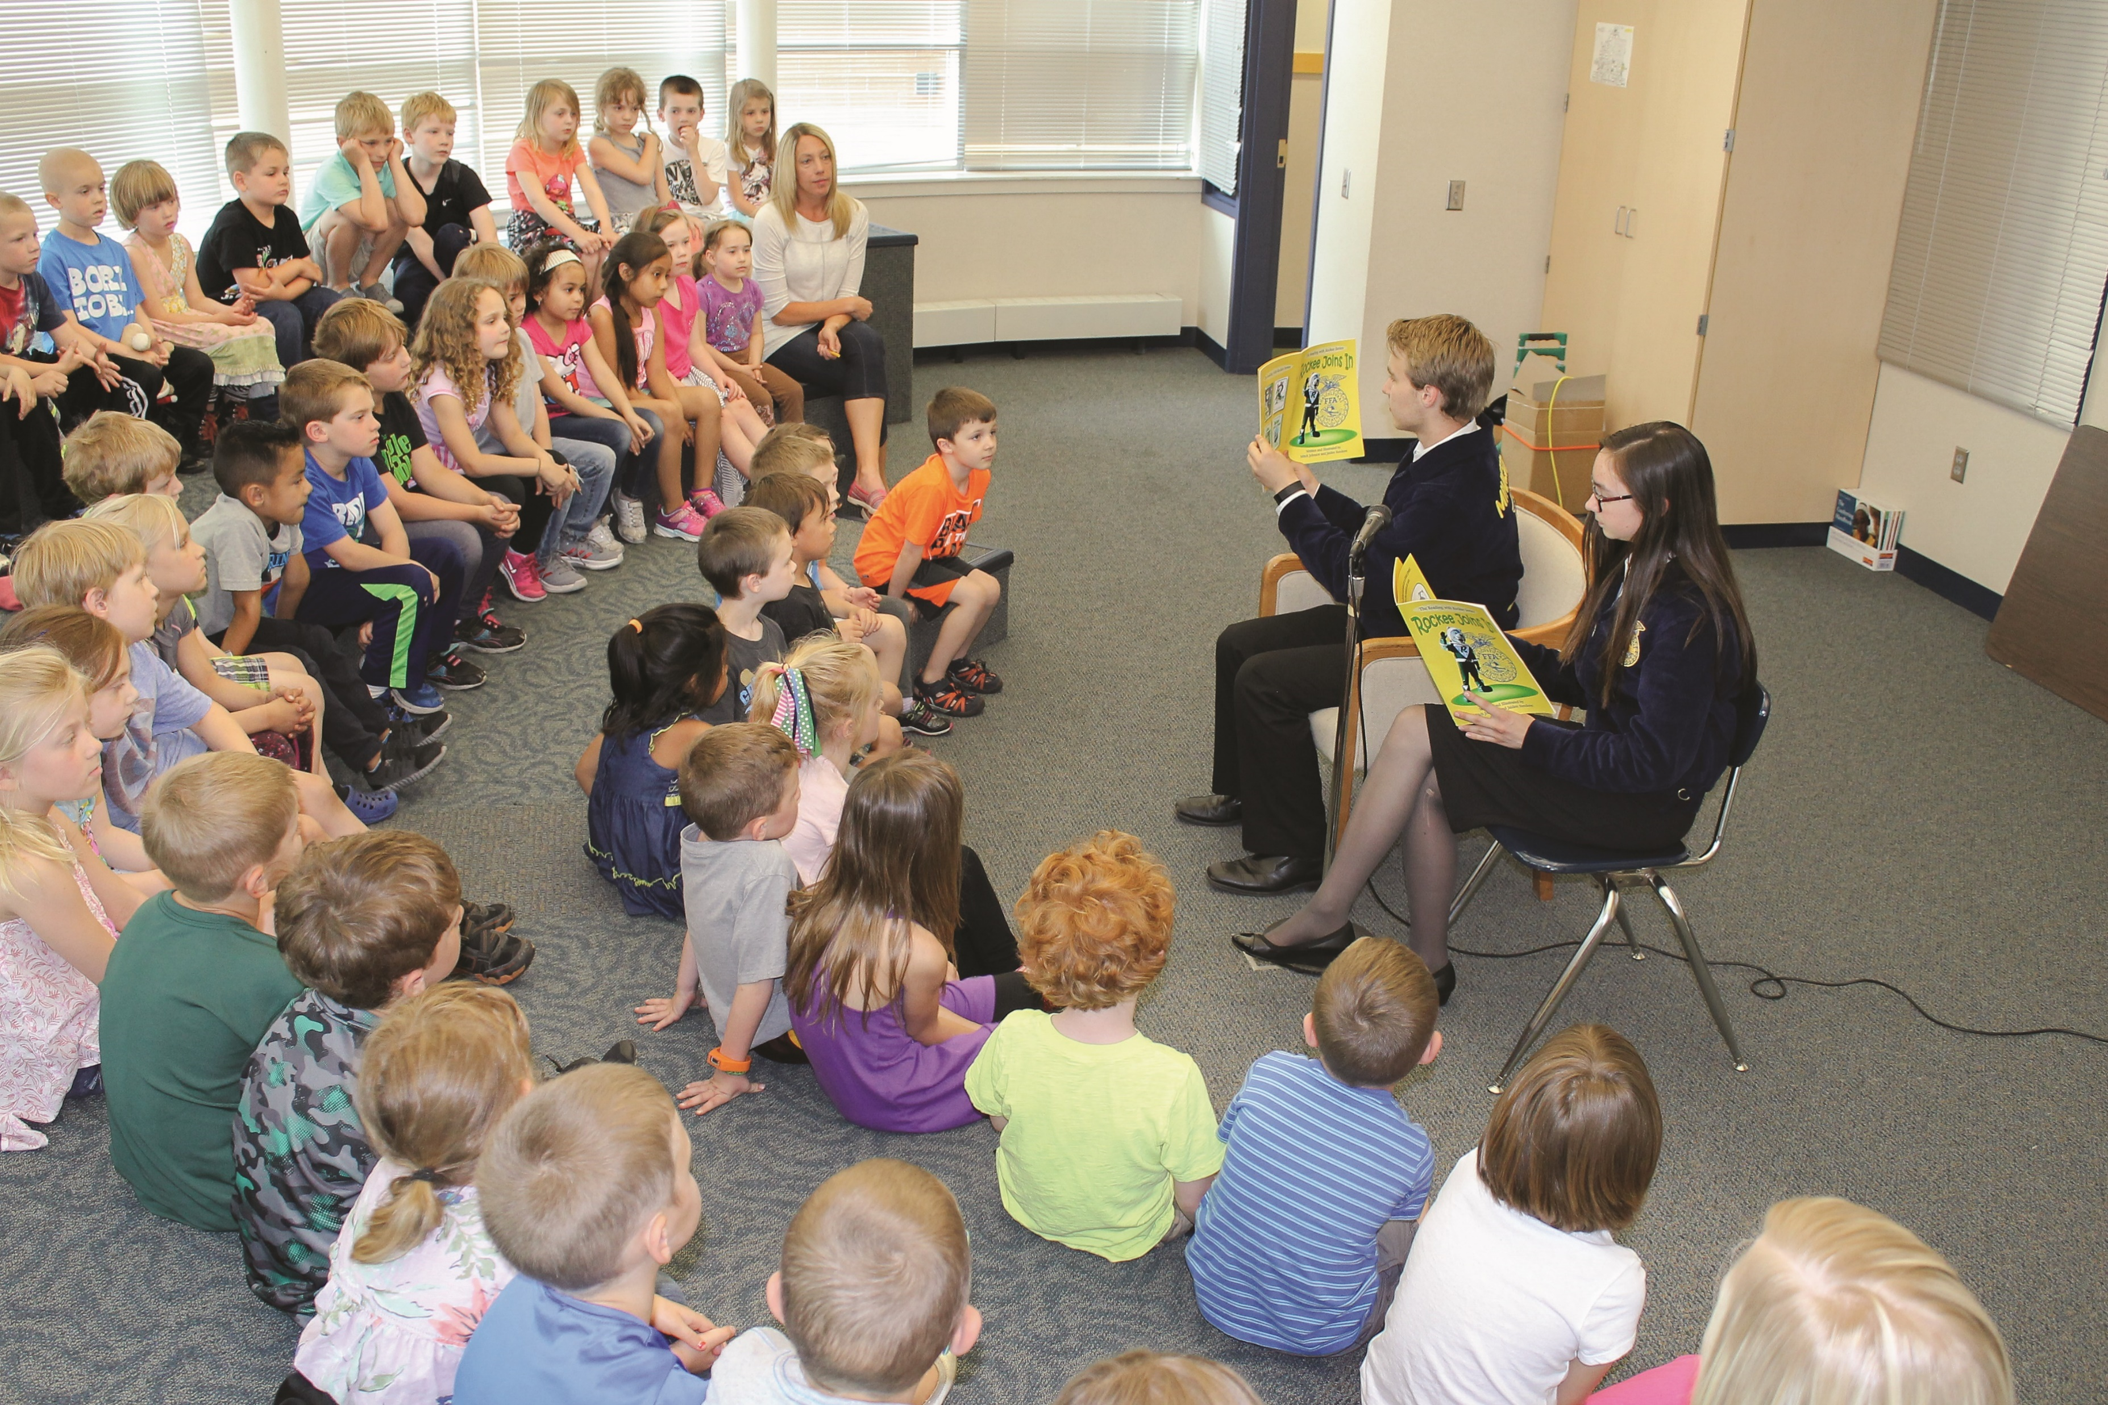
How can you advocate today?
Participate in the the PALS program.
FOR YOUR CHAPTER …
Teach a lesson to an elementary class.
Host a school farmers market.
Invite the middle school over for an Ag Day.
Invite friends to a chapter meeting.
Display flyers in hallways.
Host an SAE Share Day.

Slide 20
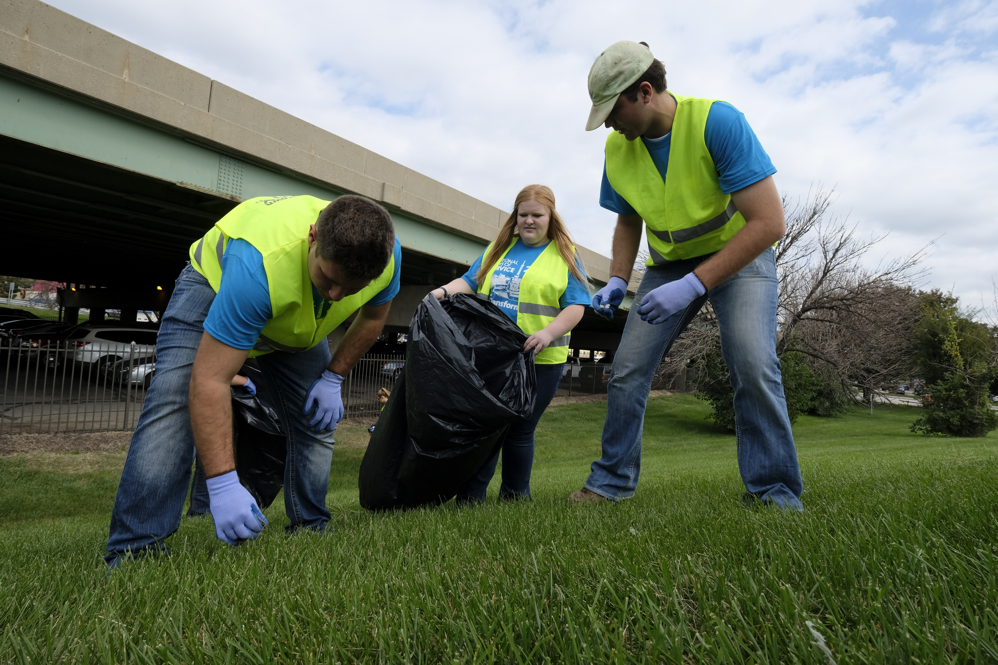
How can you advocate today?
Sell local produce or donate funds to the chapter.
FOR YOUR COMMUNITY …
Host a local Ag Day or Ag Petting Zoo.
Host a Farmer Appreciation Dinner.
Host a farmers market.
Fly an FFA flag.
Put an ad in your local newspaper.
Invite the mayor to the chapter banquet.
Set up a booth at the courthouse.
Attend a school board meeting and report on the success of your chapter.

Slide 21
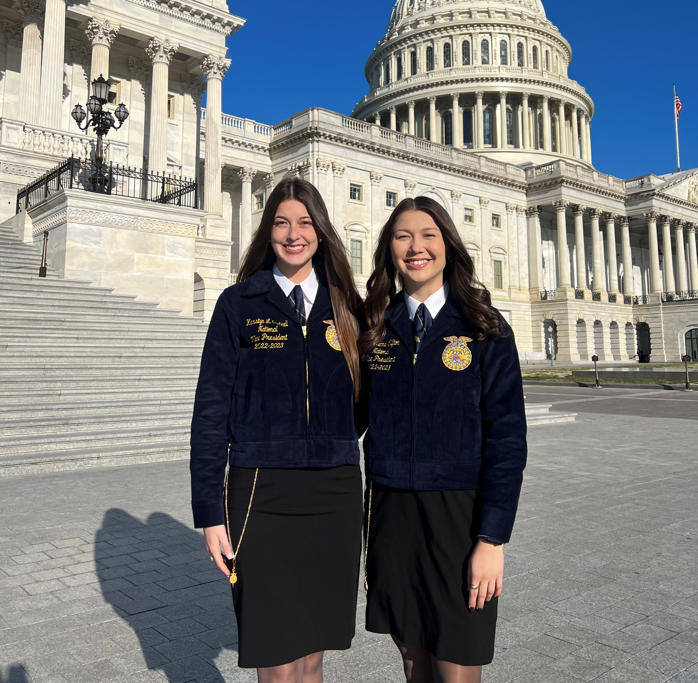
How can you advocate today?
Come up with a creative way to involve government officials and educate the public about agriculture.
FOR YOUR GOVERNMENT …
Reach out to your secretary/commissioner of agriculture and discuss current challenges in agriculture.
Invite agriculture advisors to speak at an event or in the classroom.
Get in touch with your local extension agent and discuss agricultural topics.
Post pictures from your state’s FFA Day or Ag Day at the capital.
Invite your state and/or national senators and representatives to visit your FFA chapter.
Reach out to involved agriculture supporters and learn about their ag stories.

Slide 22
Part 4:
Serve

Slide 23
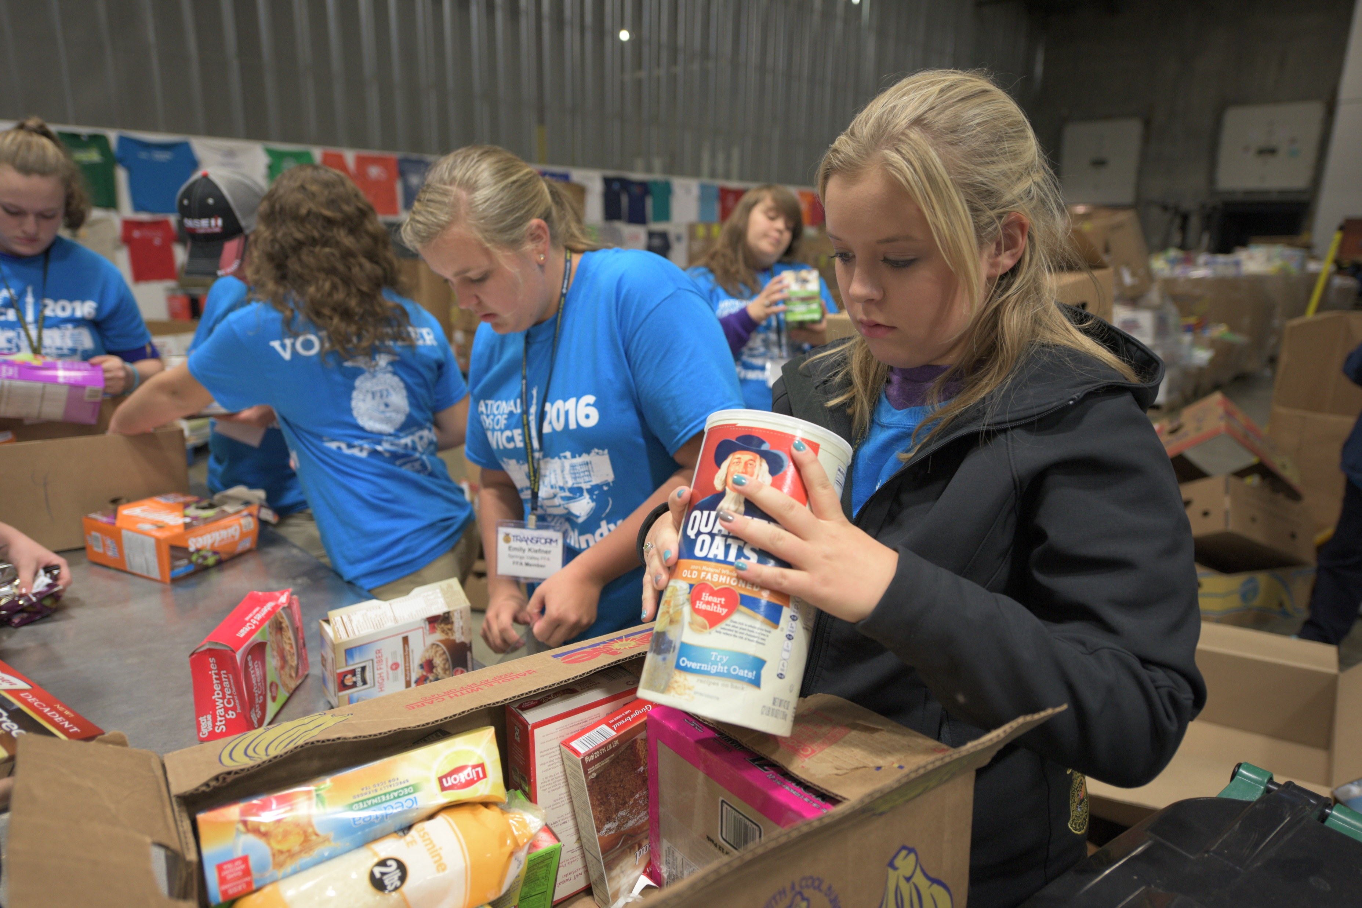
Living to Serve
Community Service
The engagement of individuals or groups in an organized activity that contributes to the local, national or world community
Examples:
  Adopt-a-highway
  Canned food drive
  Clothing drive
  Tutoring other students

Slide 24
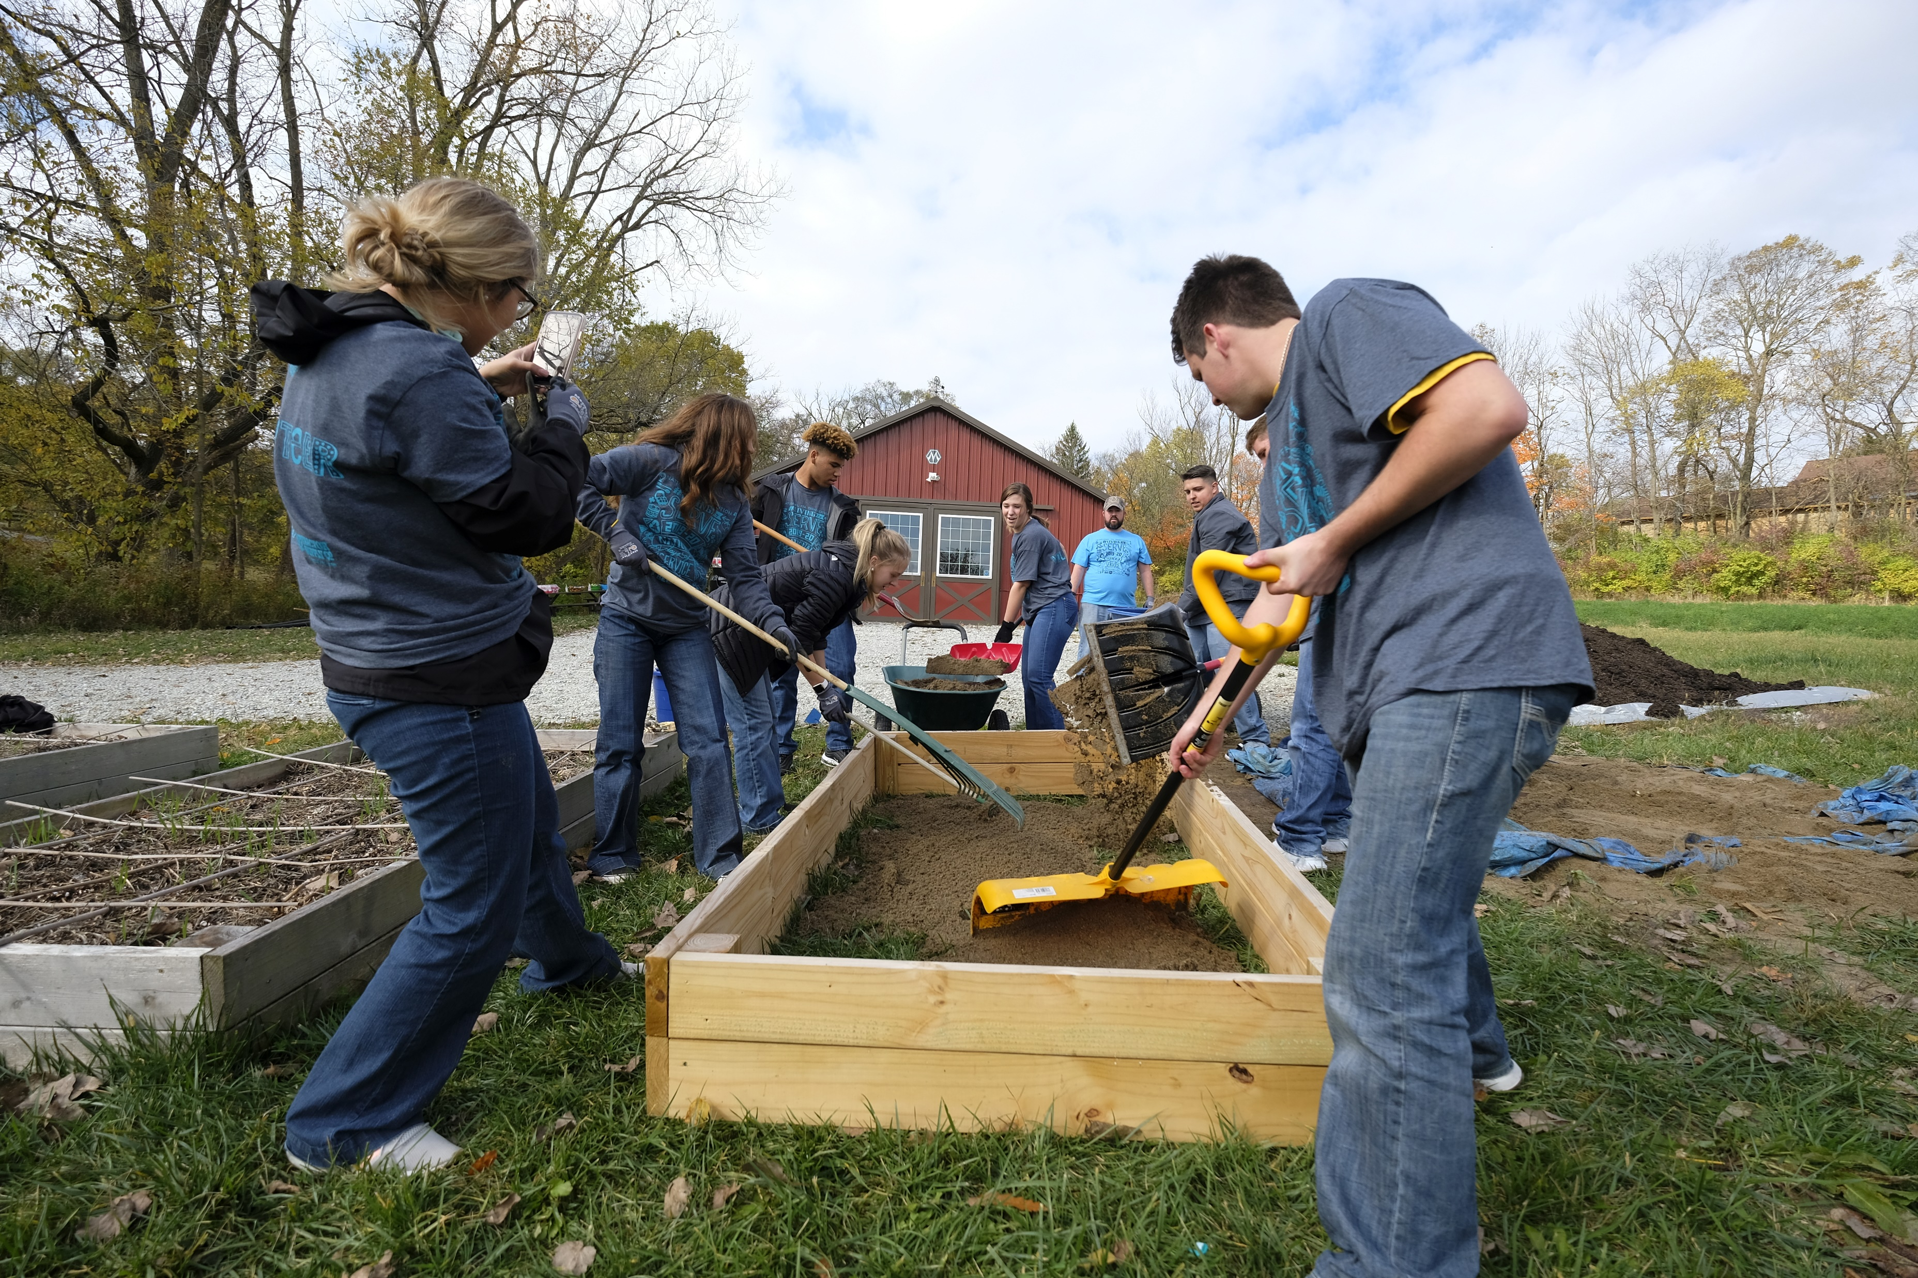
Living to Serve
Service Learning
Involves projects that occur over a semester or year, makes learning more hands-on, includes intentional and structured reflection and creates reciprocal partnerships
Example
  Building beds to ensure that every foster child has a safe place to sleep

Slide 25
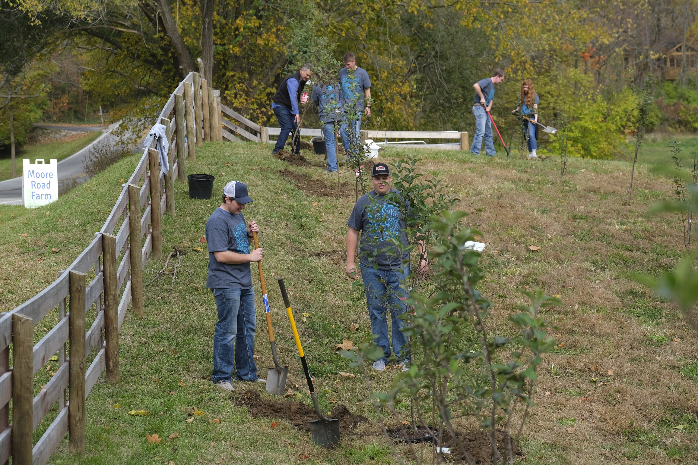

Living to Serve
Living to Serve Grant
A series of grants that provide an opportunity for FFA chapters to seek funding to support various types of service projects

Slide 26




Living to Serve
Living to Serve Grant
Focus Areas:
  Community Safety: addresses concerns regarding the safety of the community
  Hunger, Health and Nutrition: addresses unmet food insecurity needs, increases physical activity and improves healthy habits
  Community Engagement: addresses matters related to heritage and traditions, connections between community members and civic responsibility
  Environmental Responsibility: addresses air and water quality, energy and water efficiency, conservation efforts that sustain natural systems

