Slide 1
Student Handbook
Section 4: Career Success

Slide 2
Part 1:
Supervised Agricultural Experience

Slide 3
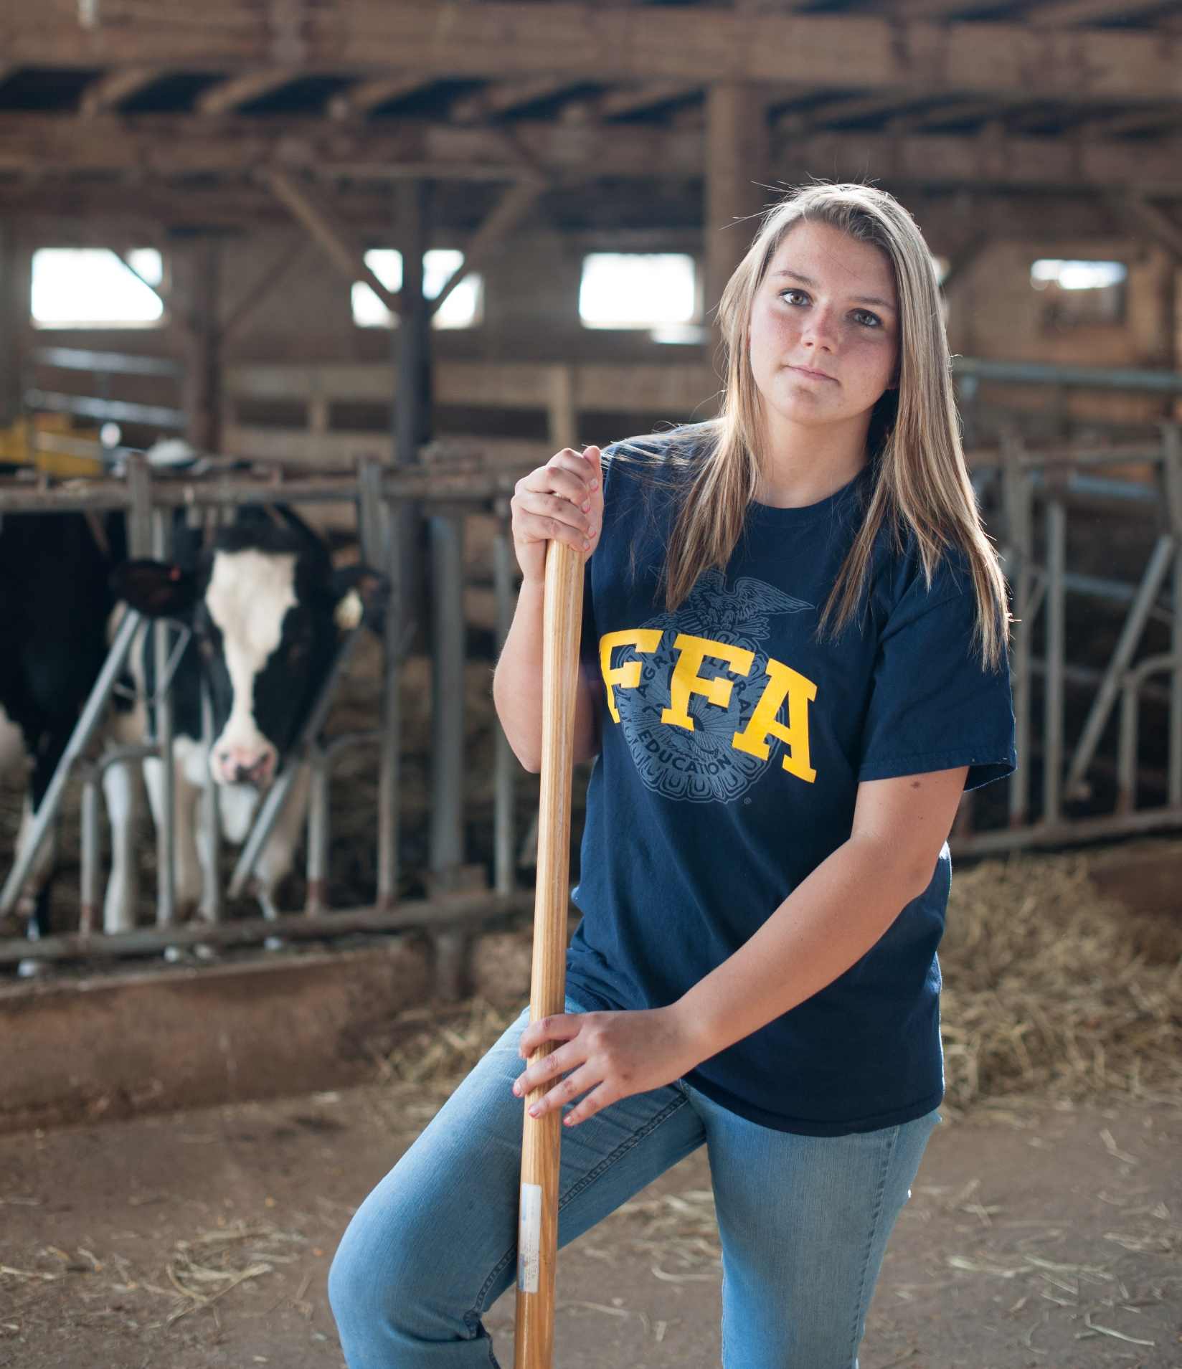
What is an SAE?
An SAE is made up of projects or enterprises where you apply agricultural skills and knowledge learned in the classroom to the real world.
  Create your own landscaping business.
  Conduct a scientific research project.
  Grow crops.
  Raise livestock.
  Secure a job in a field related to your future career goals.
  Complete community service.

Slide 4
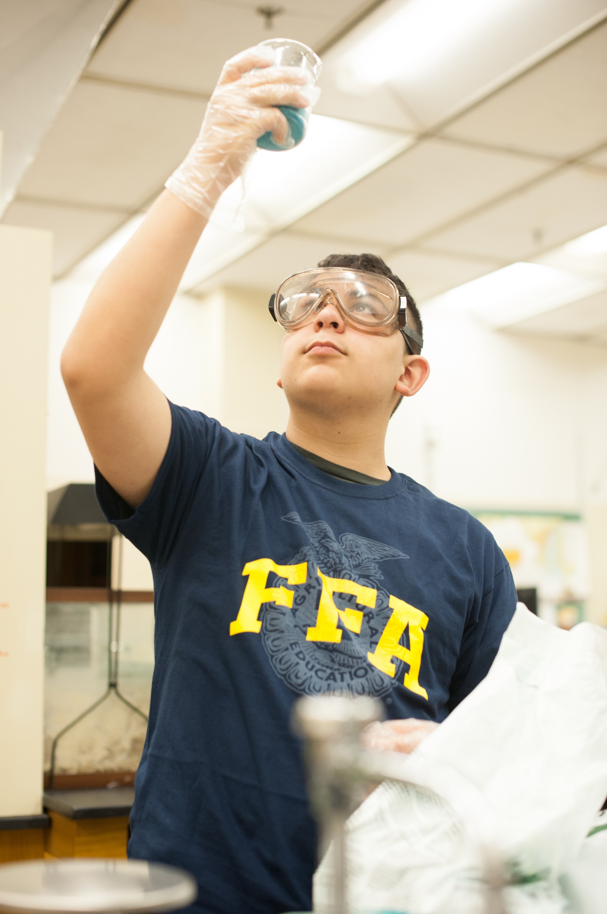
Parts of an SAE
Investigate
Explore possibilities and weigh the pros and cons of various SAE ideas.
Keep Records
Track your achievements over time in a record book.
Plan
Decide what to do and how you will get it done. Set your goals high!
Program Improvement
Improve or update your business, worksite or community by making it more attractive, efficient or valuable.
Coordinate
Communicate with your FFA advisor, supervisor/employer and parents to get your program in motion.

Slide 5
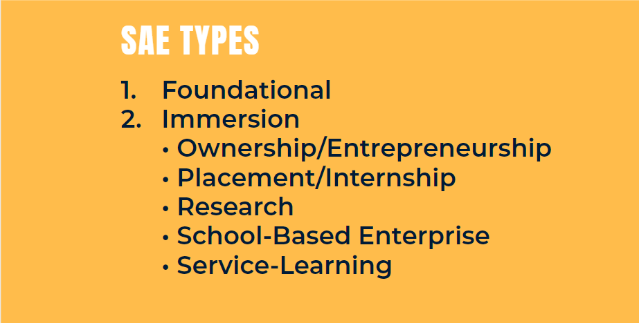

Slide 6
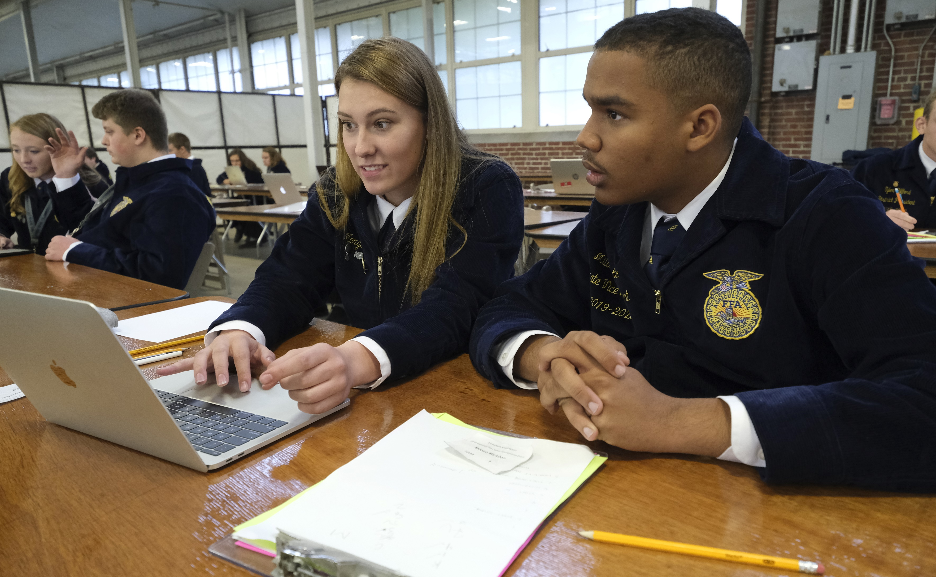
Foundational SAE
Every SAE should start as a foundational SAE with 5 components:
  Career exploration and planning
  Employability skills for college and career readiness
  Personal financial management and planning
  Workplace safety
  Agricultural literacy and exploration

Slide 7
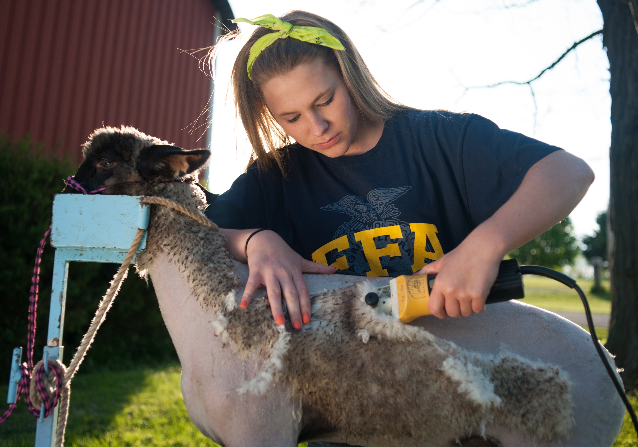
Immersion SAE
Ownership/Entrepreneurship SAE
Own and operate an agriculture-related business or enterprise providing goods and/or services to your community and beyond.
You must own the enterprise, make the management decisions and take financial risk with the ultimate goal of earning a profit.
  Operate a lawn-care service.
  Produce bedding plants or flowers.
  Raise livestock.
  Start a podcast about agriculture.

Slide 8
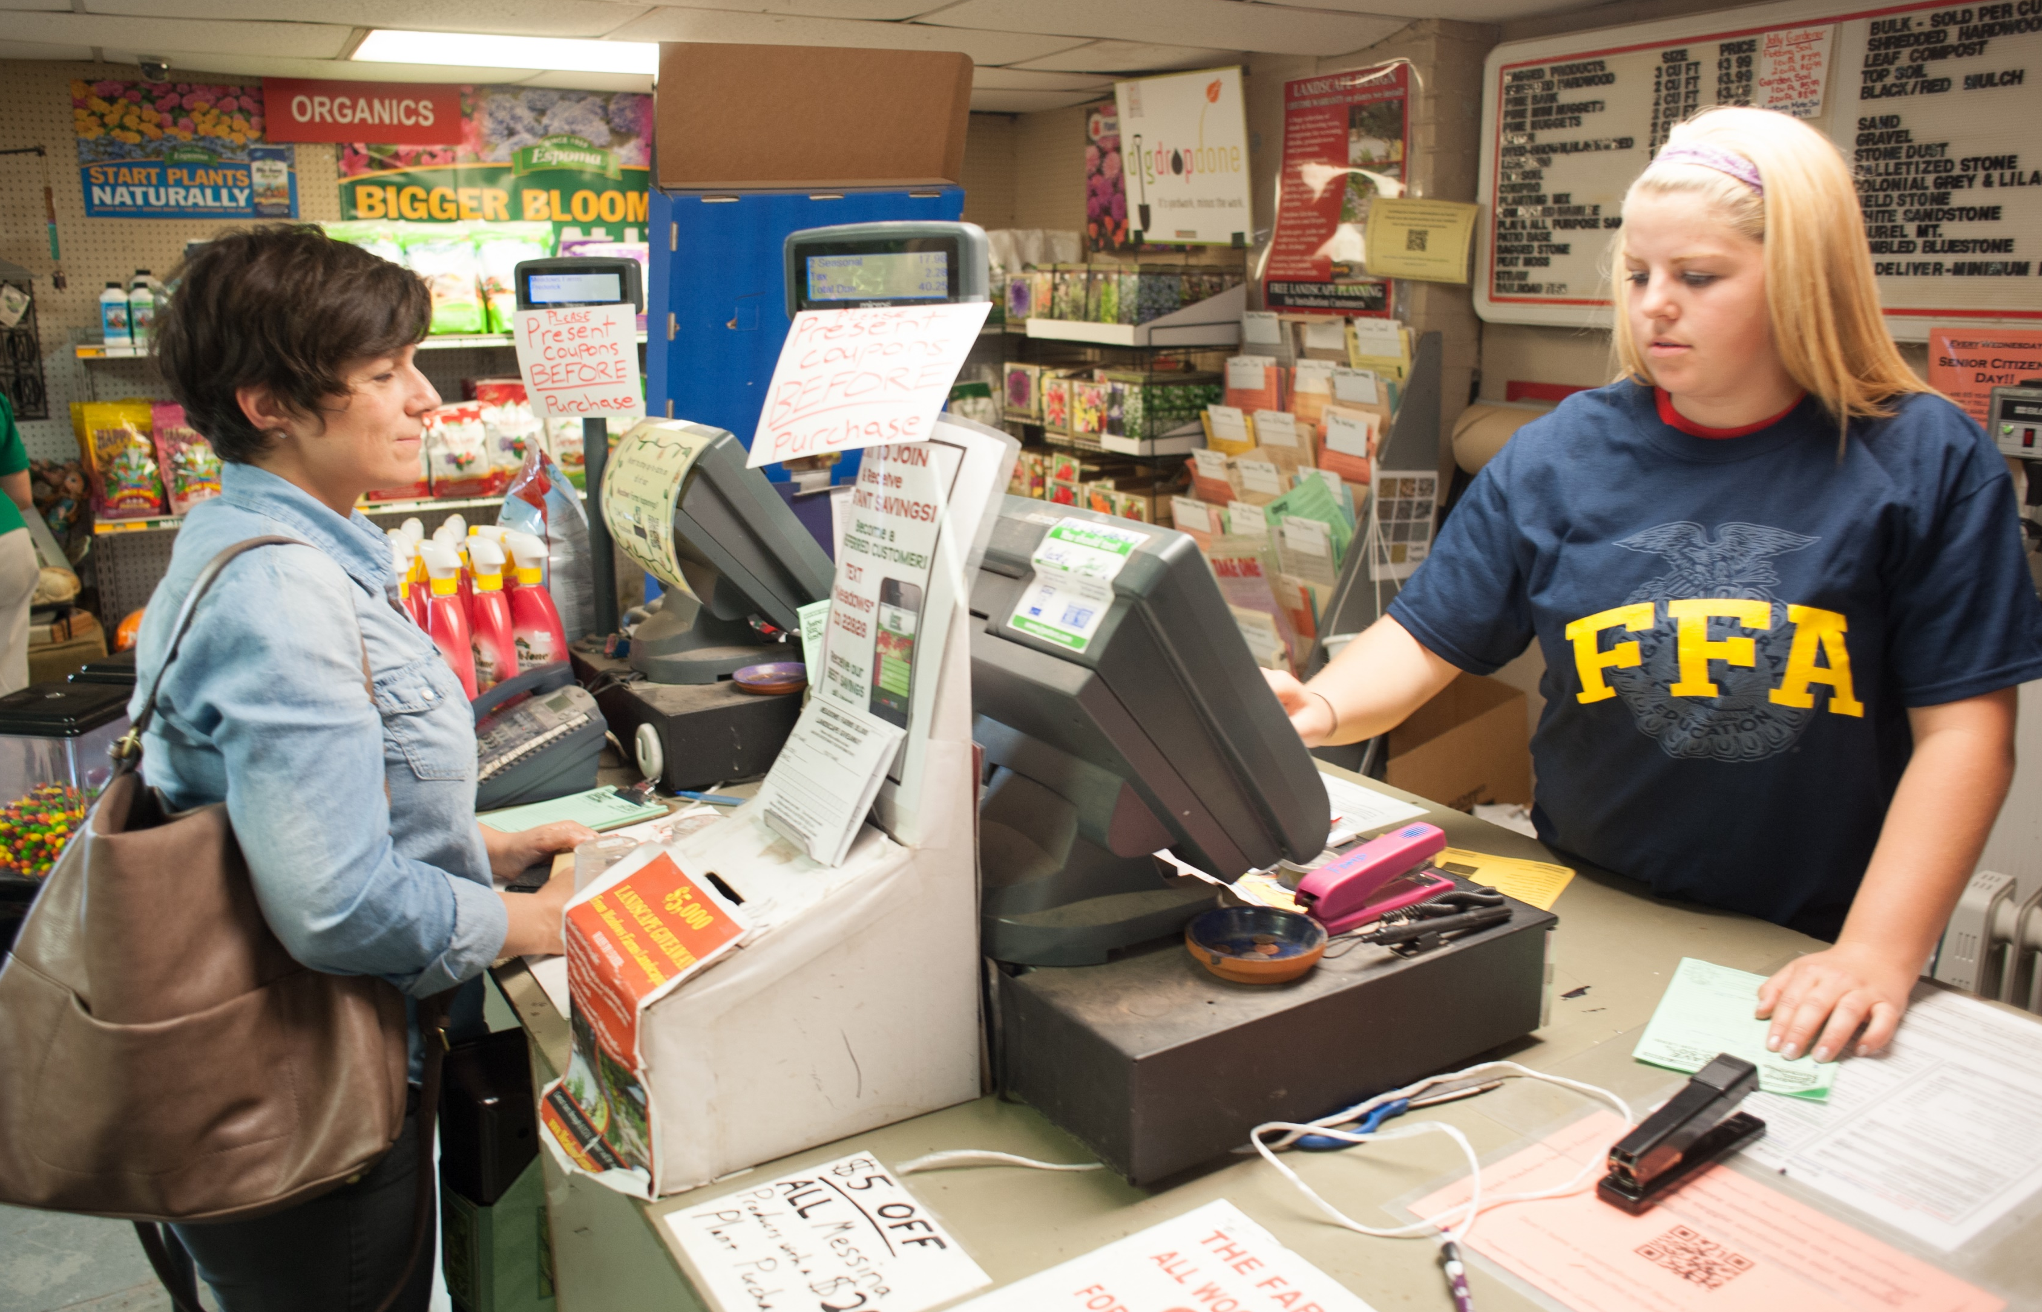
Immersion SAE
Placement/Internship SAE
Secure a job (paid or unpaid) with a local agricultural business and experience what’s it like to work for an employer..
Keep records of the number of hours you work and any earnings.
Track your skills and duties.
  Work at a farm-supply store.
  Work at a riding stable.
  Report for a local newspaper.
  Intern with a vet or pet groomer.

Slide 9
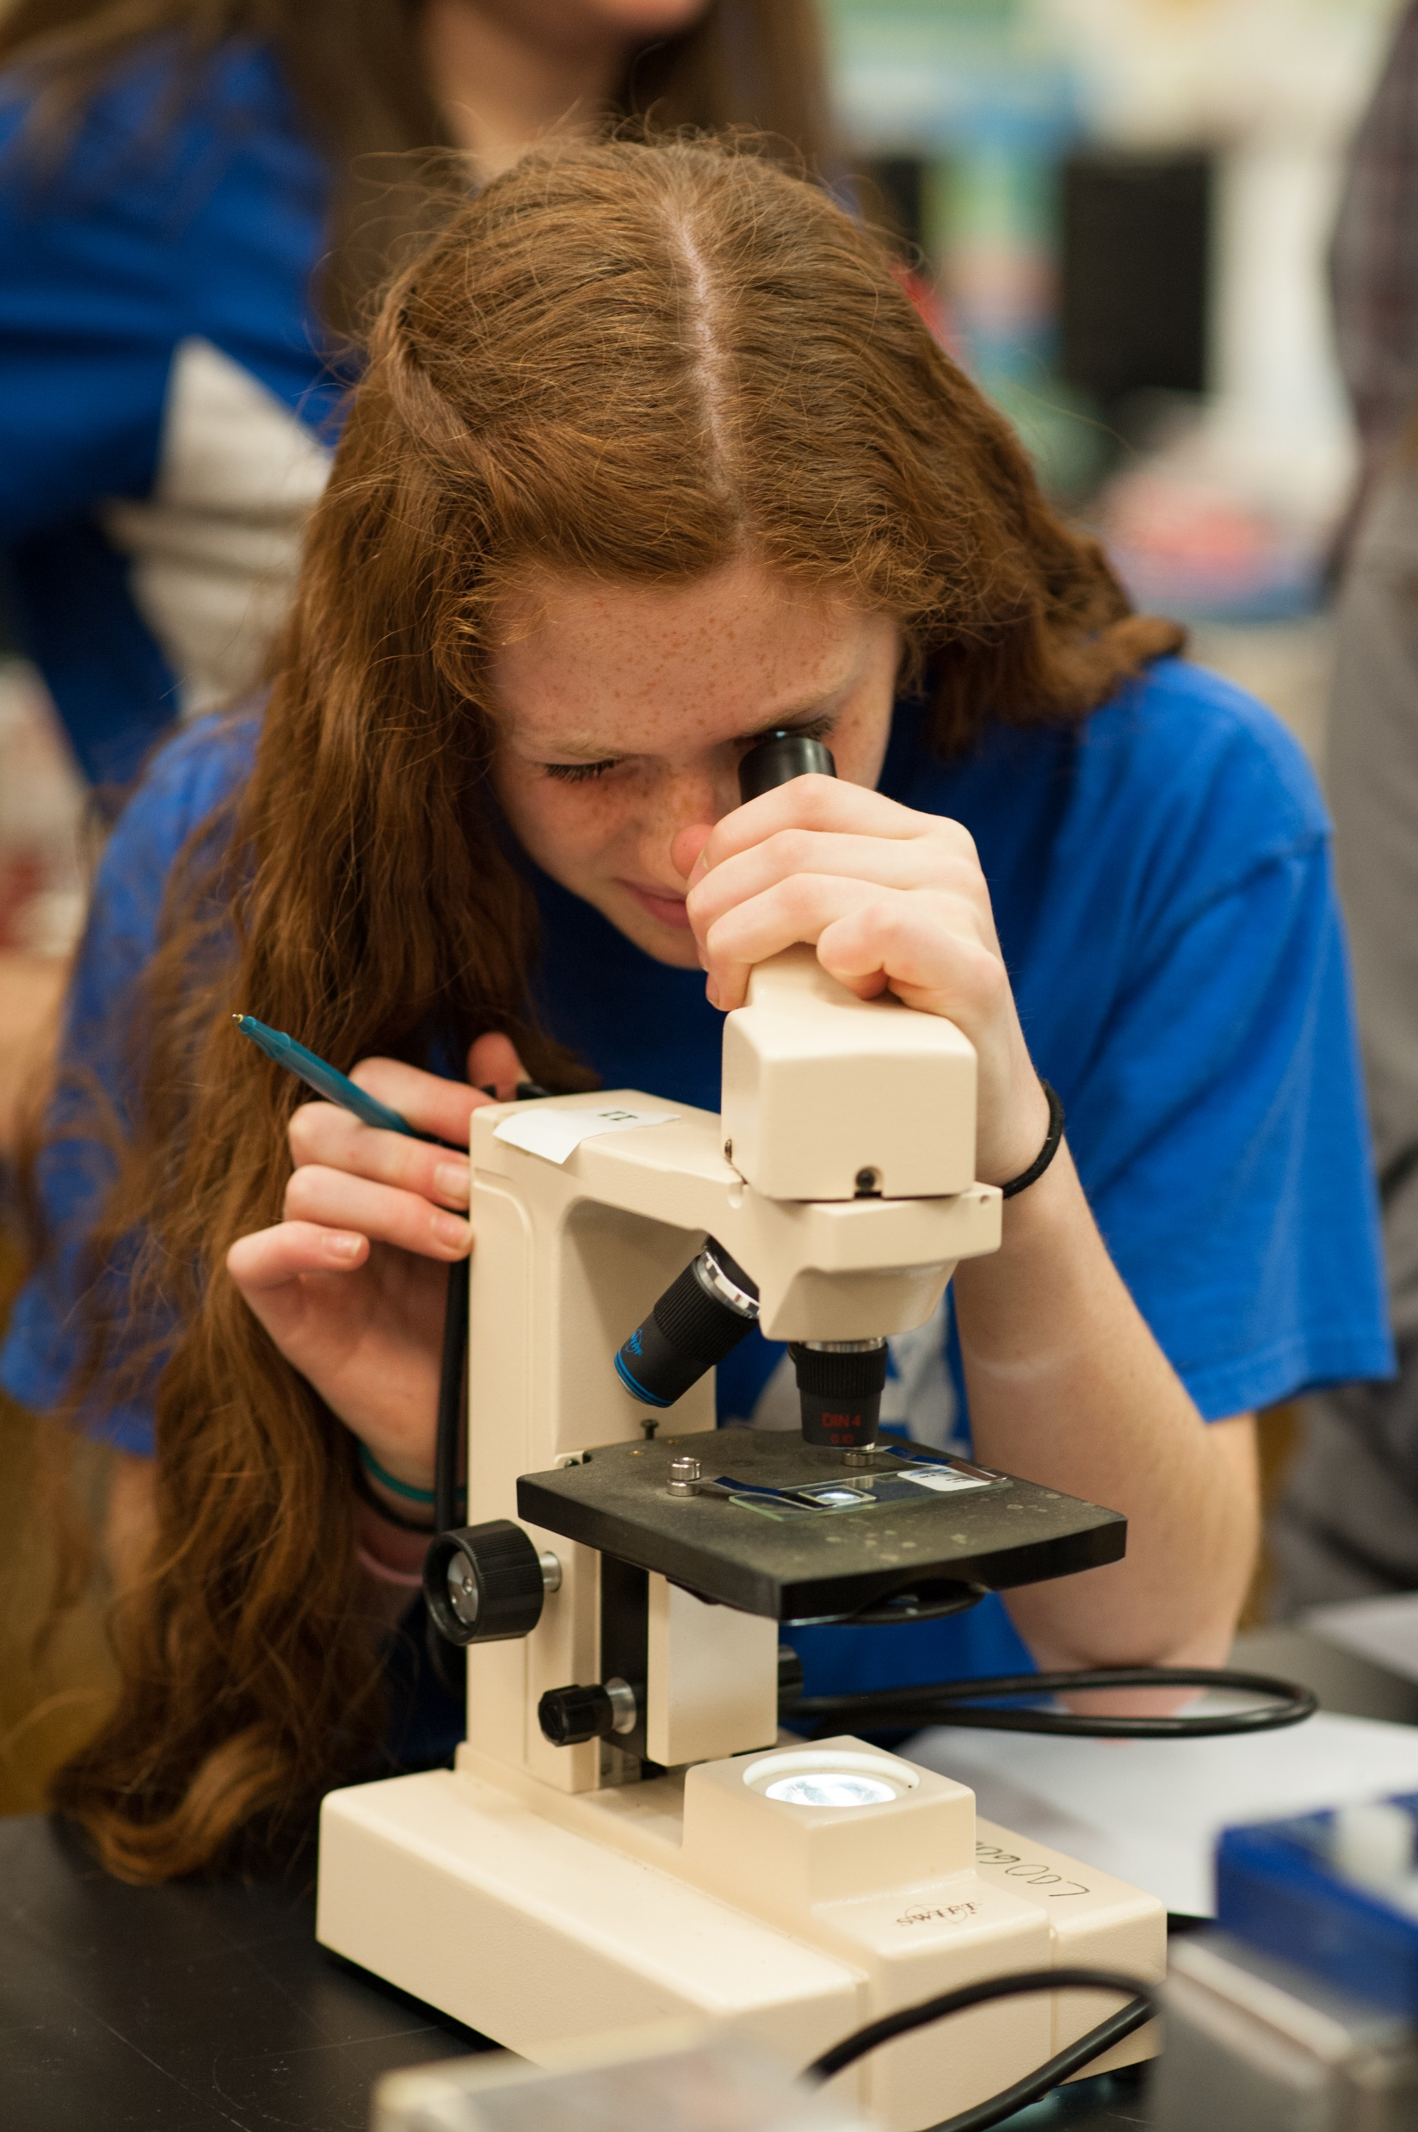
Immersion SAE
Research SAE
Conduct a research SAE by experimenting and investigating materials, processes and information to establish new or validate existing facts and conclusions.
  Experimental: the application of the scientific method on an agricultural research topic
  Analytical: begin with questioning why or how something occurs, analyze data, facts and information
  Invention: apply the engineering design process to create a new product

Slide 10
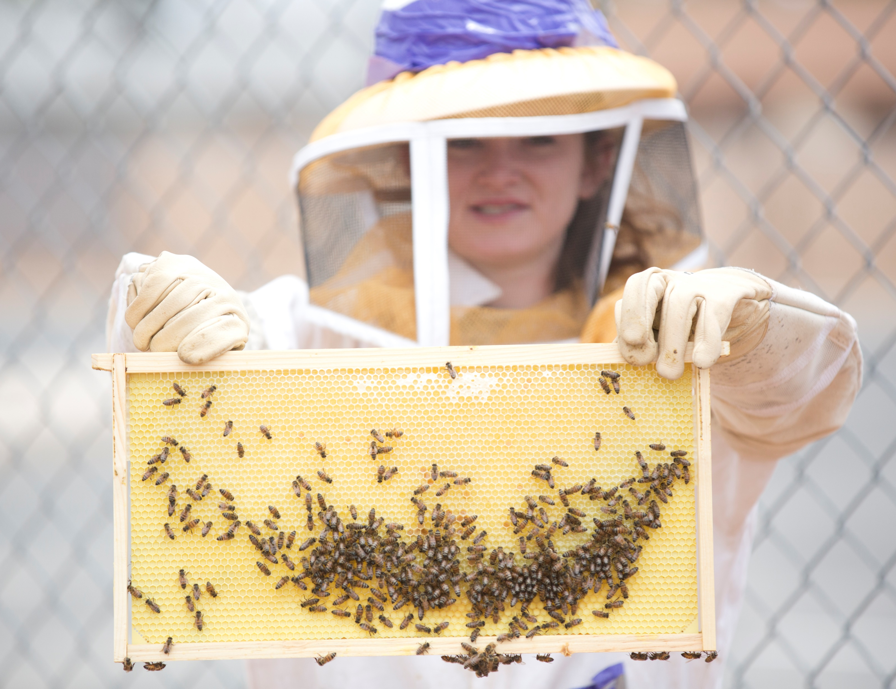
Immersion SAE
School-Based Enterprise SAE
Work with fellow FFA members to run an agricultural business right on your school campus.
  Grow and sells plants grown in the campus greenhouse.
  Build or repair agricultural equipment in the school shop.
  Raise animals in the school barn for show and sale.
  Conduct experiments in the classroom lab.

Slide 11
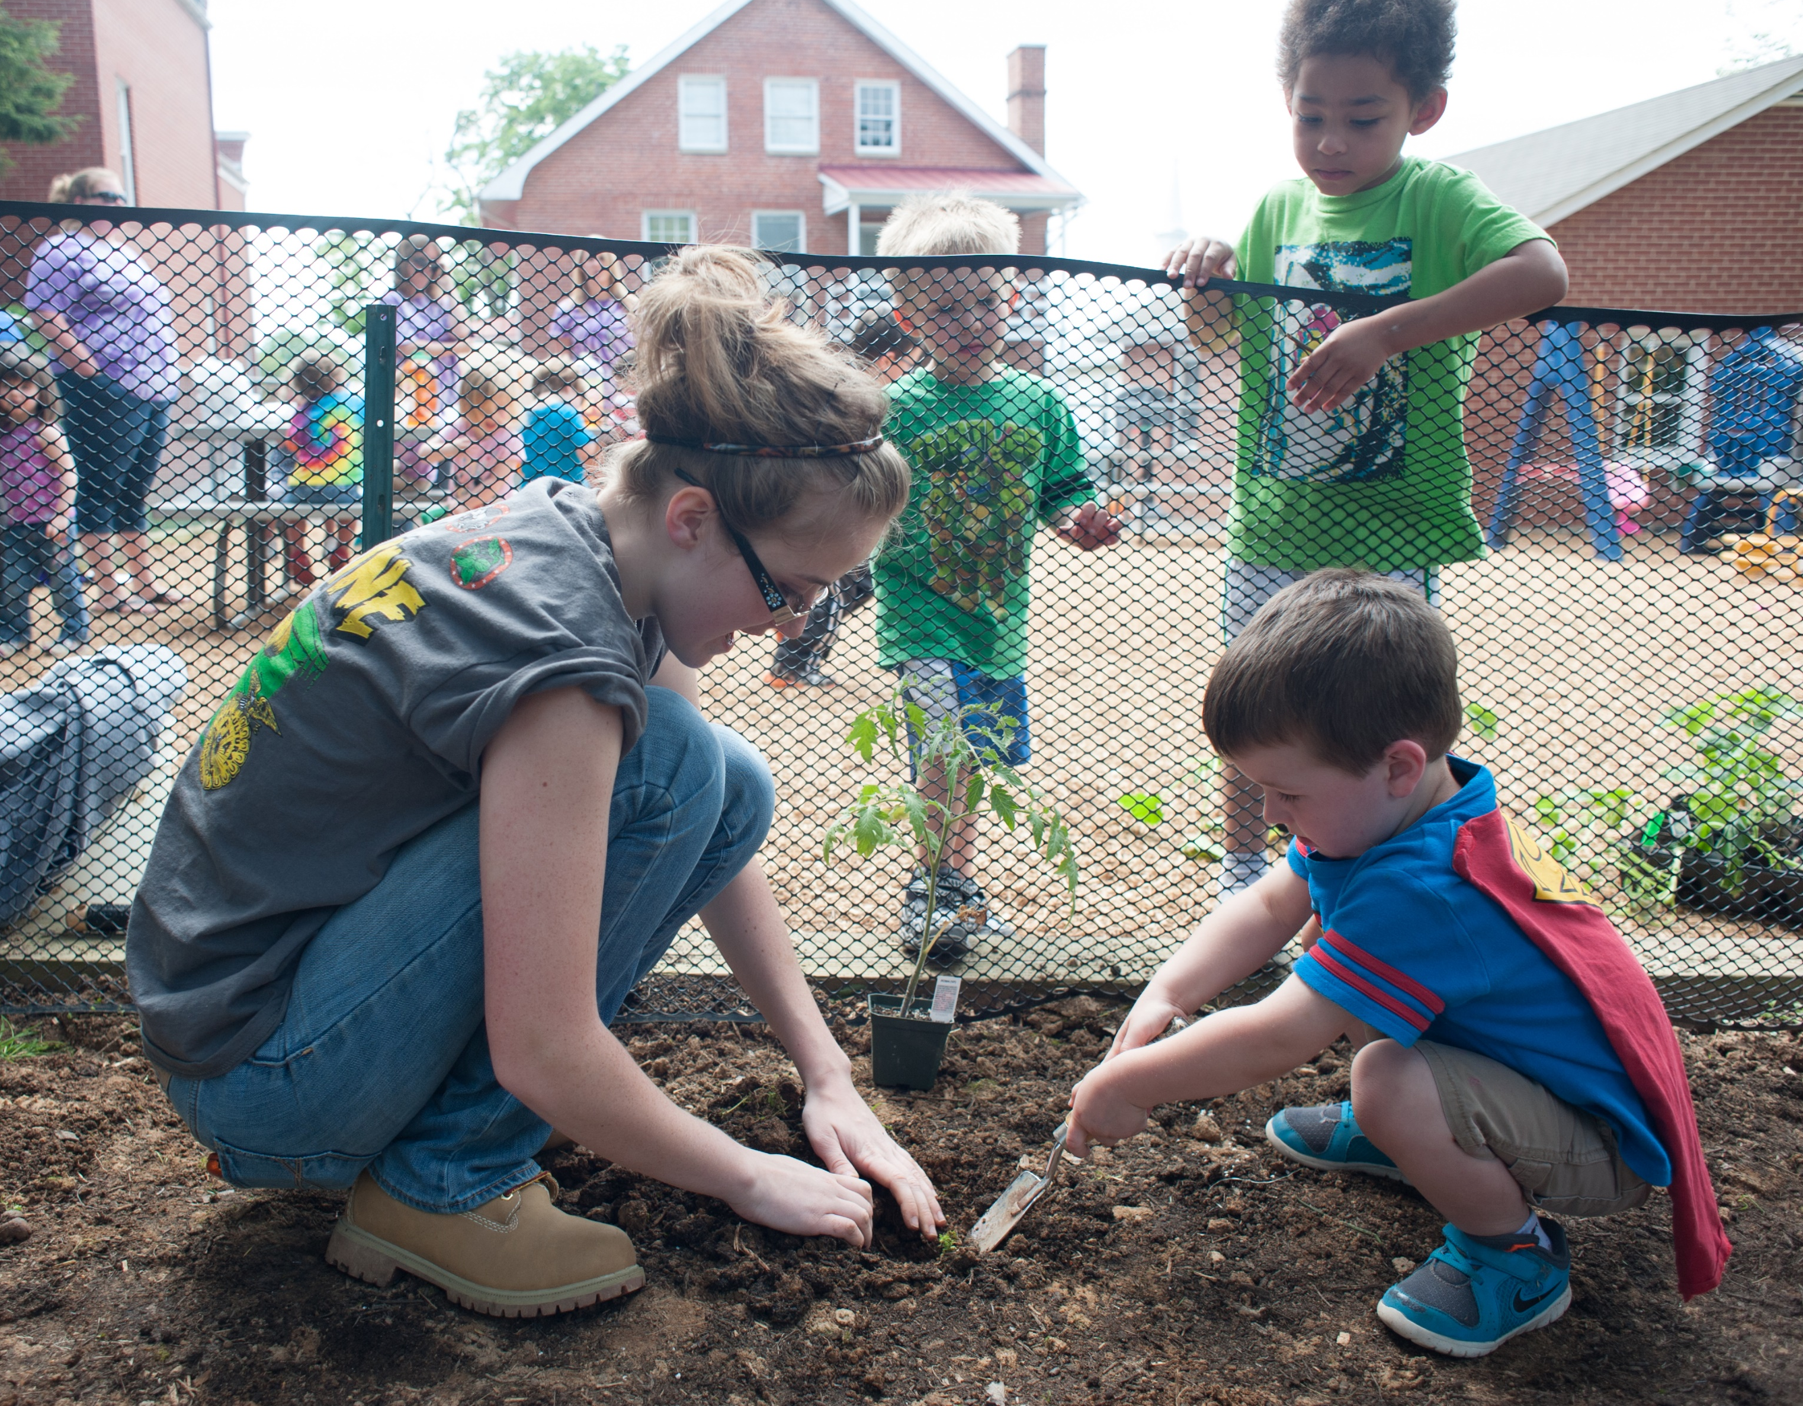
Immersion SAE
Service-Learning SAE
Plan, conduct and evaluate projects to provide a service to your school, a public entity or the community as a whole.
Keep good records of your plans, budget, income, expenses, time, skills learned and outcomes achieved.
  Plan, create and run a community garden.
  Make plans to improve the local park.
  Conduct a gleaning operation with a local food pantry and producer.

Slide 12
Part 2:
Agriscience Fair

Slide 13
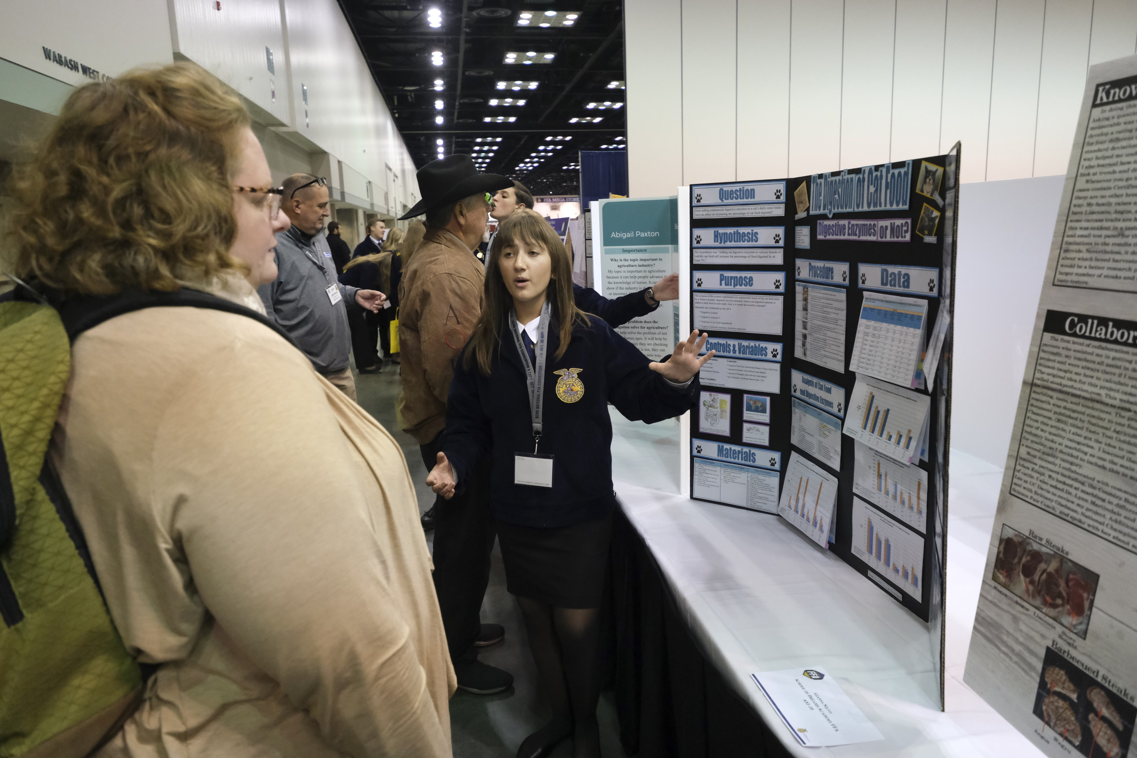
Agriscience Fair
The National FFA Agriscience Fair recognizes student researchers studying the application of agricultural scientific principles and emerging technologies in agricultural enterprises.
Provides middle and high school students the opportunity to achieve local, state and national recognition for their accomplishments in agriscience

Slide 14
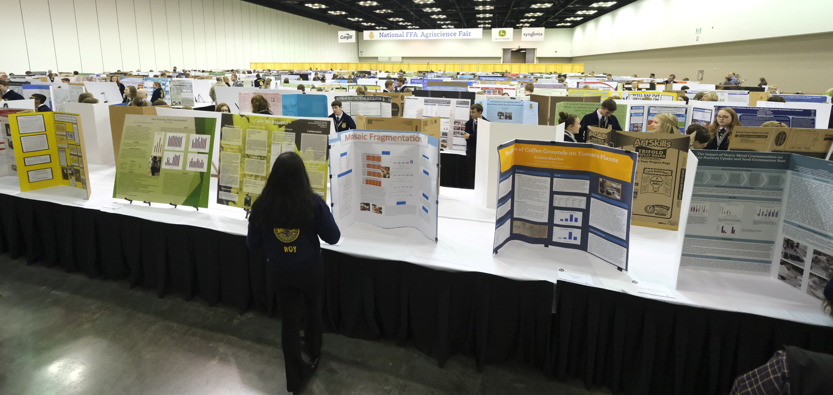
Agriscience Fair
Selecting a topic and developing a project:
Consider your ongoing SAE as a good place to begin.
Experimental SAE activities can provide valuable learning experiences for students with agriscience-related career goals.

Slide 15
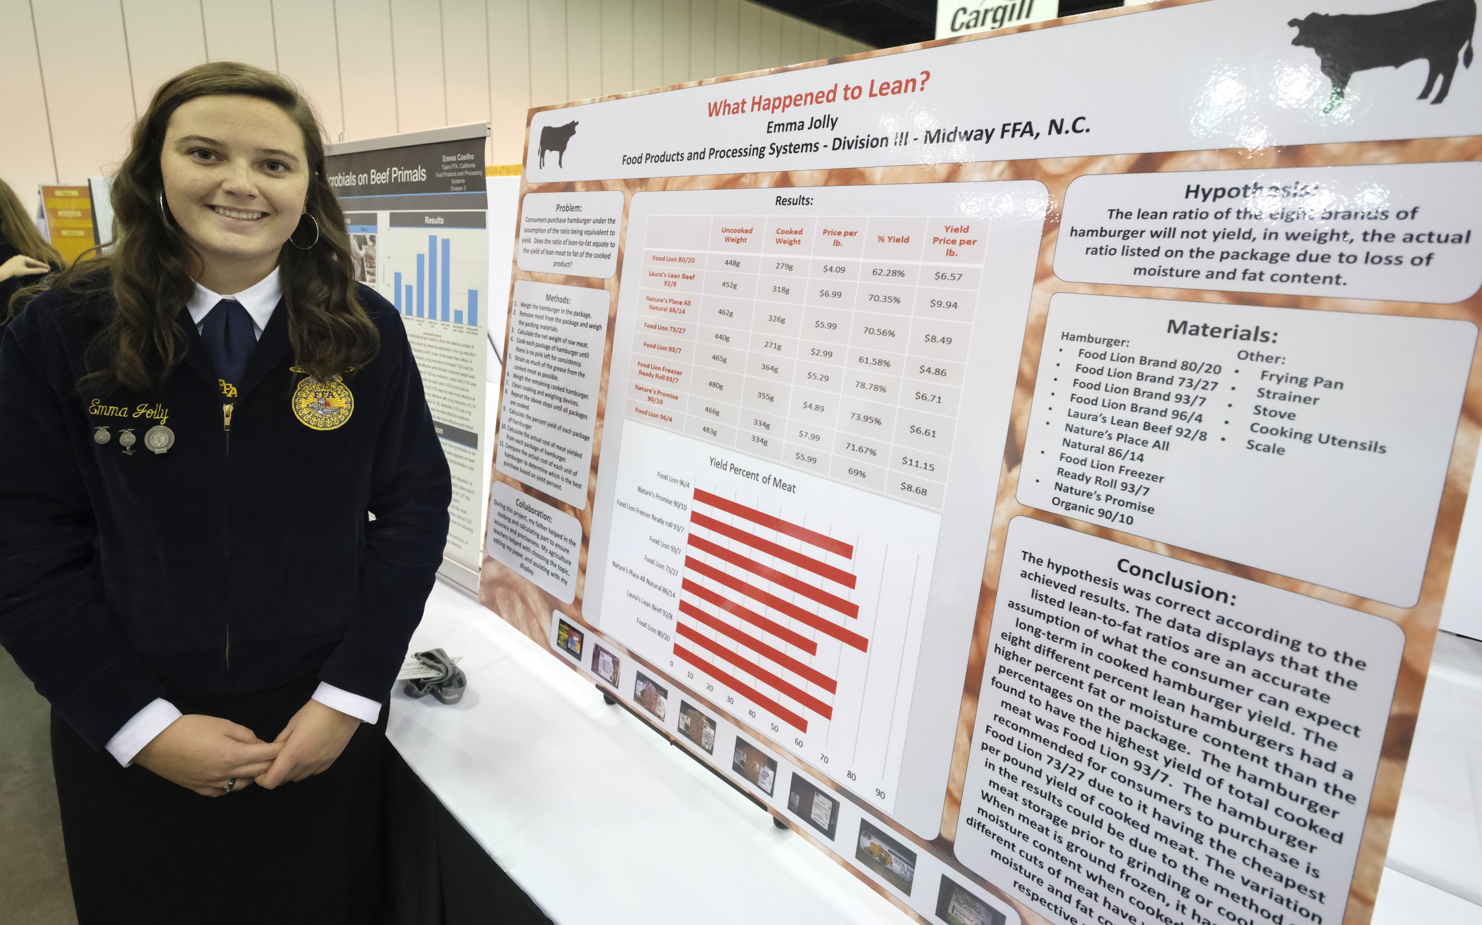
Agriscience Fair
Developing a quality agriscience project includes and requires
Focusing on an important agricultural issue, question or principle.
Specific research objectives.
Using a number of steps.
Following a scientific process to collect and analyze data.
Student commitment to a moderate or substantial amount of time
Teacher supervision

Slide 16
Part 3:
Proficiencies

Slide 17
Proficiency Awards
Once your supervised agricultural experience is up and running, what comes next? Through the National FFA Agricultural Proficiency Awards program, you have the opportunity to earn recognition, and possibly even cash, based on your SAE!
Proficiency Award Types
Placement | Entrepreneurship | Combined | Research

Slide 18

SAE Ideas
Agribusiness Systems Career Pathway
Do public relations for a livestock show or youth agriculture group.
Work on your FFA chapter’s website.
Develop and sell unique sheep blankets.
Work for a local livestock sale barn.
Put on educational workshops at the zoo or farm.

Slide 19

SAE Ideas
Animal Systems Career Pathway
Raise and sell lambs, pigs and/or beef cattle or work for a producer.
Work at a local pet shop.
Give horseback riding lessons.
Work at a veterinary clinic.
Raise and sell rabbits for meat or as pets.

Slide 20

SAE Ideas
Biotechnology Systems Career Pathway
Create a biodiesel-blend fuel from soybean oil.
Train and travel with a bovine embryologist and assist with embryo transfers.
Hybridize irises; breed broken color irises and variegated foliage irises.
Sell feed supplements for show livestock.

Slide 21

SAE Ideas
Environmental Service Systems Career Pathway
Conduct a shoreline preservation, tree planting and habitat improvement project.
Build shelters, install water sources and provide food plots to improve habitat of deer, quail and turkeys.
Work to conserve and preserve endangered sea turtles and their habitat.

Slide 22

SAE Ideas
Food Products and Processing Systems Career Pathway
Work in a meat processing plant.
Make jams and market them during county fairs.
Make lip gloss from soybean oil, aloe vera, witch hazel or beeswax, and sell it at craft shows and online.
Make new kinds of jerky, sausage and other meat products.

Slide 23

SAE Ideas
Natural Resources Systems Career Pathway
Improve and maintain wildlife habitat.
Sell firewood.
Raise chukars, pheasants and quail; sell eggs or the birds to place into local habitat areas.
Guide tourists on horseback trips into wilderness areas.
Start a whitetail-deer breeding business.

Slide 24

SAE Ideas
Plant Systems Career Pathway
Work at a florist shop.
Cash-rent and crop-share part of a farm.
Run a pick-your-own berry patch, orchard or garden.
Grow and market Easter lilies and poinsettias at the school greenhouse.
Work for a golf course — mowing, reseeding, spraying weeds, helping with the water systems and landscaping.

Slide 25

SAE Ideas
Power, Structural and Technical Systems Career Pathway
Design and fabricate new agricultural equipment.
Open a welding and repair shop.
Work in a mechanic shop.
Help build livestock barns and livestock pens.
Help add on to your home and do improvement projects to landscaping, patio or driveway.

Slide 26
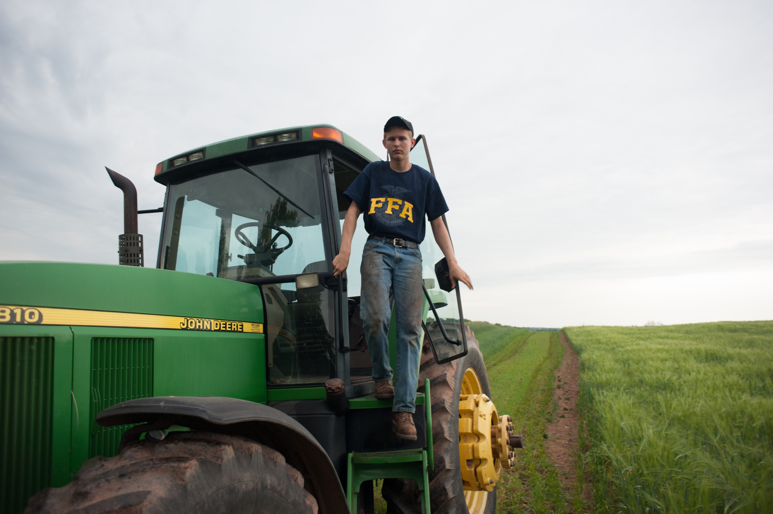
Star Awards at the Chapter Level
Star Greenhand
Given to the most active first-year member with a strong SAE and demonstrating a high level of leadership
Chapter Star Farmer
Given to a chapter member with an outstanding ownership/entrepreneurship SAE in production agriculture and demonstrates the most involvement in all areas of the chapter’s activities

Slide 27
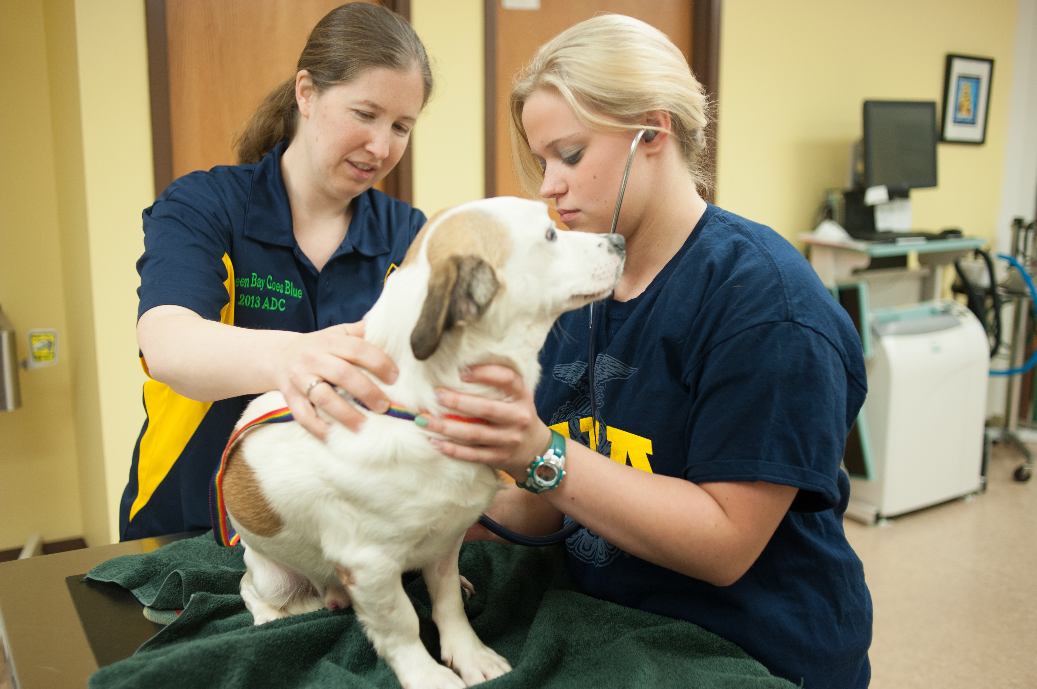
Star Awards at the Chapter Level
Chapter Star in Agribusiness
Given to a chapter member who has earned their chapter degree, with an outstanding nonproduction ownership/entrepreneurship SAE in agriculture and demonstrates the most involvement in all areas of the chapter’s activities
Chapter Star in Agriscience
Given to a chapter member who has earned their chapter degree, with an outstanding agriscience research-based SAE and is actively involved in all areas of the chapter
Chapter Star in Agricultural Placement
Given to a chapter member who has earned their chapter degree, with an outstanding placement SAE in agribusiness or production agriculture and is actively involved in all areas of the chapter

Slide 28
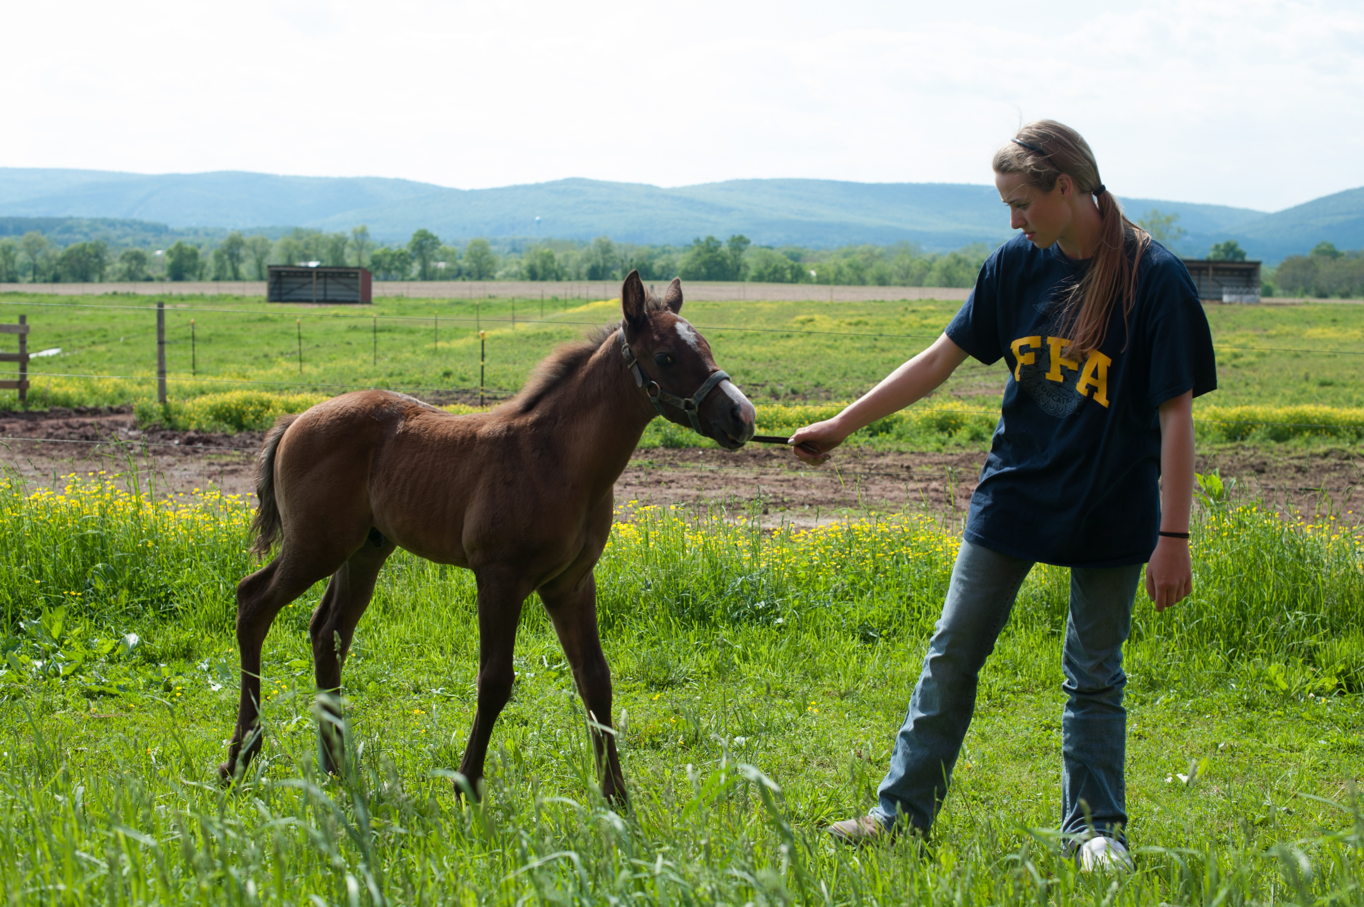
Star Awards at the State Level
State Star Farmer
Awarded at the state level to one FFA member with an outstanding achievement in their production-agriculture SAE and active participation in FFA
(selected from the top applicants for the State FFA Degree)
State Star in Agribusiness
Awarded at the state level to one FFA member with an outstanding achievement in their nonproduction agribusiness SAE and active participation in FFA
(selected from the top applicants for the State FFA Degree)

Slide 29
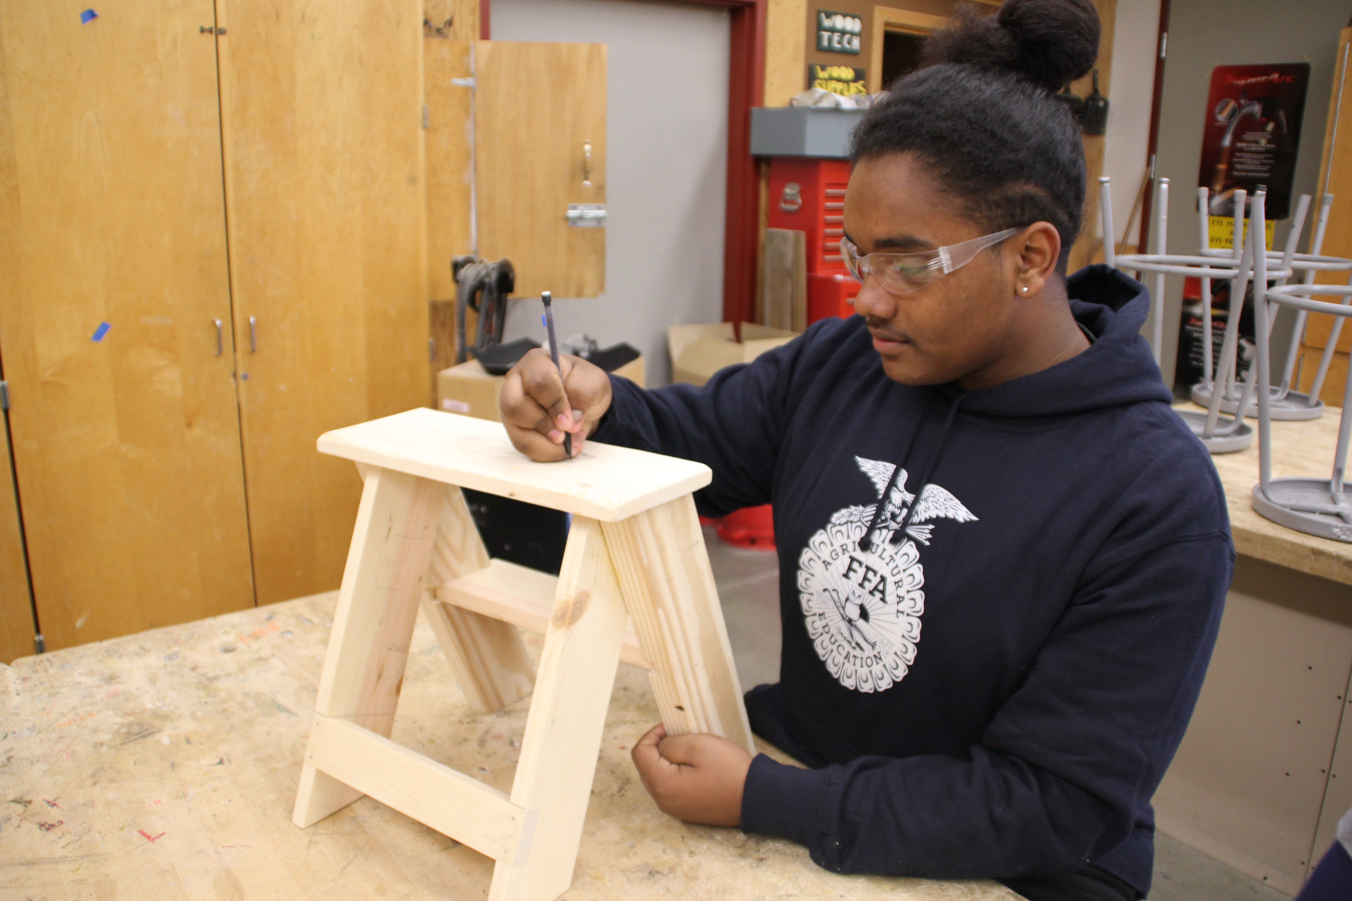
Star Awards at the State Level
State Star in Agricultural Placement
Awarded at the state level to one FFA member with an outstanding agricultural placement SAE and active participation in FFA
(selected from the top applicants for the State FFA Degree)
State Star in Agriscience
Awarded at the state level to one FFA member with an outstanding agriscience SAE and active participation in FFA
(selected from the top applicants for the State FFA Degree)

Slide 30
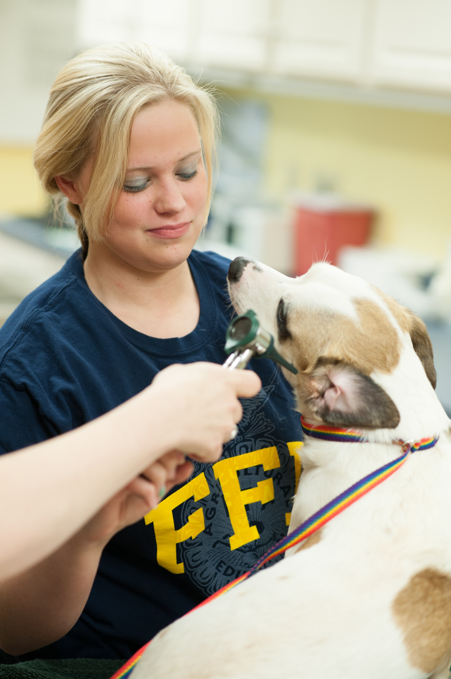
Star Awards at the National Level
American Star Farmer
Considered the highest recognition in the nation for an aspiring young farmer; awarded to the FFA member with the top production-agriculture SAE in the nation; recognized for the member’s achievement in career and leadership development; selected from four national finalists
American Star in Agribusiness
Considered the highest recognition in the nation for a member pursuing a career in agribusiness; awarded to the FFA member with the top nonproduction agribusiness SAE in the nation; recognized for career and leadership development; selected from four national finalists

Slide 31
Star Awards at the National Level
American Star in Agricultural Placement
Considered the highest recognition in the nation for a member excelling in placement in the industry of agriculture; awarded to the FFA member with the top agricultural placement SAE in the nation; recognized for the member’s achievement in career and leadership development; selected from four national finalists
American Star in Agriscience
Considered the highest recognition in the nation for a member involved in the field of agriscience; awarded to the FFA member with the top agriscience-based SAE in the nation; recognized for their career and leadership development; selected from four national finalists

Slide 32
Part 4:
Career and Leadership Development Events

Slide 33
What is a CDE/LDE?
Career development events (CDEs) and leadership development events (LDEs) help you learn skills to be successful in your future career.
These events build on what you learn in your agricultural education classes and FFA.
Practice making decisions and experience teamwork and competition.

Slide 34
Career Development Events
Agricultural Communications
Agricultural Sales
Agricultural Technology and Mechanical Systems
Agronomy
Dairy Cattle Evaluation and Management
Environmental and Natural Resources
Farm and Agribusiness Management
Floriculture
Food Science and Technology
Forestry
Horse Evaluation
Livestock Evaluation
Marketing Plan
Meats Evaluation and Technology
Milk Quality and Products
Nursery/Landscape
Poultry Evaluation
Veterinary Science

Slide 35
Leadership Development Events
Agricultural Issues Forum
Conduct of Chapter Meetings
Creed Speaking
Employment Skills
Extemporaneous Public Speaking
Parliamentary Procedure
Prepared Public Speaking

Slide 36

Career Development Events
Agricultural Communications
Work with a team to represent graphic designers, web designers, news-release and news writers and broadcasters; put together a communications proposal and presentation explaining how you will publicize an event or issue.
Agricultural Sales
Your team will be given a sales situation and a short amount of time to develop the necessary strategies to sell the product; each team member conducts a sales call to a panel of judges.

Slide 37
Career Development Events
Agricultural Technology and Mechanical Systems
Through a team activity, hands-on problem-solving project and a written exam, your team will be tested on your knowledge of a broad range of systems related to agricultural mechanics, from machinery and equipment systems to environmental/natural resource systems.
Agronomy
Your team will be agronomists and given a scenario of an agronomy situation. You will develop an oral presentation and a written plan that addresses the situation. Individual team members will determine crop quality and identify various weeds, crop plants, seeds and soils along with insects, plant diseases, nutrient deficiencies or disorders.

Slide 38
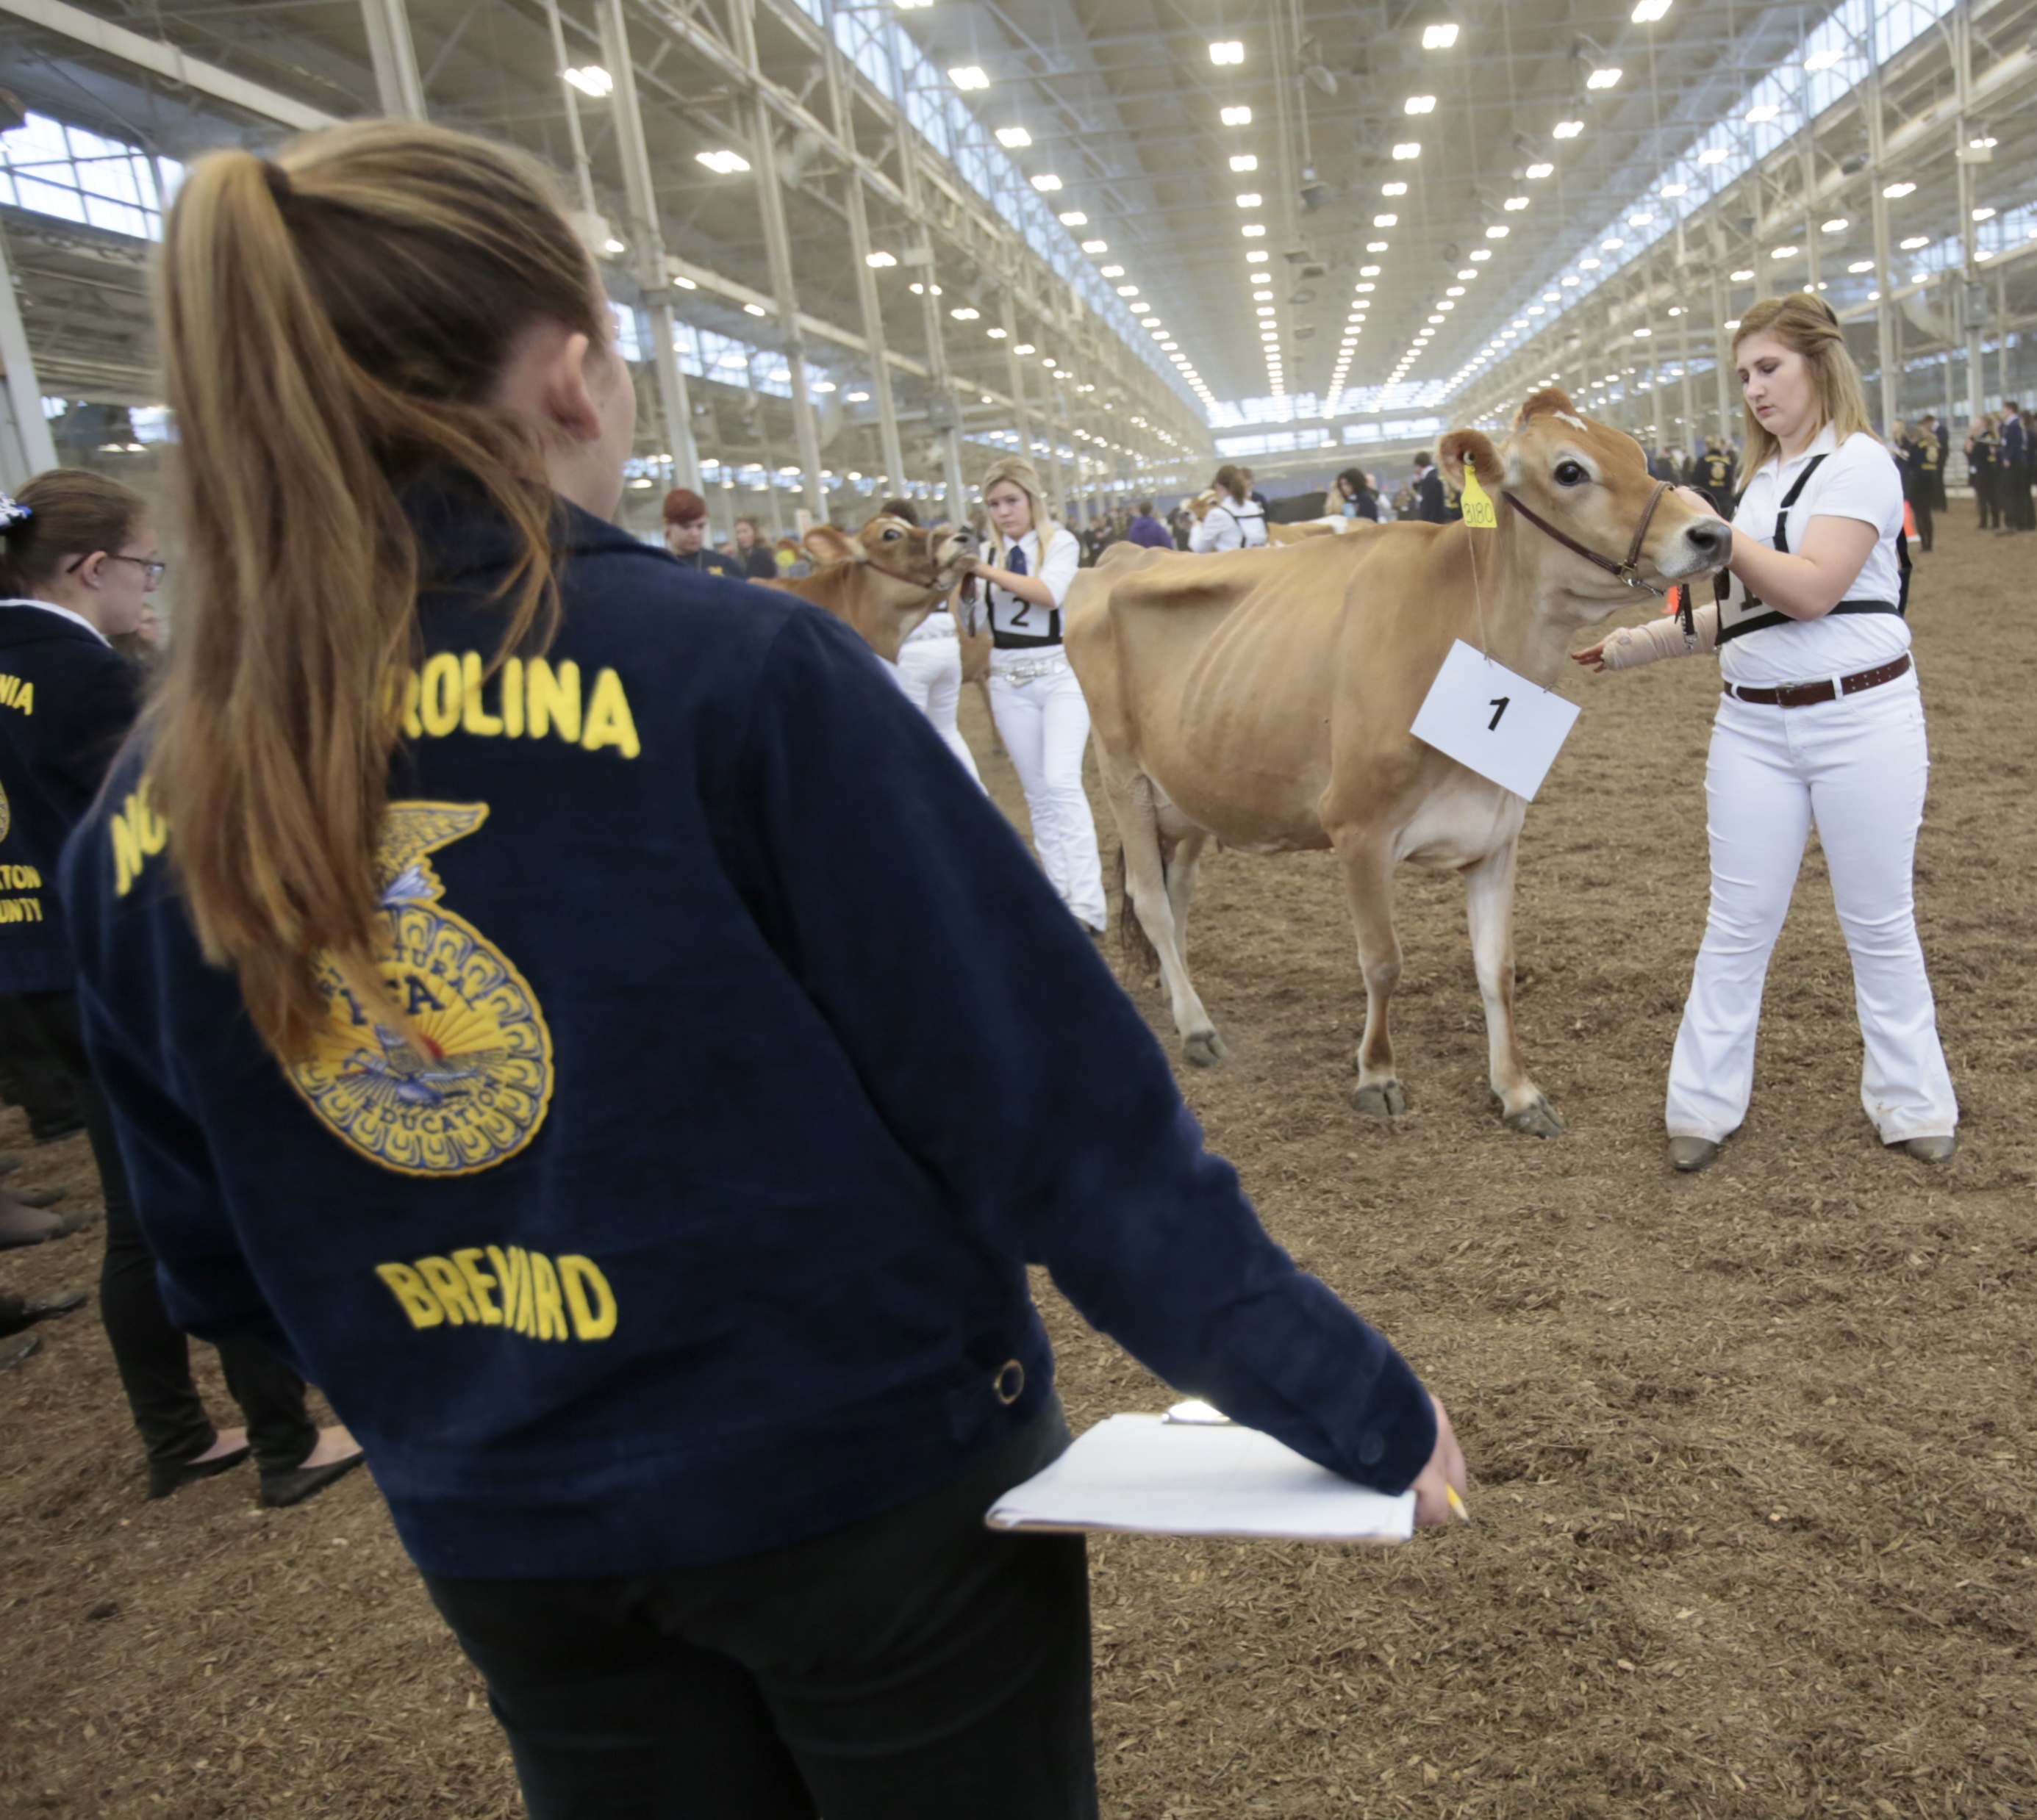
Career Development Events
Environmental and Natural Resources
Your team will be asked to develop written and oral presentations to solve a scenario that deals with an environmental or natural resource problem. Scenarios cover topics ranging from soils and water to ecosystems and waste management.
Dairy Cattle Evaluation and Management
This CDE tests your team’s knowledge of dairy cattle type, production records and herd management. You will be appraising pedigrees and herd records, doing management exercises, and evaluating live dairy cattle and defending your decisions orally.

Slide 39
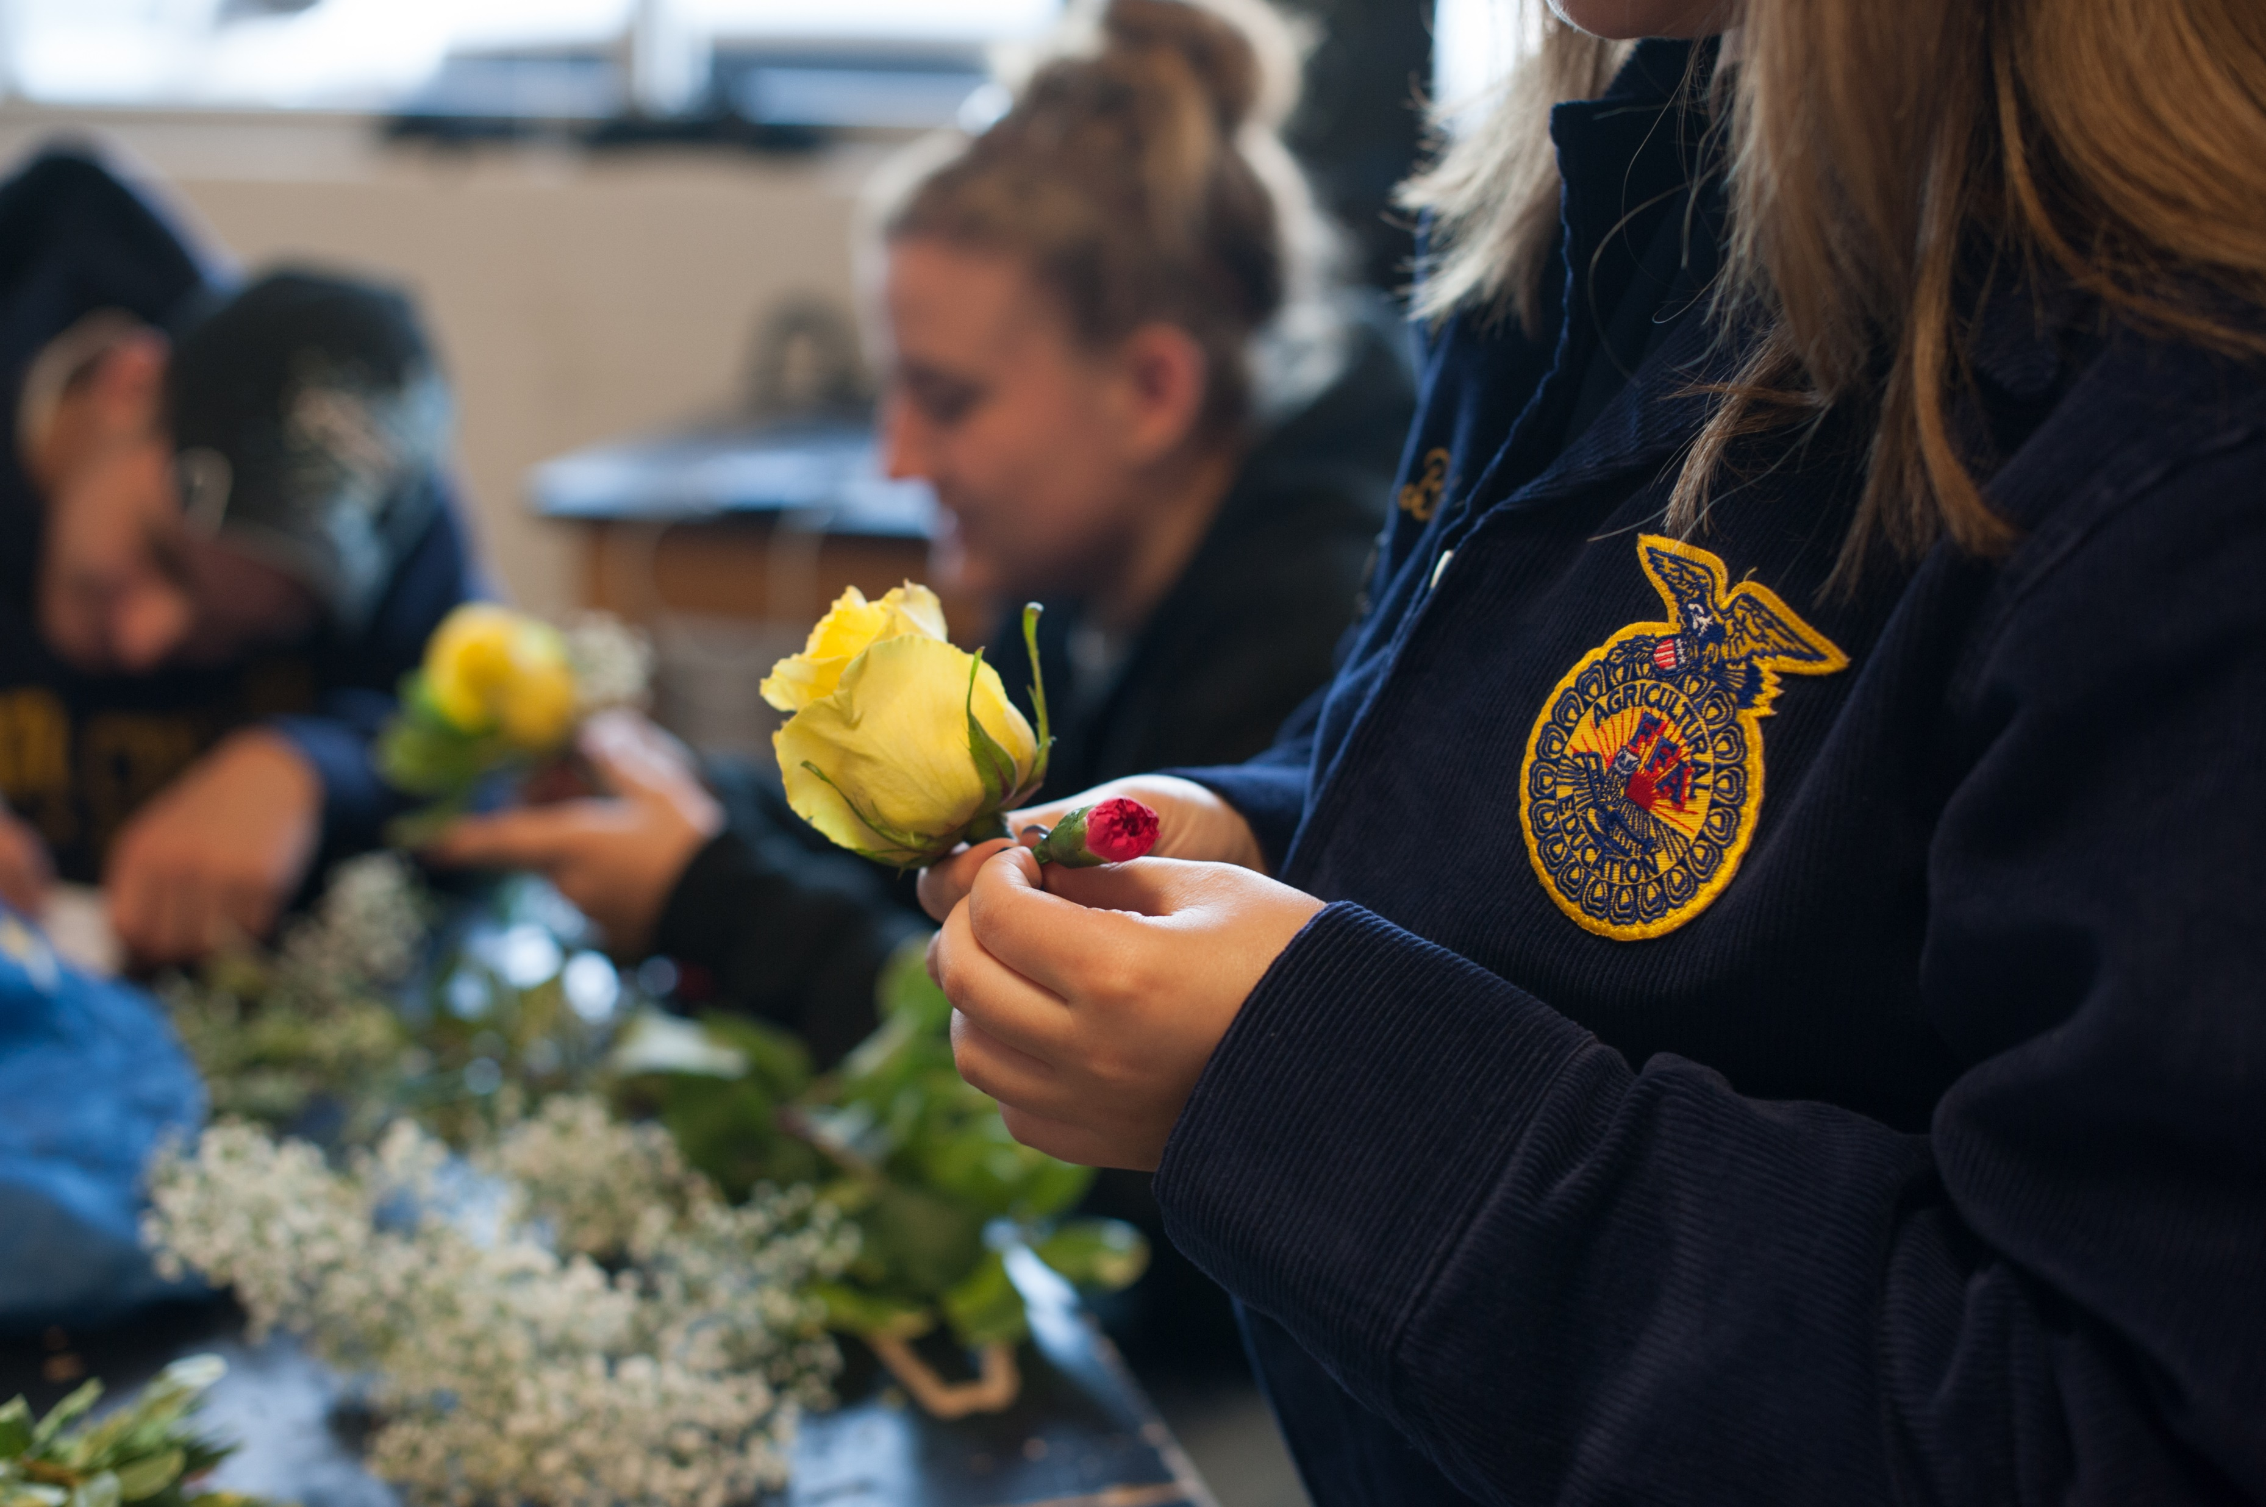
Career Development Events
Farm and Agribusiness Management
Your team will solve a business problem and take a written test on business principles. Your team is judged on your use of business management and economic principles, analysis of farm records and management resources and consideration given to risk management practices.
Floriculture
Your team will work together on projects such as making a floral decoration for an event, demonstrating the use of horticultural precuts or designing on location. Working individually, you will each complete a flower arrangement.

Slide 40
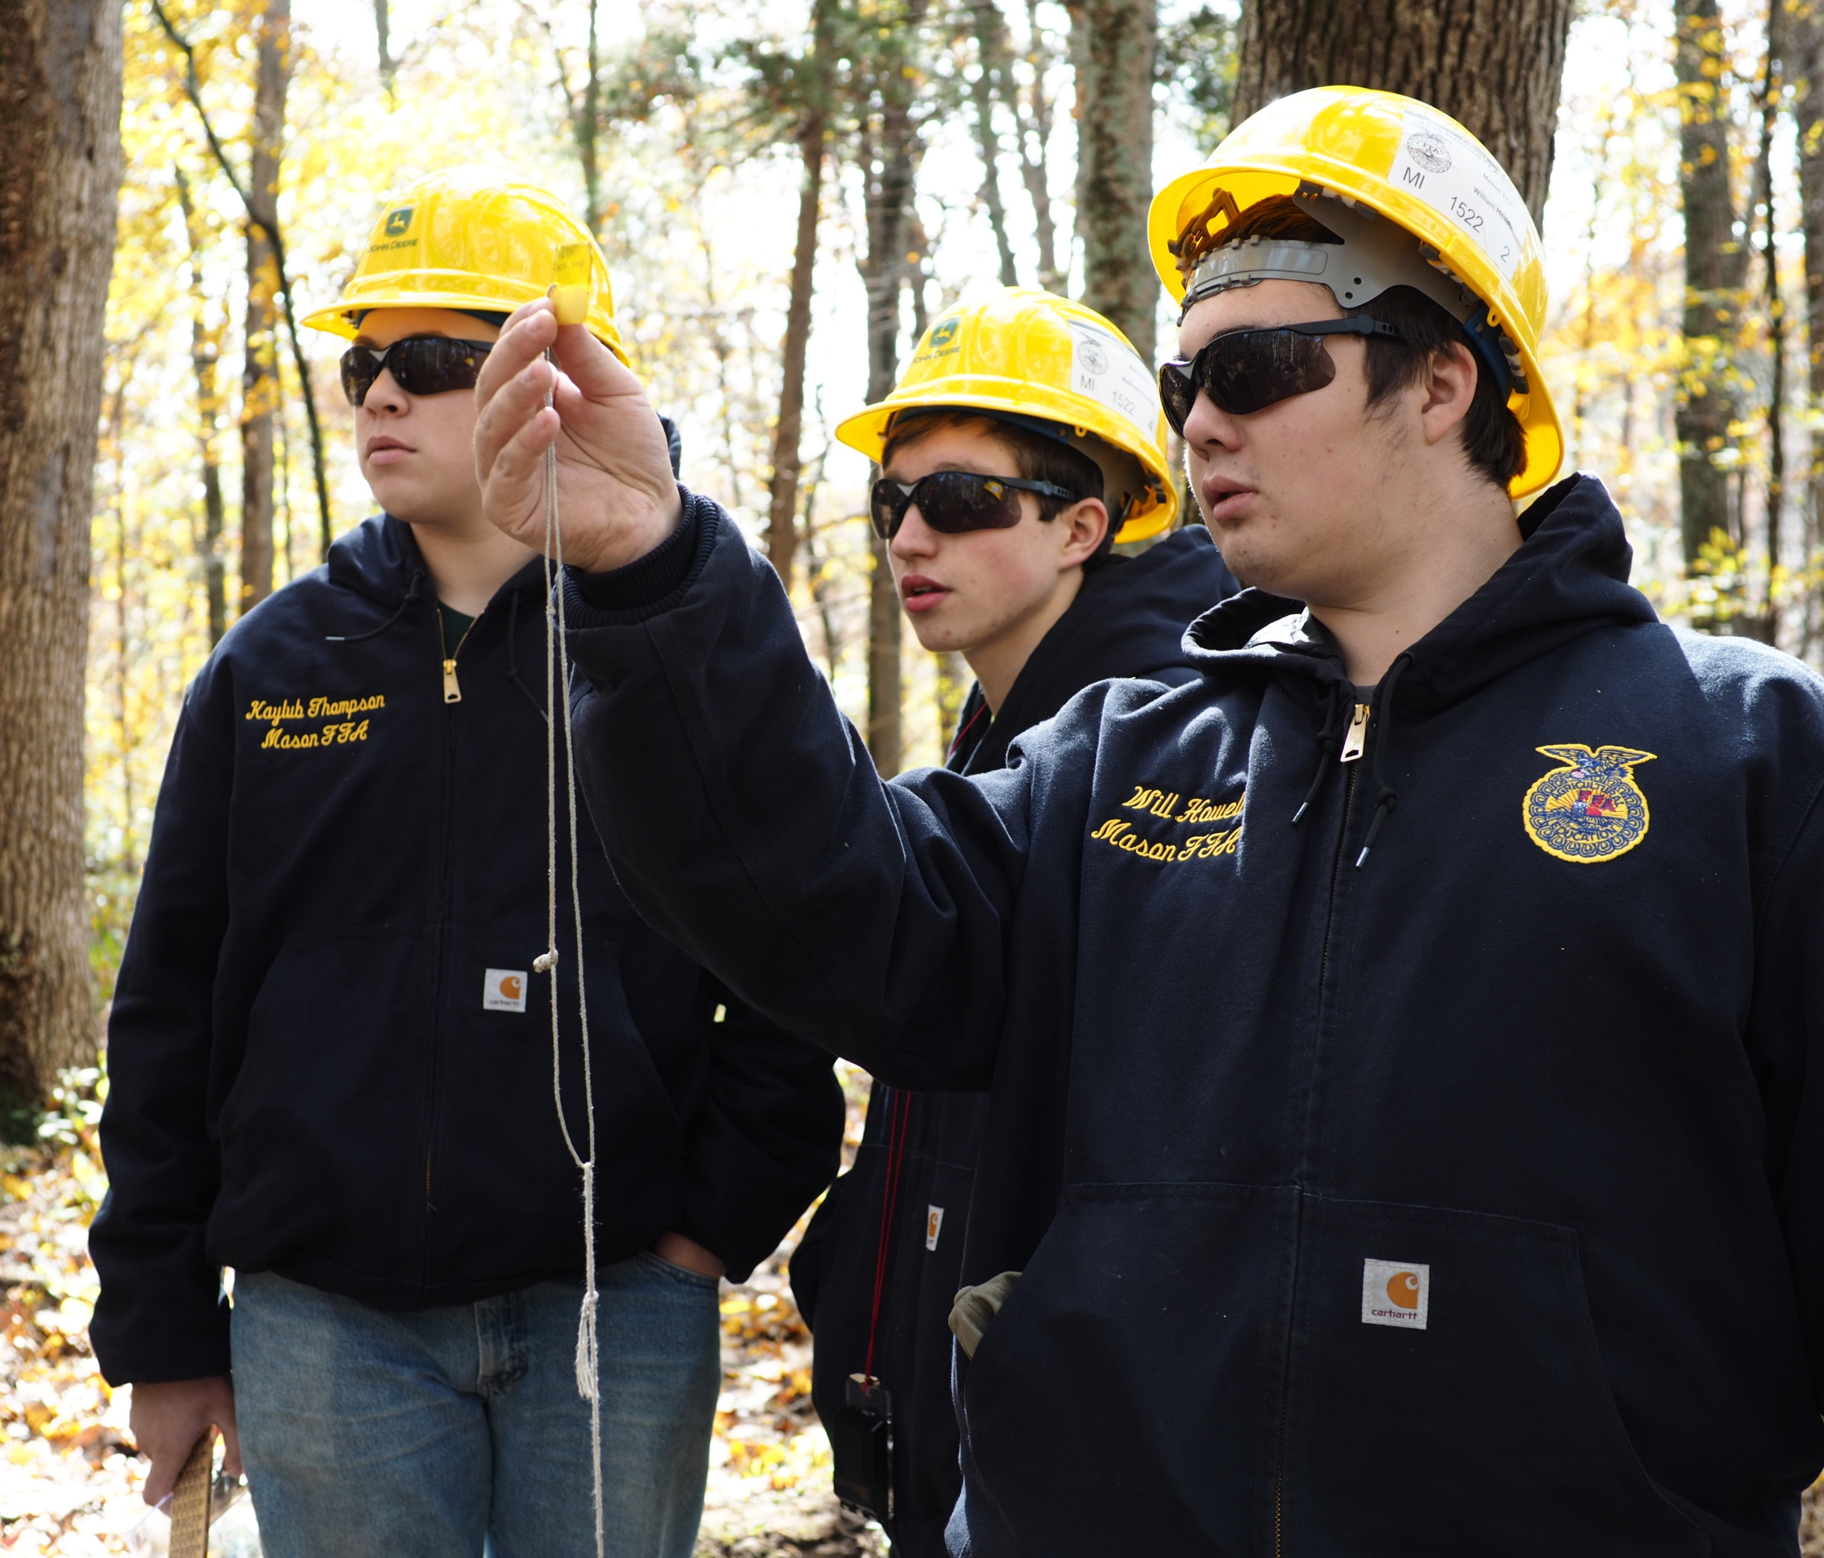
Career Development Events
Food Science and Technology
Your team will be asked to evaluate a marketing scenario describing a need for a new design or a redesign of a product. You will be evaluated on your understanding of the concepts of product formulation, package design, nutritional label development and implementation of quality control.
Forestry
Your team is expected to recognize environmental and social factors affecting the management of forests, identify species of trees, identify hand tools, understand silvicultural practices in the US, identify forest disorders, take forest inventory and recognize safety practices in forest management.

Slide 41
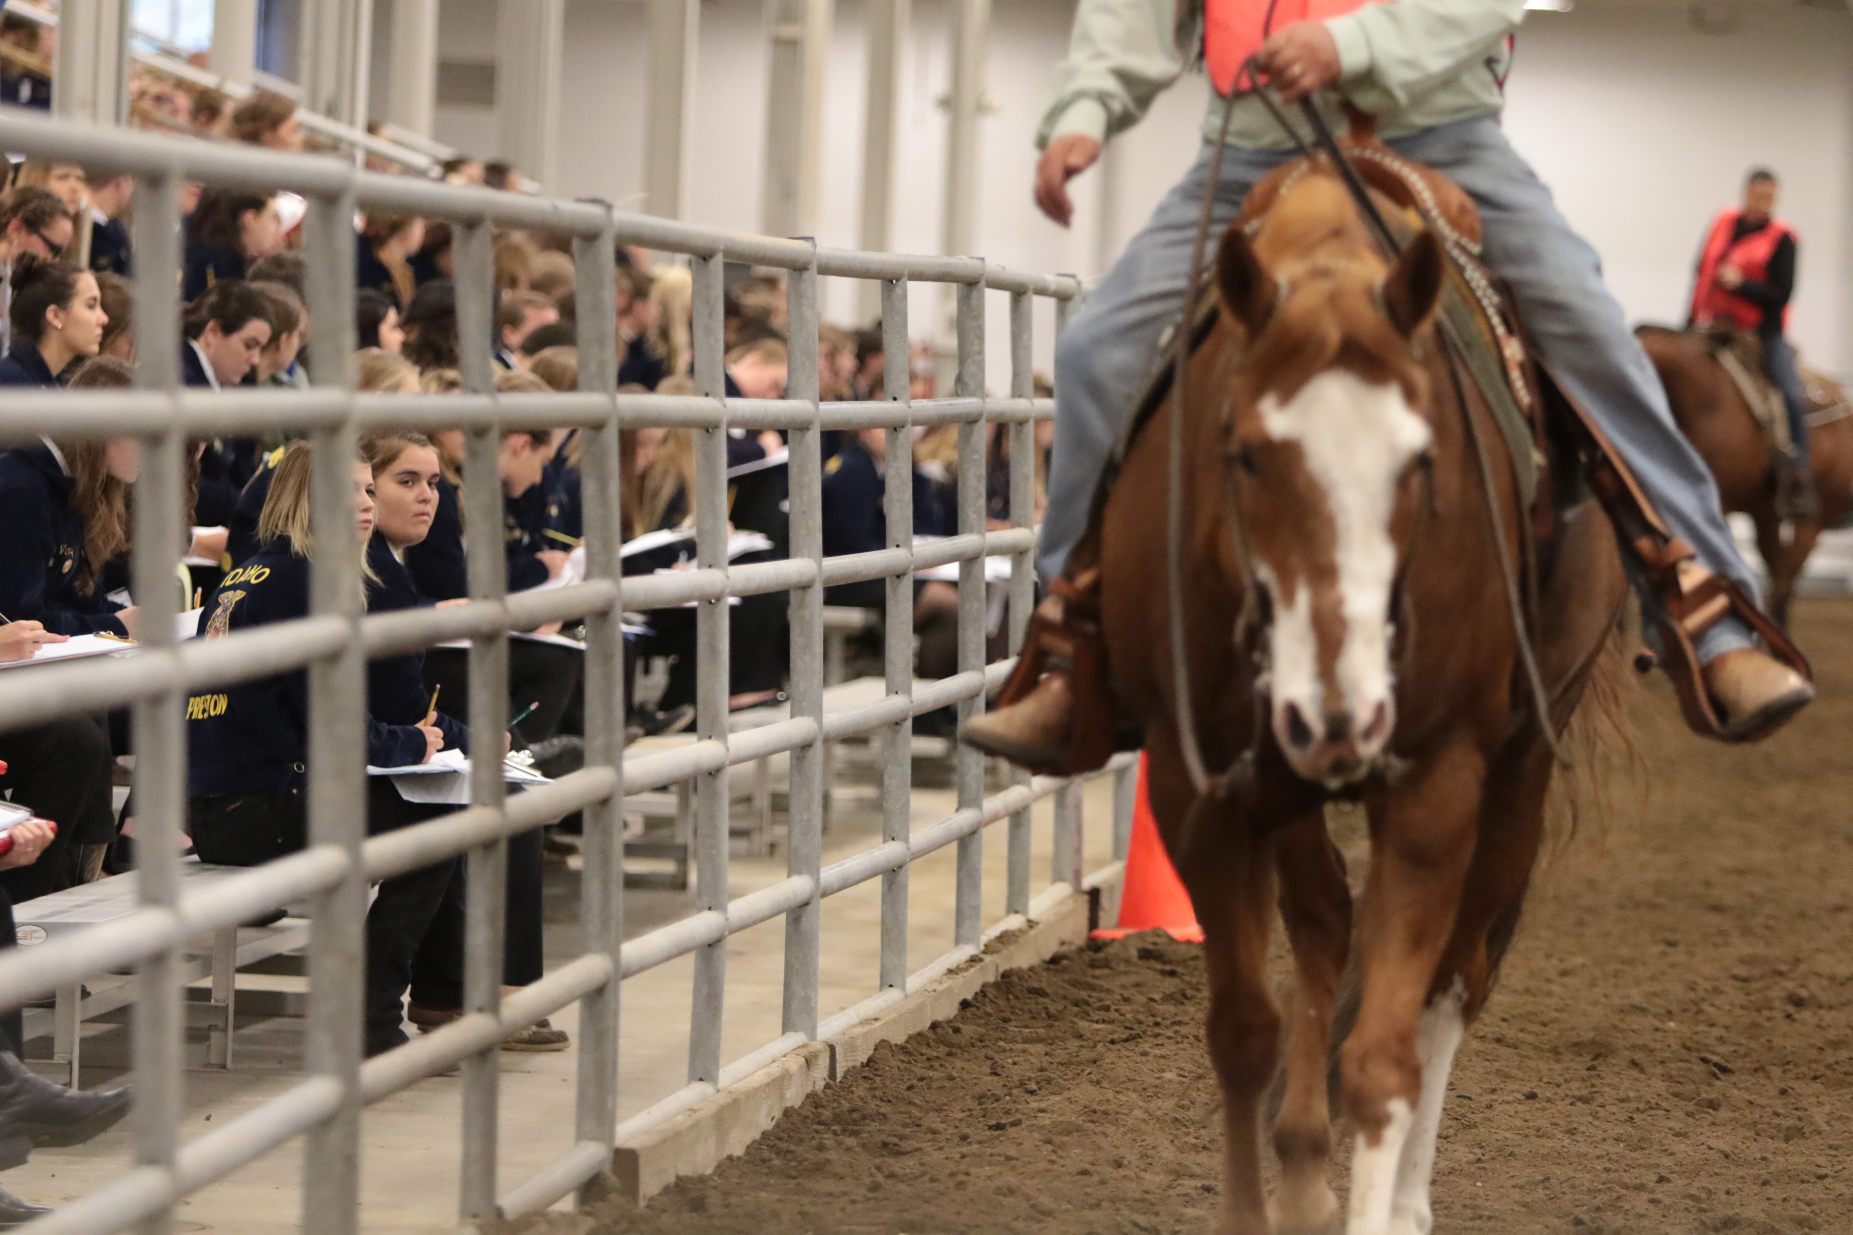
Career Development Events
Horse Evaluation
You team is tested on everything from your ability to problem-solve industry scenarios dealing with nutrition, management, reproduction and marketing to identification of breeds, tack/equipment, feed and horse anatomy. You then become the judge and defend your decisions through oral reasons.
Livestock Evaluation
Your team will rank breeding and market classes of beef, sheep, goats and swine. As in other evaluation CDEs, you will give oral reasons to back up your decisions.

Slide 42
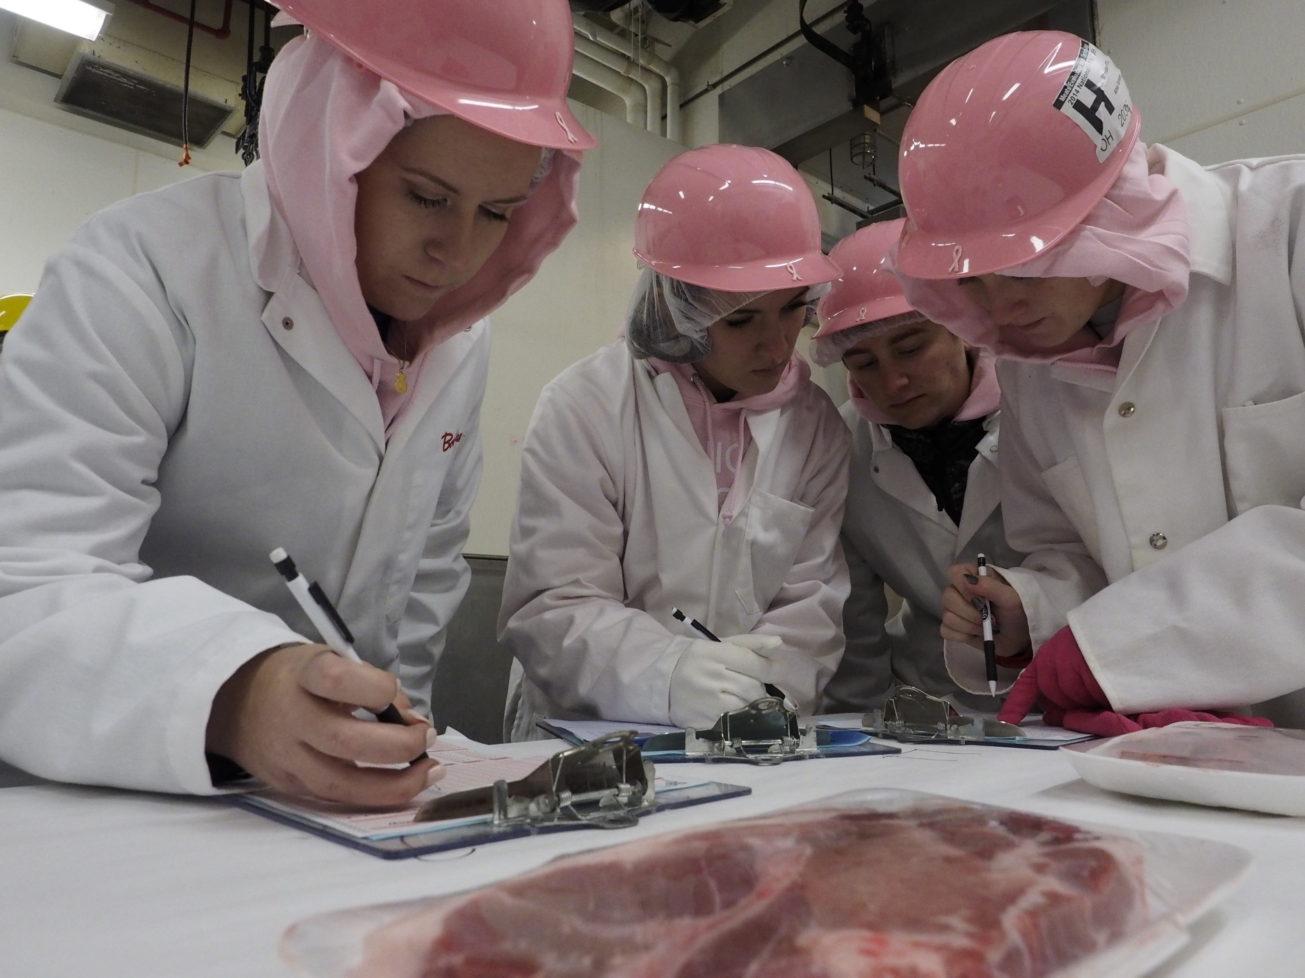
Career Development Events
Meats Evaluation and Technology
In this CDE, you will compare carcasses, retail cuts and wholesale cuts of meat, and you will see the meat industry through the eyes of a USDA inspector.
Marketing Plan
Like every business owner, you team will perform all the steps necessary to market a product or service, including developing a written marketing plan, analyzing this plan, making a business proposition, setting up strategies and an action plan, projecting a budget and evaluating your progress.

Slide 43

Career Development Events
Milk Quality and Products
Your team will use skills necessary for quality control, milk marketing and management of disease impacting milk quality. You will also identify cheese characteristics, real and artificial milk products and milk defects.
Nursery/Landscape
This CDE tests the knowledge that your team has about every angle of the industry — from identifying plant materials, plant disorders, supplies and equipment to your ability to demonstrate best practices in design and construction.

Slide 44
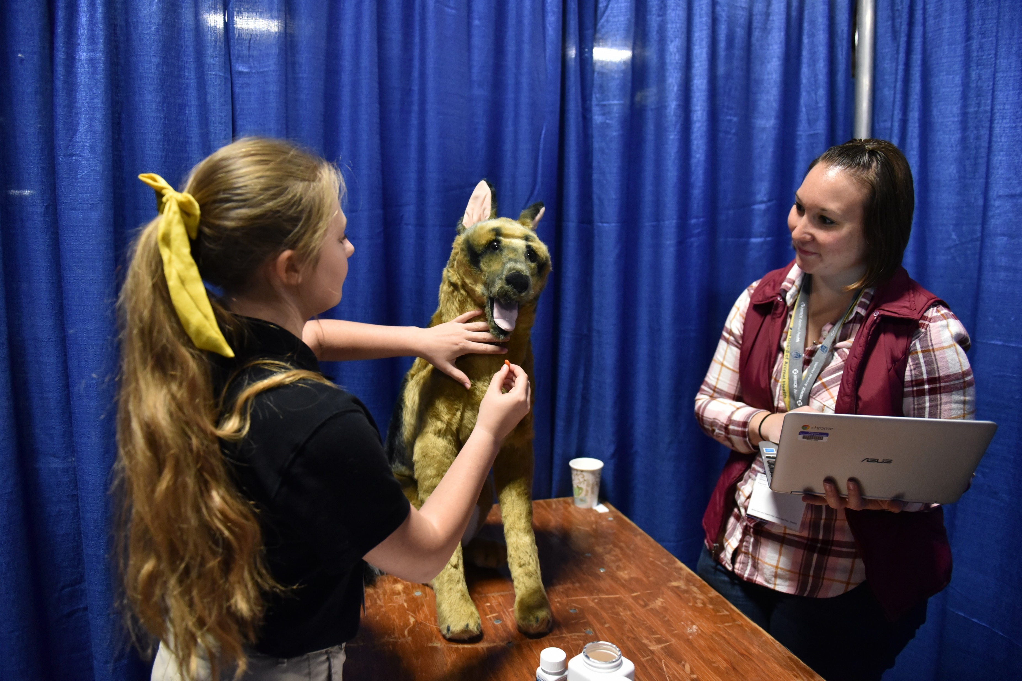
Career Development Events
Poultry Evaluation
Members will select live meat-type chickens for broiler breeding, evaluate and place live egg-type hens, and rate finished products by evaluating and grading ready-to-cook carcasses and parts of chickens and turkeys.
Veterinary Science
Teams demonstrate technical competency with small and large animals by completing a written exam, critical-thinking scenario questions, identifications and hands-on practicums.

Slide 45
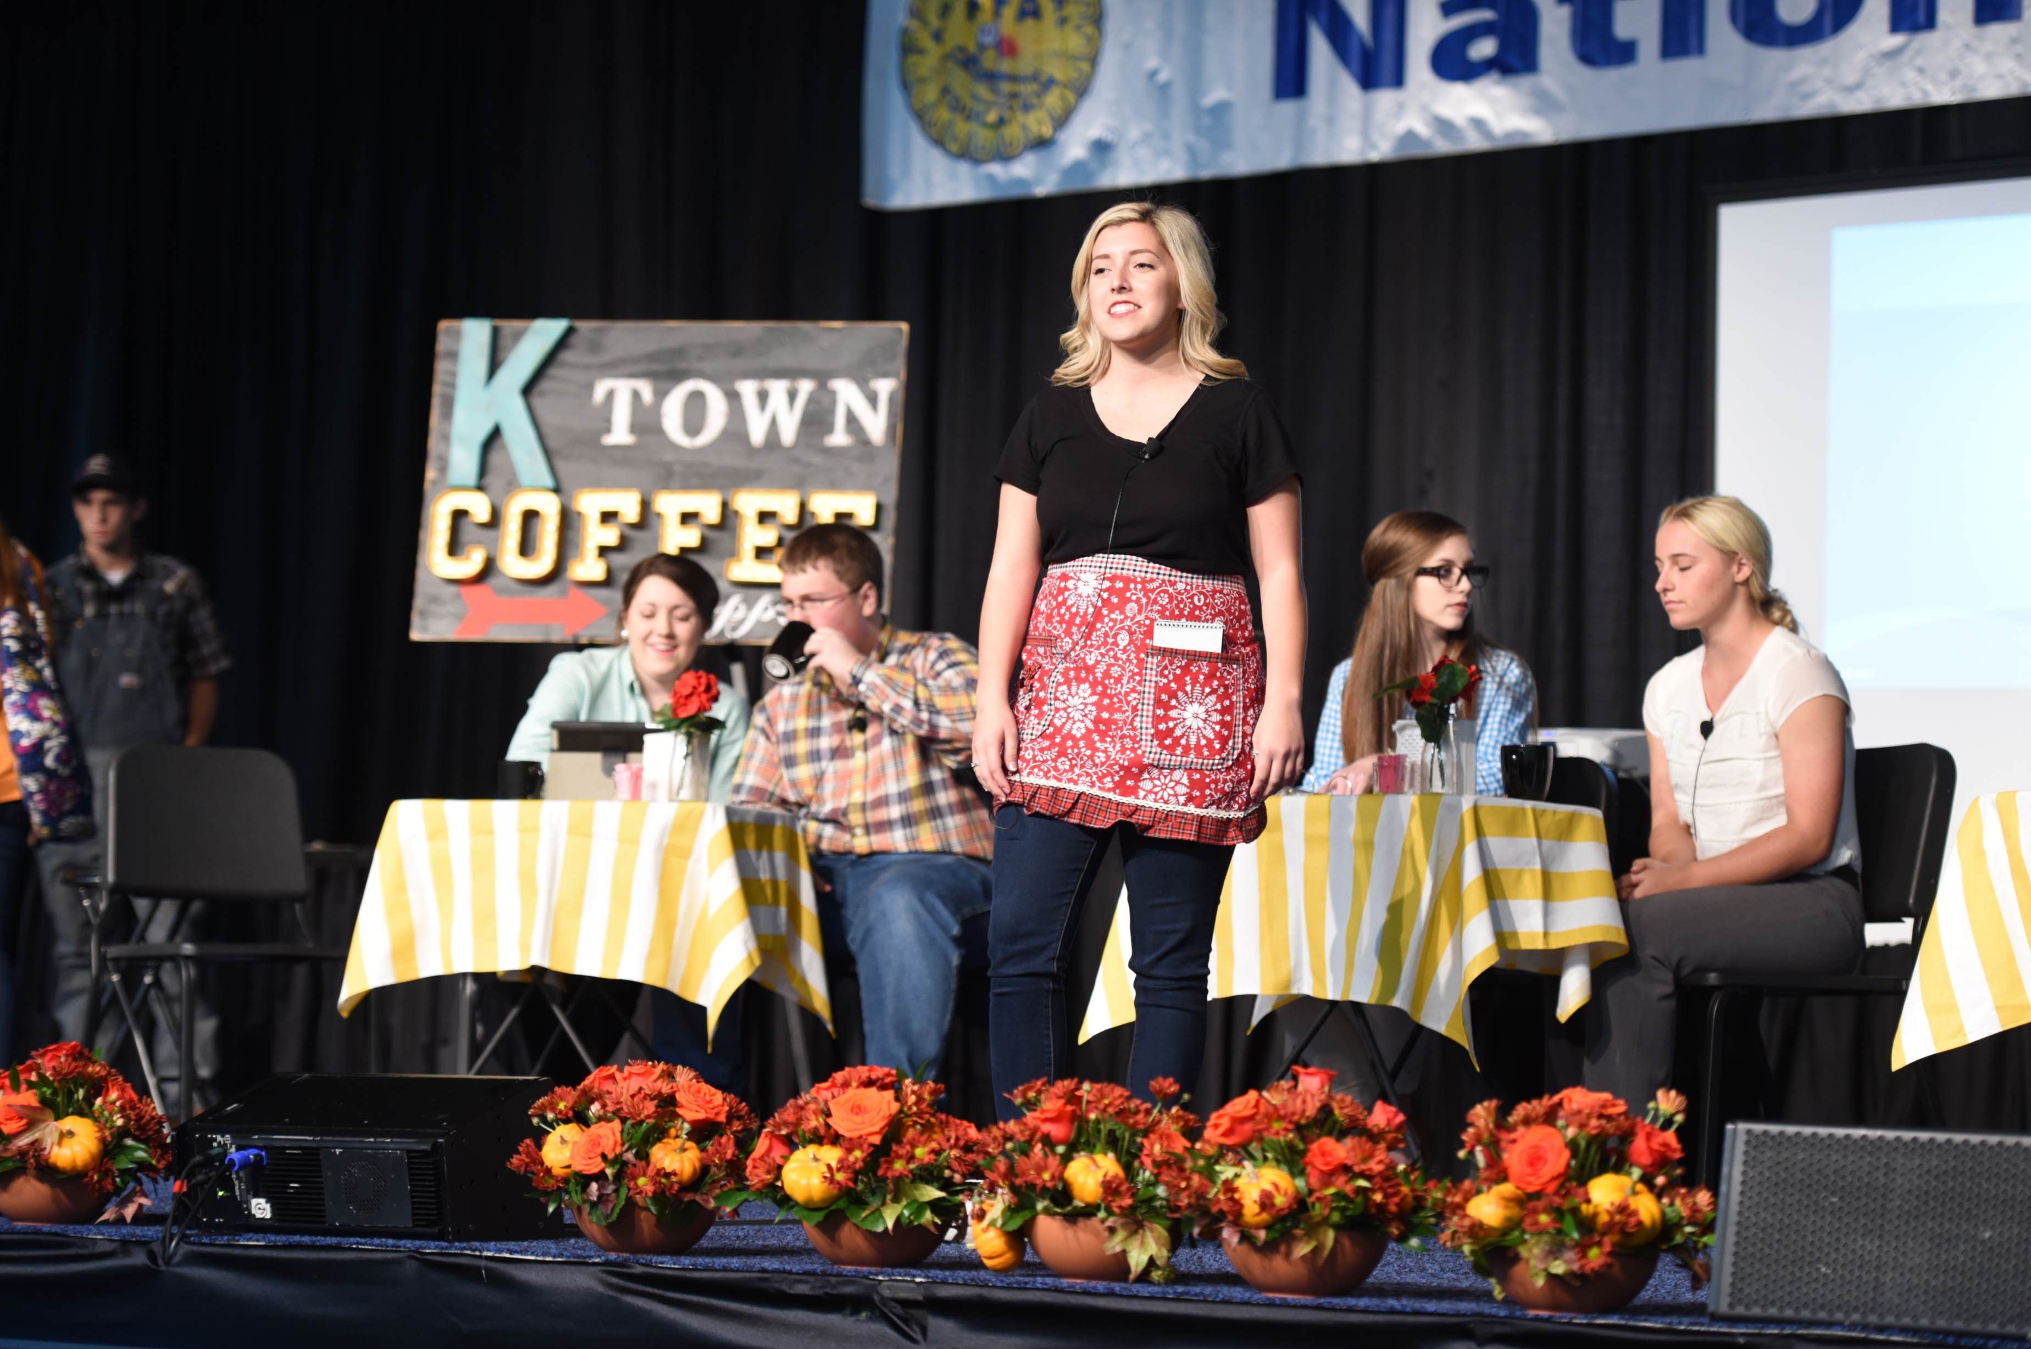
Leadership Development Events
Conduct of Chapter Meetings
Seventh-, eighth- and ninth-grade members are introduced to parliamentary procedure while learning to conduct efficient meetings.
Agricultural Issues Forum
This LDE challenges your team to present a topic of local interest or concern.

Slide 46
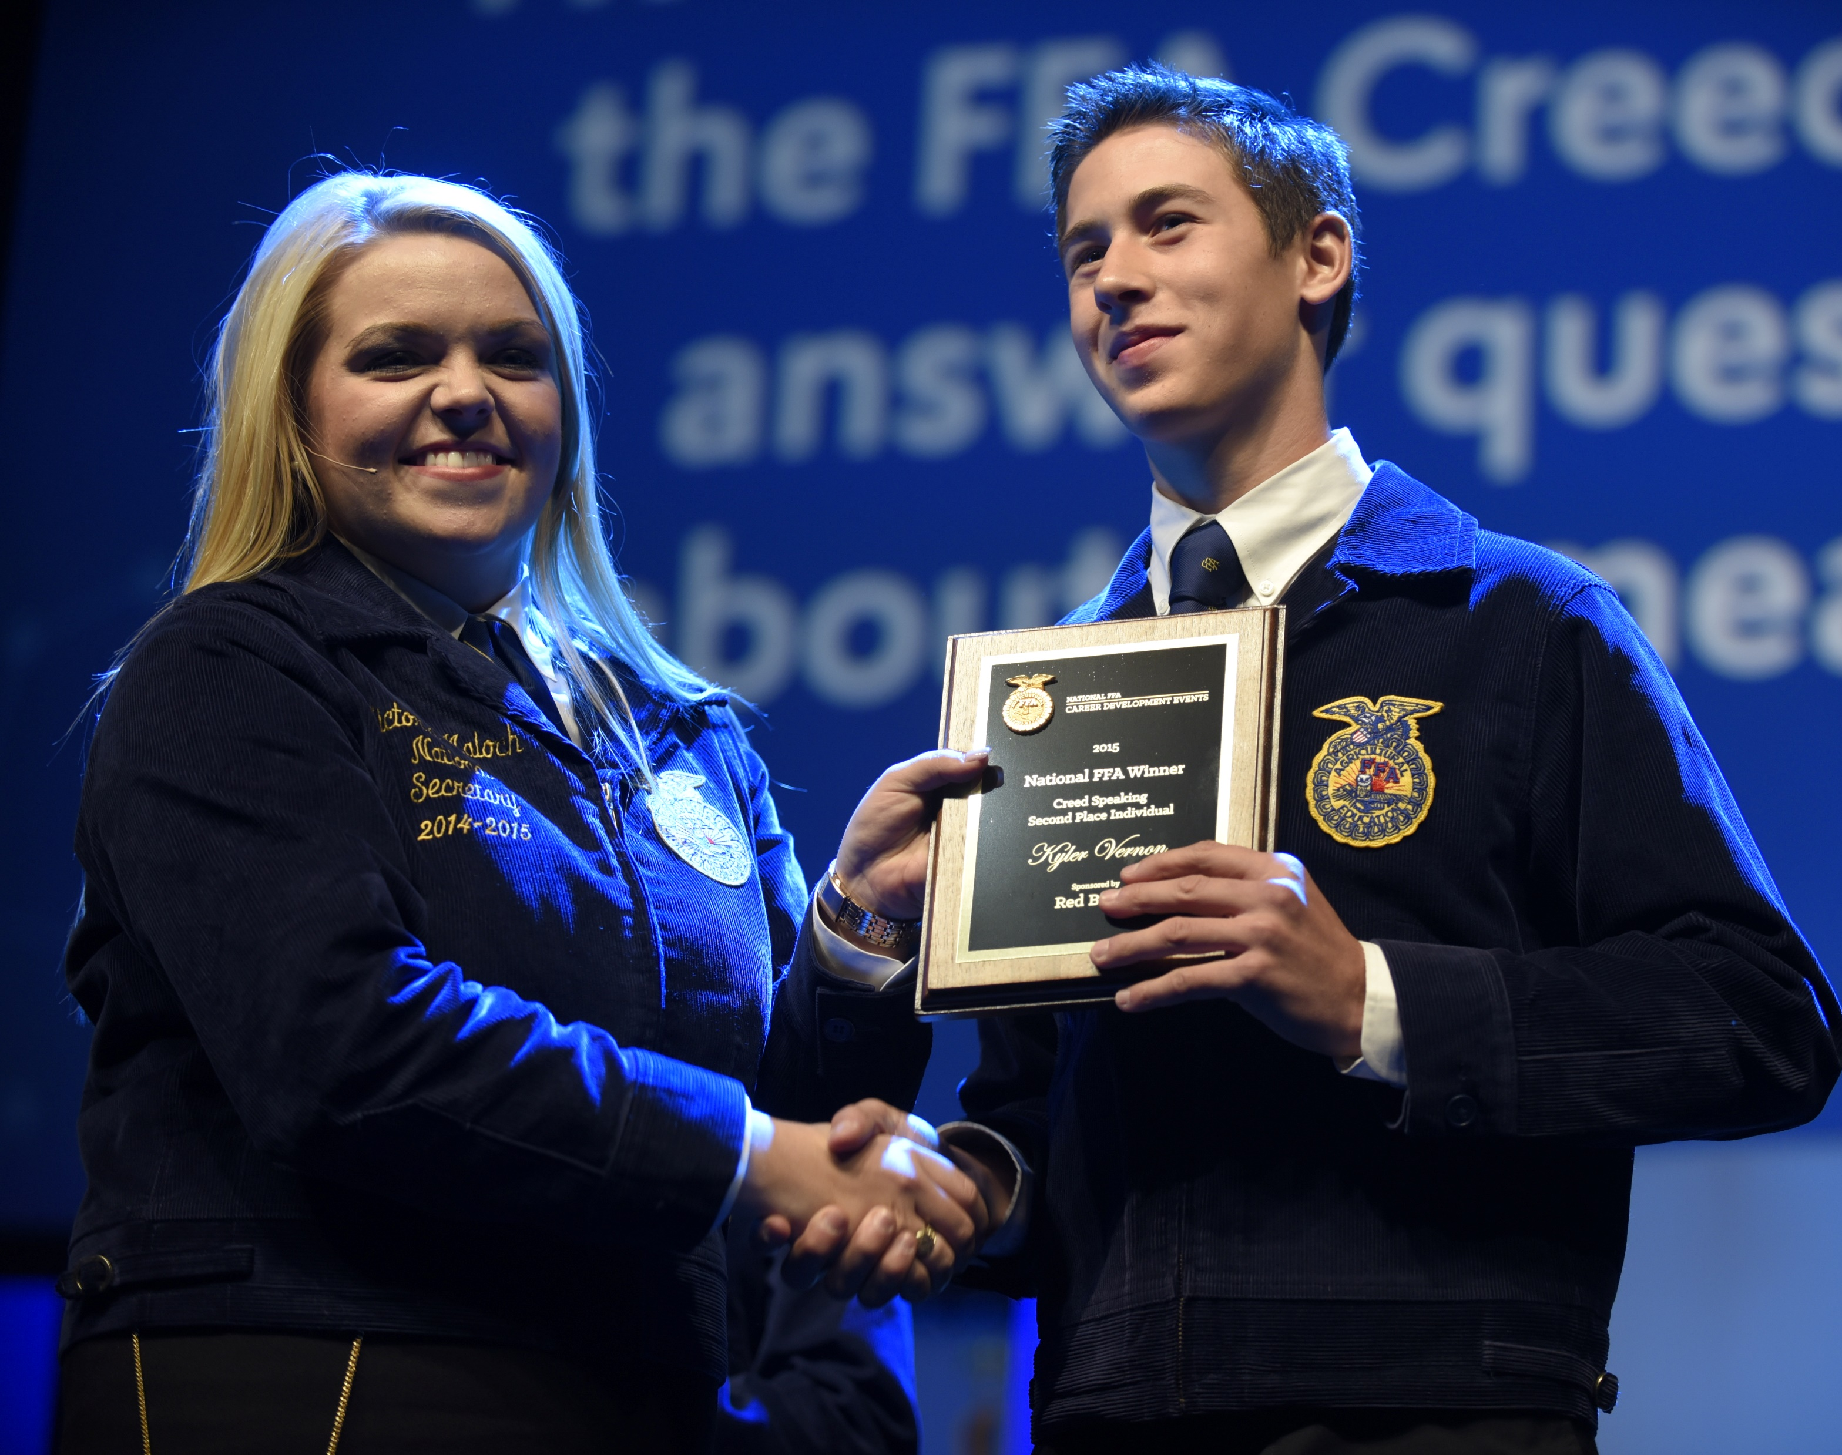
Leadership Development Events
Creed Speaking
Seventh-, eighth- and ninth-grade members will memorize the FFA Creed and recite it for judges. Questions will also be asked about the Creed.
Employment Skills
This LDE evaluates you on all the steps that make a good interview — filling out the job application, cover letter, resume, interview and follow-up letter.

Slide 47
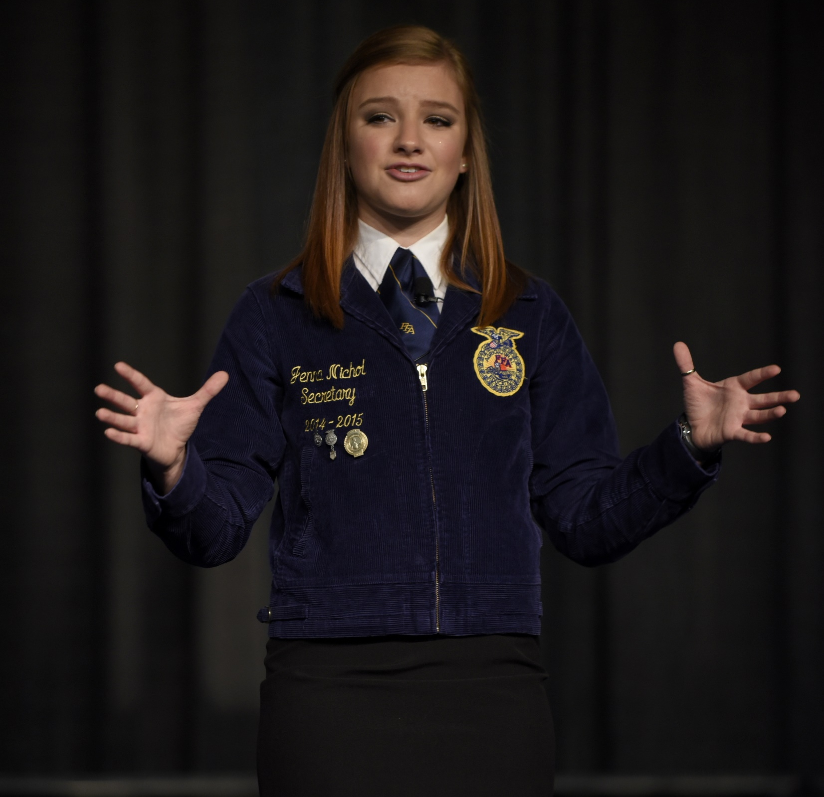
Leadership Development Events
Extemporaneous Public Speaking
You are given 30 minutes to prepare a four- to six-minute speech covering one of 12 agriculture-related topics. You will be evaluated on your speaking ability, presentation, content and ability to answer questions.
Prepared Public Speaking
Select an agriculture-related topic that interests you, research that topic and then put together a creative, informative and interesting speech to deliver.

Slide 48
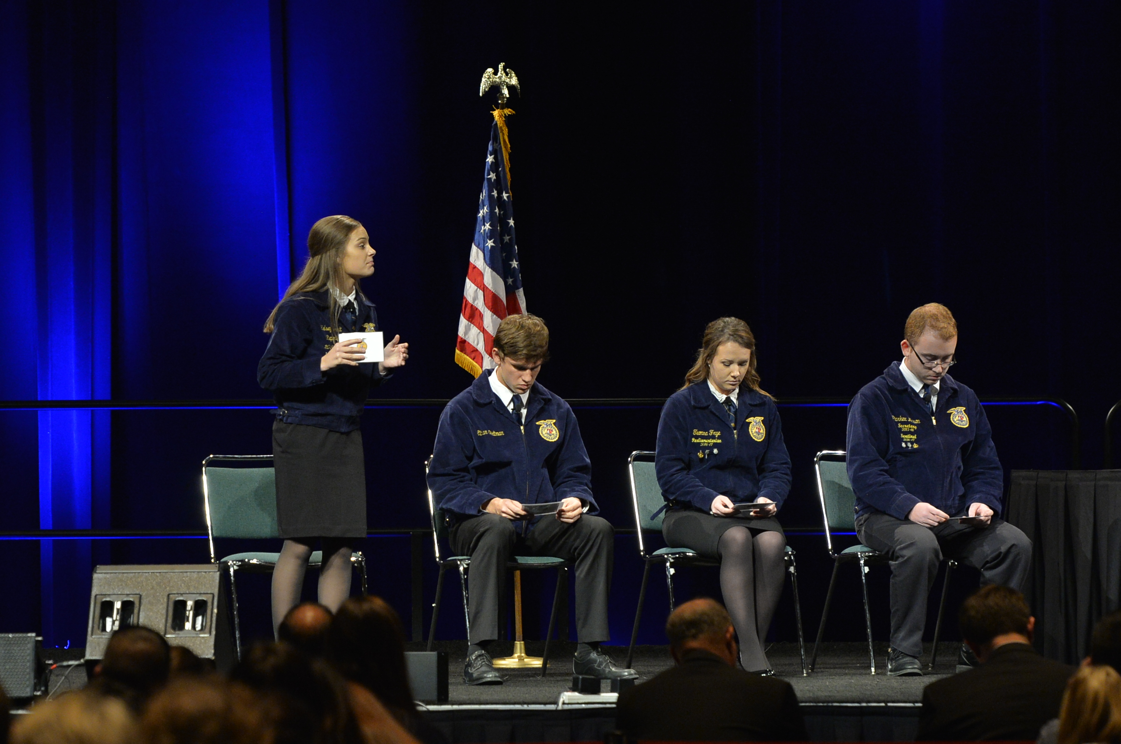
Leadership Development Events
Parliamentary Procedure
This LDE takes what FFA members do in chapter meetings to the next level. In this event, you are evaluated on your team’s ability to conduct an orderly and efficient meeting using parliamentary procedure.

Slide 49
Part 5:
Careers in Agriculture

Slide 50
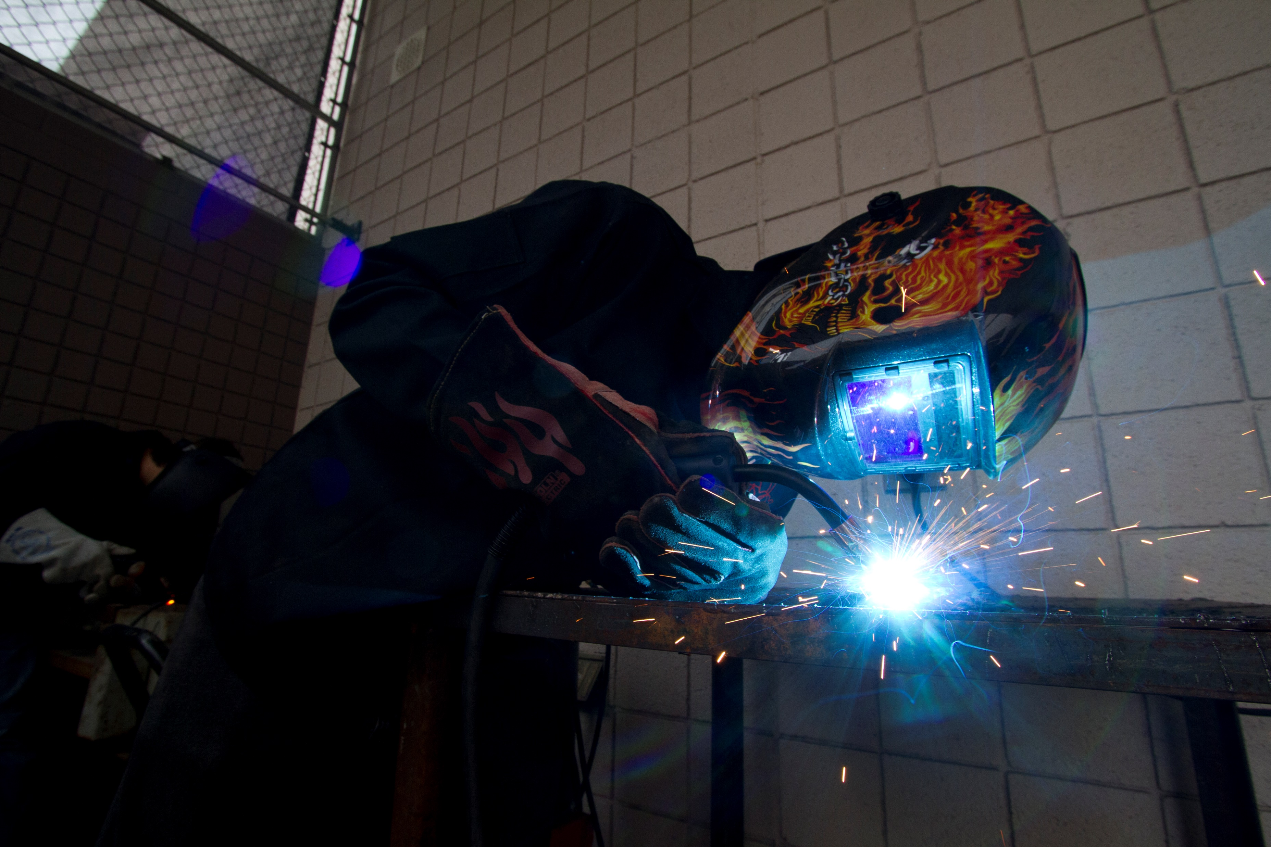
Careers in Agriculture
One in six people are employed in agriculture worldwide.
Nearly 60,000 job openings in agriculture each year in the U.S.
Your agricultural education classes and FFA can help you determine the right career for you.
Through these experiences, you can begin acquiring the skills needed for a successful and exciting career.

Slide 51
Part 6:
Career-Based Resources

Slide 52

FFA Resume Generator
This resource will help you develop a polished resume.
Makes resume creation simpler and formats it correctly
Information is saved so you can easily update your resume.

Slide 53

AgExplorer
National FFA and AgCareers.com joined forces to create this career resource.
Learn about which career might be right for you through videos, virtual field trips and over 300 unique career profile pages and by completing the interactive “My Career Quiz” to be matched to careers.

Slide 54
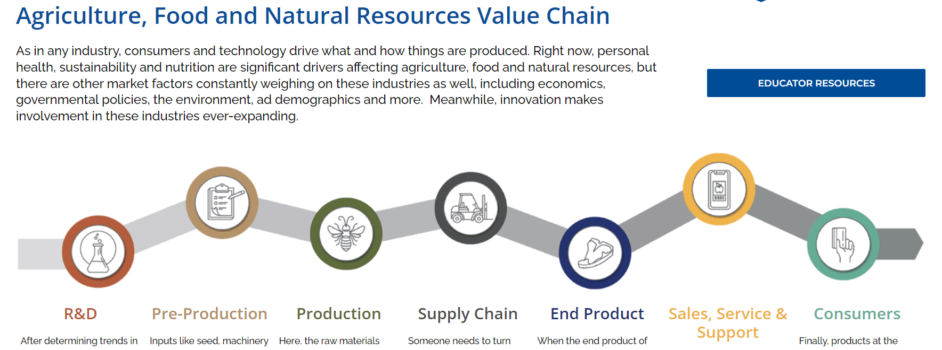
Agriculture, Food and Natural Resources Value Chain
This resource represents the process, from start to finish, of how items in our lives make their way to us.

Slide 55
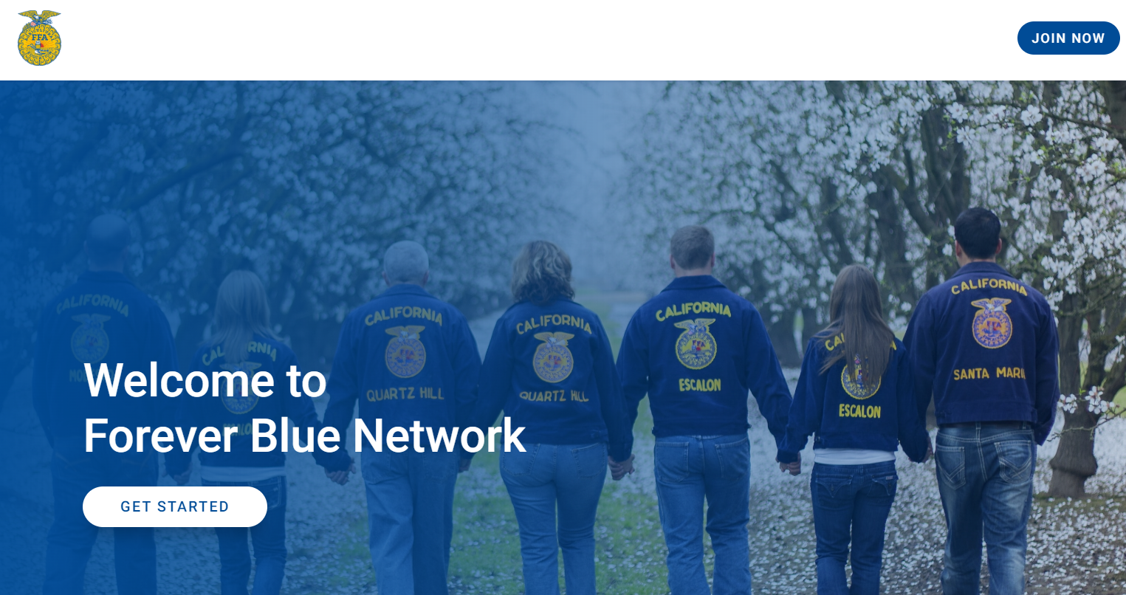
Forever Blue Network
The National FFA Organization launched its own networking platform.
Provides high school junior and senior FFA members, alumni and supporters exclusive access to events, groups, mentors and job opportunities

Slide 56
Part 7:
Global/International Connections

Slide 57

Global/International Connections
An estimated world population of 9 billion people is expected by the year 2050.
American farmers must produce more food on less land than at any point in history.
Future leaders in agriculture, like FFA members, should be attentive to the supply and demand of the global marketplace.

Slide 58
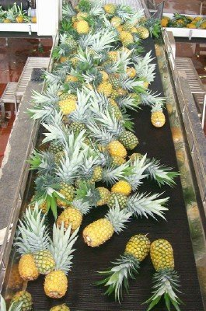
Global/International Connections
How to broaden your horizons:
Start an International Agricultural Development SAE using the SAE Kit from National FFA (link on page 128).
Explore group travel seminars offered by your school, chapter or another youth organization.
Consider participating in a mission trip.
Begin a chapter-to-chapter exchange program with FFA members in another state.
Attend conferences/seminars with an international focus.
Attend the National FFA Convention & Expo and connect with an agribusiness that has a global presence.

Slide 59
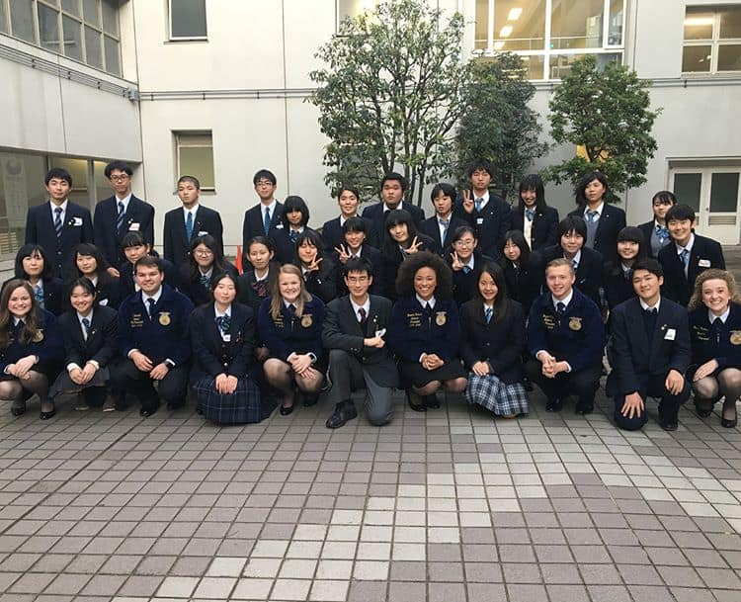
Global/International Connections
Stay local, but develop worldwide knowledge:
Take part in the World Food Prize Global Youth Institute (link on page 128).
Identify a country of interest and learn what agriculture looks like on its soil.
Interview or job shadow a professional who works to produce food, fuel or fiber across the globe.
FFA isn’t strictly an American concept, so search the web for “Future Farmers” in Japan, Thailand and Korea.
Google the term “cultural values” and learn how culture affects daily life.
Visit the ethnic food aisle at your local grocery store.

