Slide 1
Student Handbook
Section 5: Appendix

Slide 2
Part 1:
How to Tie a Tie

Slide 3
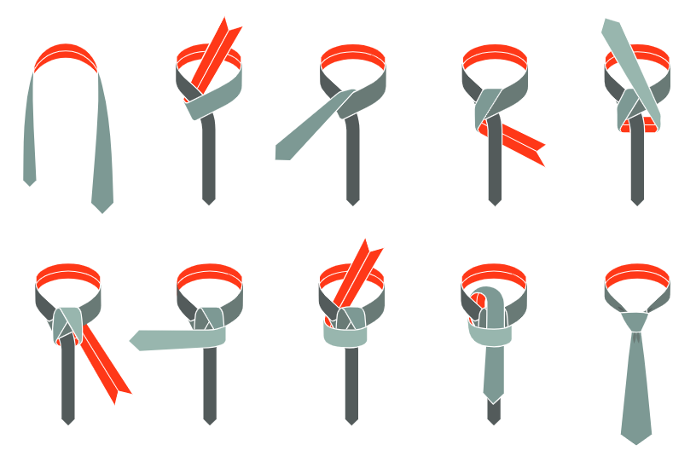
Windsor Knot
Start with wide end of the tie on your right and extending a foot below narrow end.
Cross wide end over narrow and bring up through loop.
Bring wide end down, around and behind narrow and up on your right.
Then pull down through loop and around across narrow.
Turn and pass up through loop.
Complete by slipping down through the knot in front. Tighten and draw up snug at collar.

Slide 4
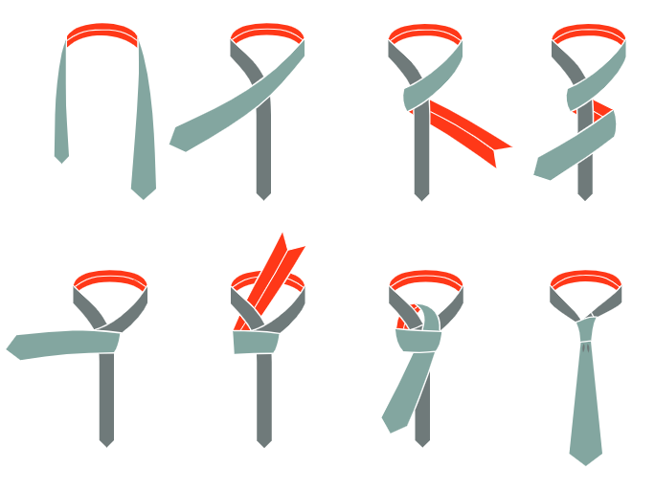
The Four-in-Hand Knot
Start with wide end of the tie on your right and extending a foot below narrow end.
Cross wide end over narrow and back underneath.
Continue around, passing wide end across front of narrow once more.
Pass wide end up through loop.
Holding front of knot loose with index finger, pass wide end down through loop in front.
Remove finger and tighten knot carefully.
Draw up tight to collar by holding narrow end and sliding knot up snug.

Slide 5
Part 2:
Chapter Social Media Tips

Slide 6
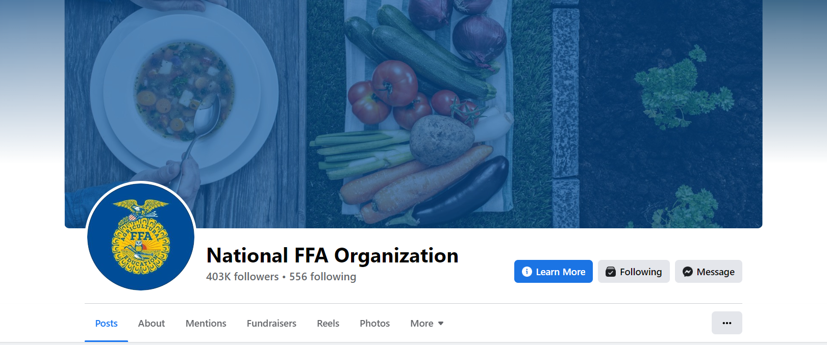
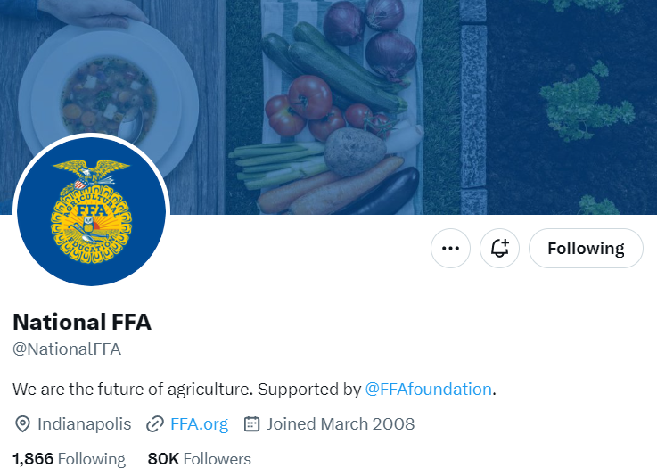
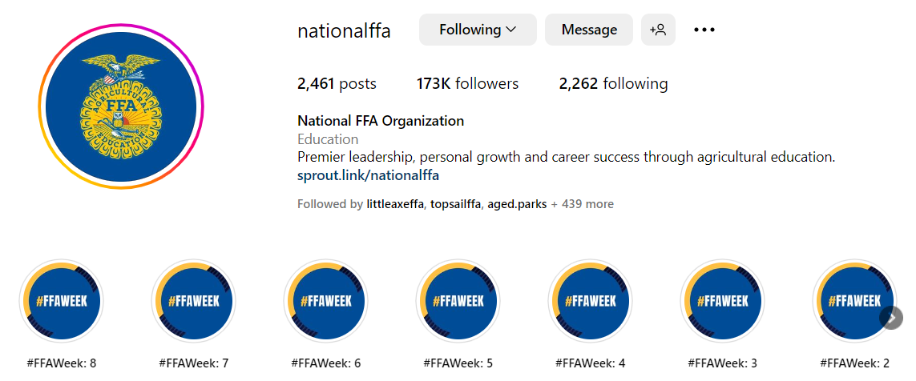
Chapter Social Media Tips
FFA wants to communicate with its membership, and social media is a great outlet because so many FFA members use social media.
Facebook, Twitter, Instagram
When posting, remember your FFA voice — a positive, respectful and inspirational tone.
Resist the urge to reply to unkind comments; do not argue with negative comments.
Once it’s on the internet, it’s there forever.

Slide 7
Chapter Social Media Tips
Engage in the Conversation: Ask for feedback, use open-ended posts and reply to comments in a positive and timely manner.
Help Guide the Posts: Encourage users to post pictures and videos of your events.
Update Often — but not too often! Stick to two to three updates a day; try a post in the morning, afternoon and evening.
Watch Your Tone: It’s okay to be a little less formal, but pay attention to your grammar and spelling, and avoid slang, keep it positive and don’t forget that professionals may be following your social media too.
Customize Your Hashtag: You are encouraged to use hashtags from National FFA, but also create your own personalized to your chapter or event.
Enlist a Team for Promotion: Posting doesn’t have to only land on one person — a chapter can create a team to help make all the posts, especially during high-traffic times or events.

Slide 8
