Slide 1

#TeachAgChat: Leveraging Twitter as a Professional Development Tool
Jillian Gordon, Clarke Central High School (@jillianedu)
Dr. OP McCubbins, Tennessee Tech (@opmccubbins)

Slide 2
Objectives
Describe Twitter as an effective tool for developing professional learning networks and aggregating resources/information.
Identify best practices for Twitter utilization
Discuss future #Twitter applications for school-based agricultural education

Slide 3
What is Twitter?
An INFORMATION NETWORK!
Sign in or Sign up now!
Lets immerse in the process!

Slide 4
Some Basics
Mentions - @ + HANDLE (e.g., @opmccubbins)
Hashtags - used to index keywords or topics
(Don’t add spaces or punctuation in a # or it won’t work)

Slide 5
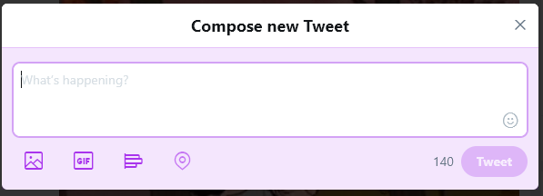
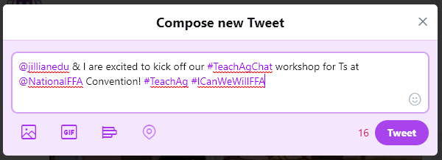
Some Basics
Sending a Tweet

Slide 6

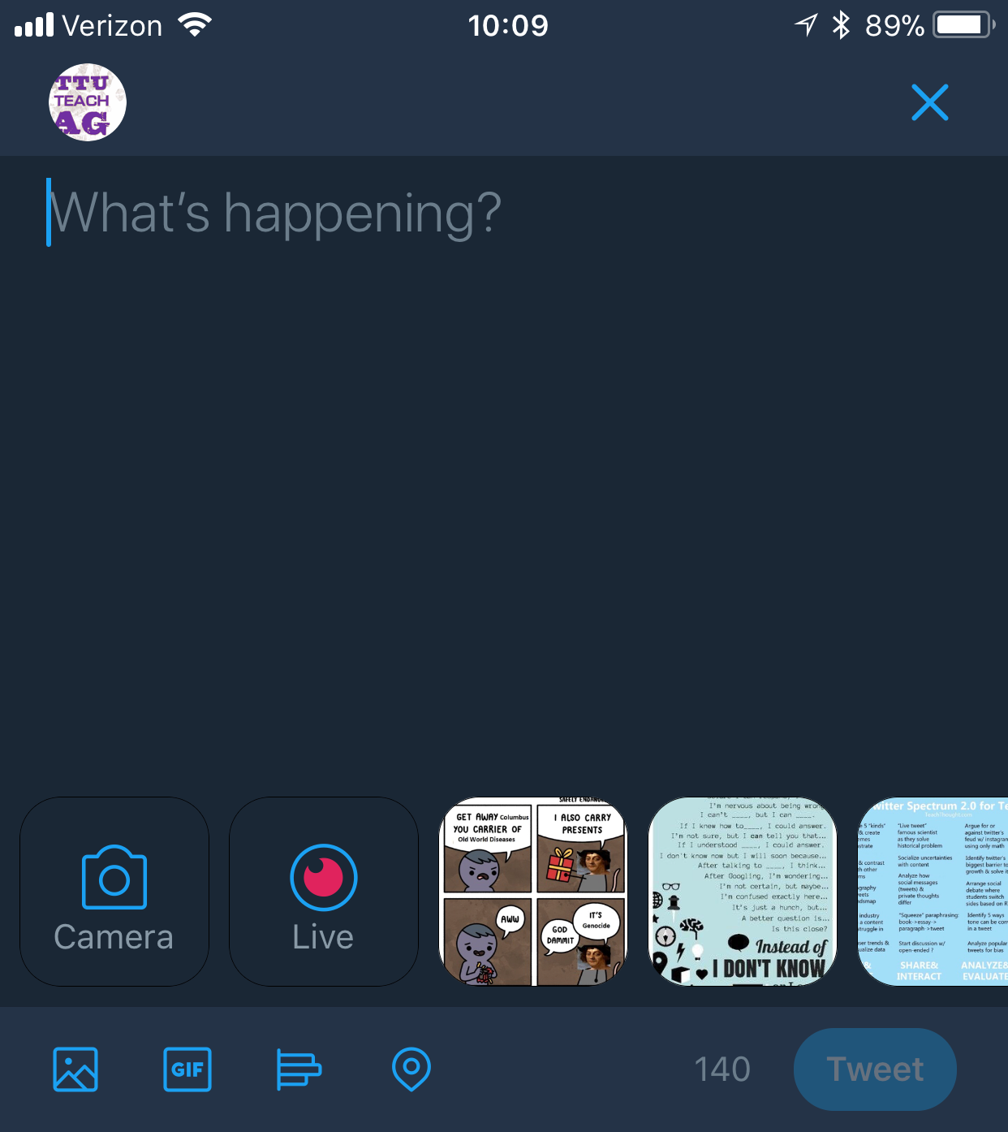
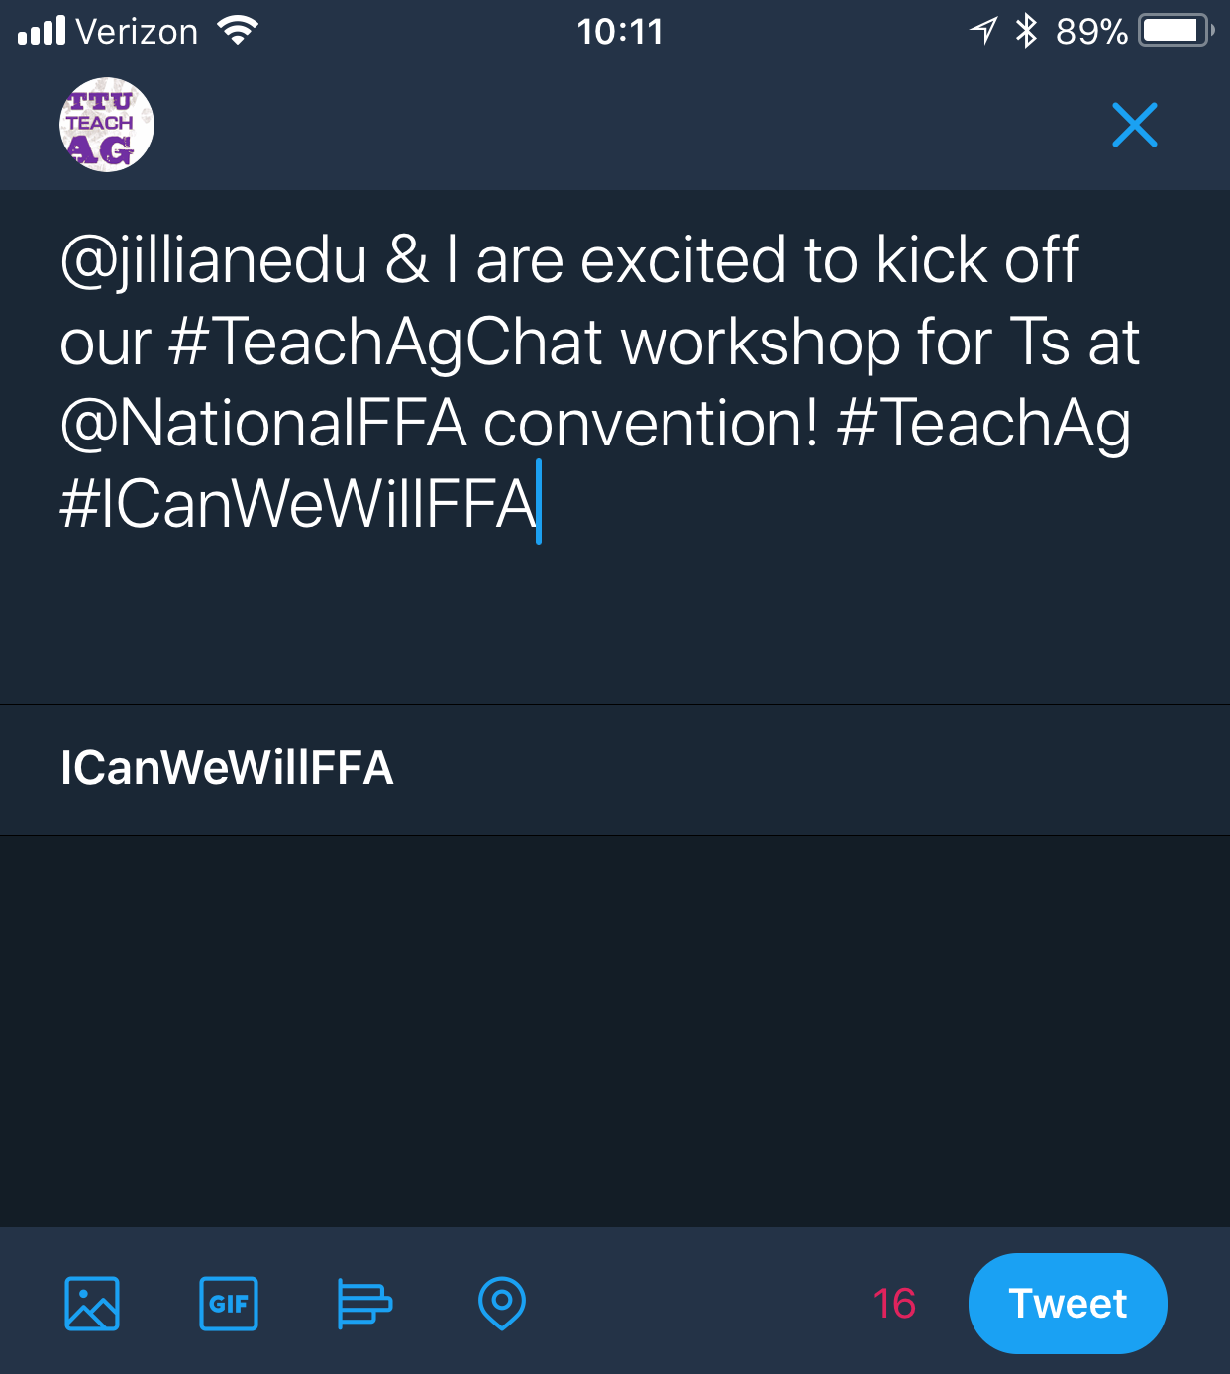
Some Basics
Sending a Tweet

Slide 7
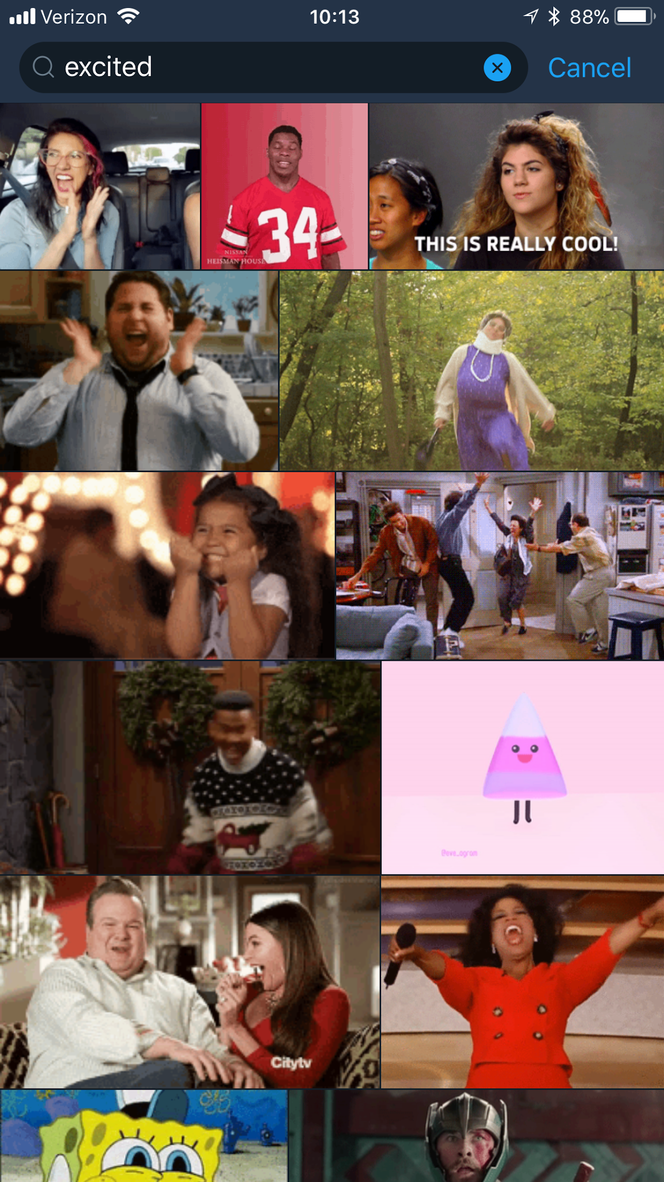
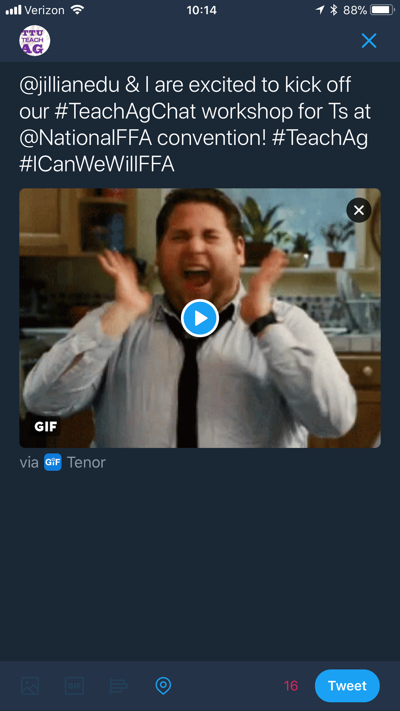
Some Basics
Q1-Q3
Including Media

Slide 8
Why use Twitter?
Great way to interact
Fantastic resources for best practices and innovative methods
Experts are only a Tweet away
To build a...
PROFESSIONAL LEARNING NETWORK!

Slide 9
Twitter Utilization
Polls - Seek input from others outside of the classroom
Twitter Lists - Can help manage the madness of your feed
  Example List: National FFA Convention
Backchannel Discussion/Class Conversations
Class Updates (assignments, due dates, reminders, etc.)
Create a class/org hashtag! (i.e., #TTUTeachAg or #psuaged18)
Document field trips
Exit Tickets
Notifications

Slide 10
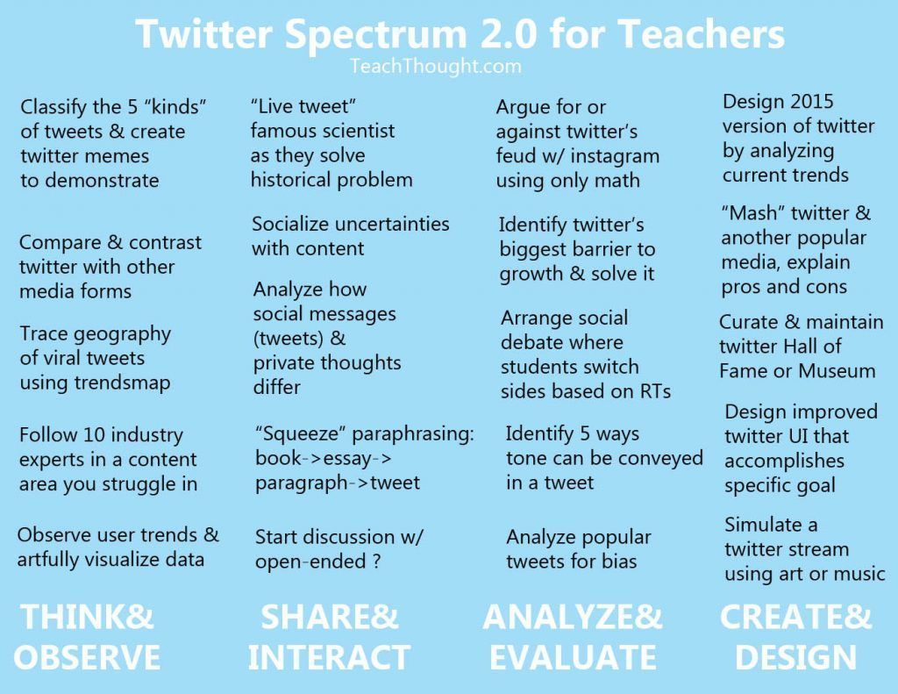
Q4

Slide 11
What are Twitter Chats?
A digital chat with users across the country on a specific topic-identified by a specific hashtag-to broaden knowledge and collaborate on new and innovative ideas.
#PDinyourPJs

Slide 12
#TeachAgChat
@TeachAgChat
#TeachAgChat Blog
#TeachAgChat Handbook

Slide 13
Managing the Madness
Hootsuite - Schedule tweets
TweetDeck

Slide 14
Resources
Q5-Q6
Twitter Glossary
Using Hashtags
30 Innovative Ways to Use Twitter In The Classroom
20 Ways High Schools Are Using Twitter In The Classroom
25 Ways To Use Twitter In The Classroom By Complexity
13 Reasons to Use Twitter in the Classroom
5 Unique Uses of Twitter in the Classroom
60 Ways To Use Twitter In The Classroom By Category
District Uses Twitter for PD

Slide 15
#TeachAgChat Schedule
Planning for Program Success in #AgEdu (November 2)
Informal Science Education, Communication, and Extension for Increasing Public Science Literacy (November 16)
Cultivating Digital Citizenship through Agricultural Youth Organizations (December 14)
All chats are from 8-9PM EST

