Slide 1
All About Poultry
Poultry Body Parts
Types of Poultry
Turkey Numbers
Poultry History — Then vs. Now

Slide 2
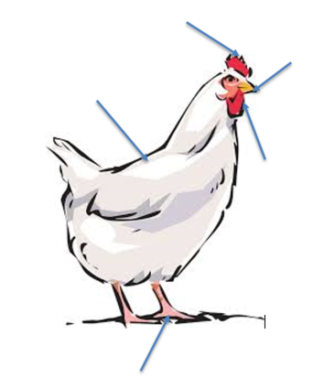
Poultry Body Parts
Comb
Beak
Plumage
Wattle
Shank

Slide 3
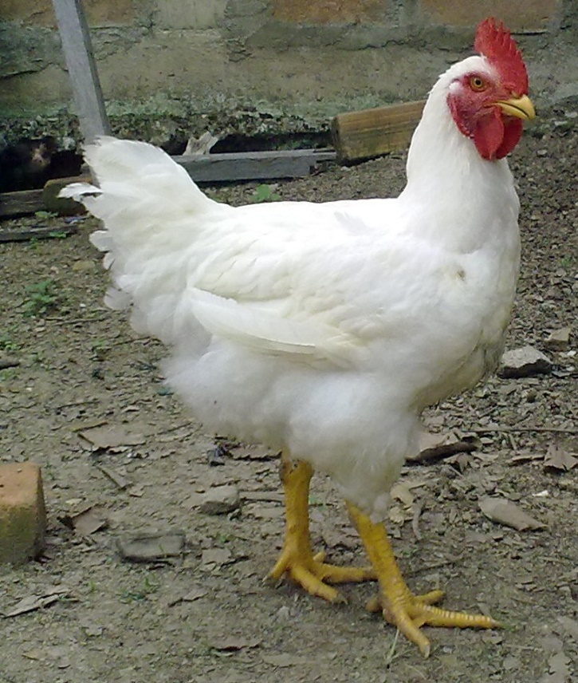
Types of Poultry
Broiler Chicken

Slide 4
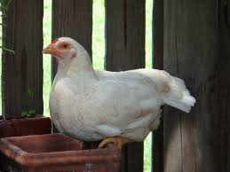
Layer Chicken

Slide 5
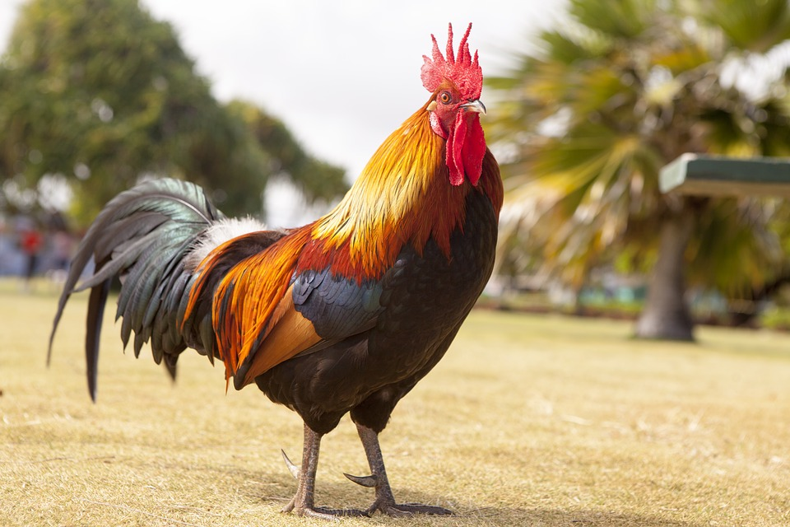
Rooster

Slide 6
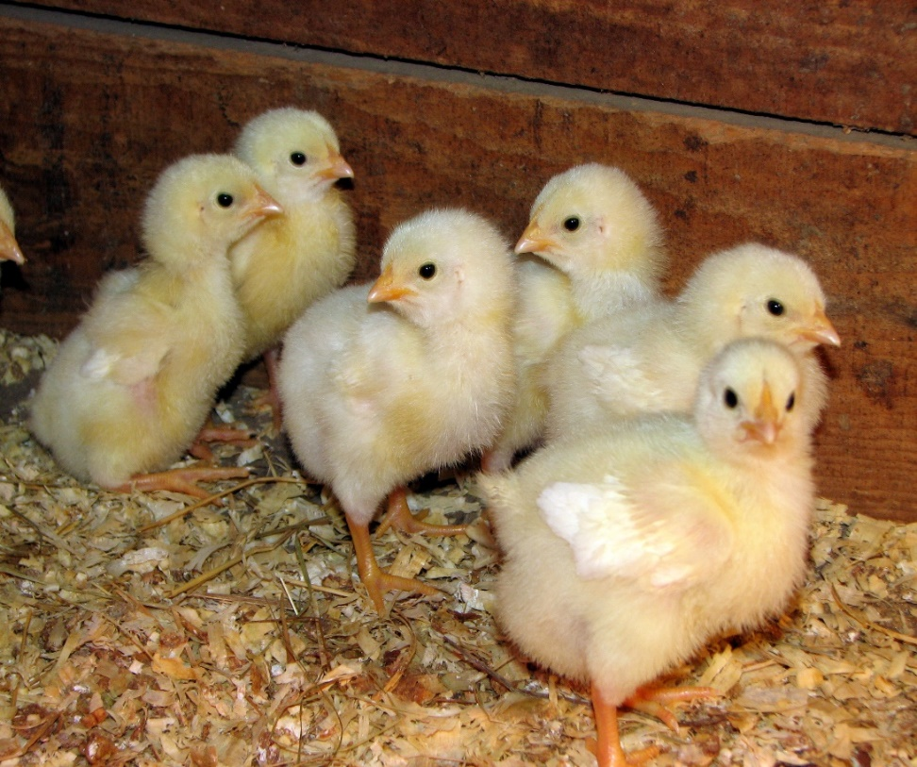
Chick

Slide 7
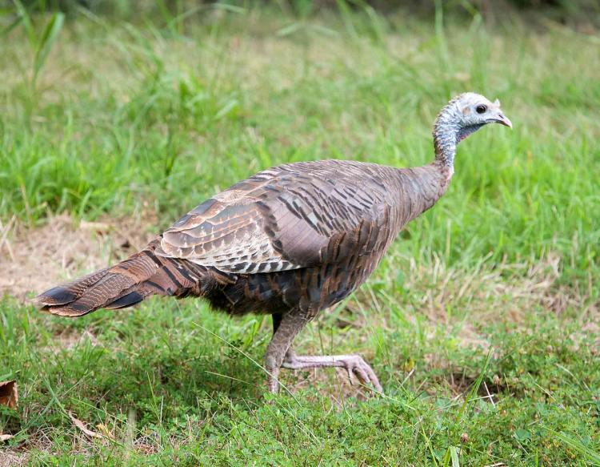
Hen (Turkey)

Slide 8
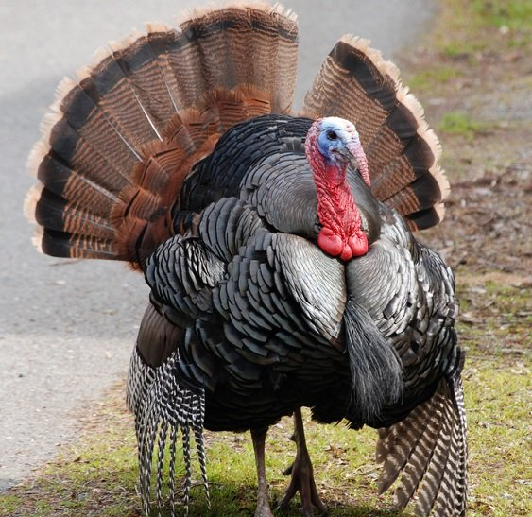
Tom (Turkey)

Slide 9
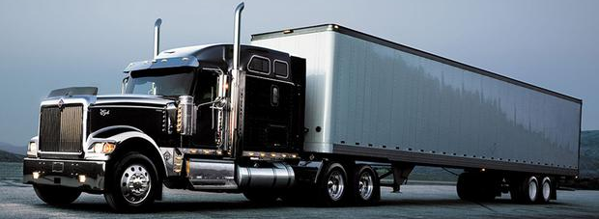
Turkey Numbers
Turkeys Produced in 2017
  243 million
  7.5 billion pounds = 93,750 semi-trucks

Slide 10
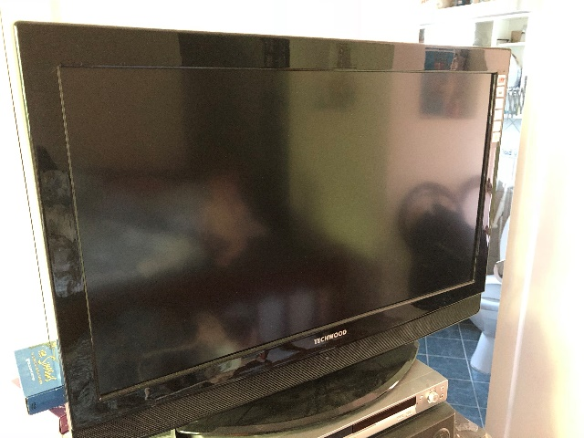
Turkey Consumed in the U.S.
  16.4 pounds per person= 19-in flat screen TV
  28.5% during holidays

Slide 11
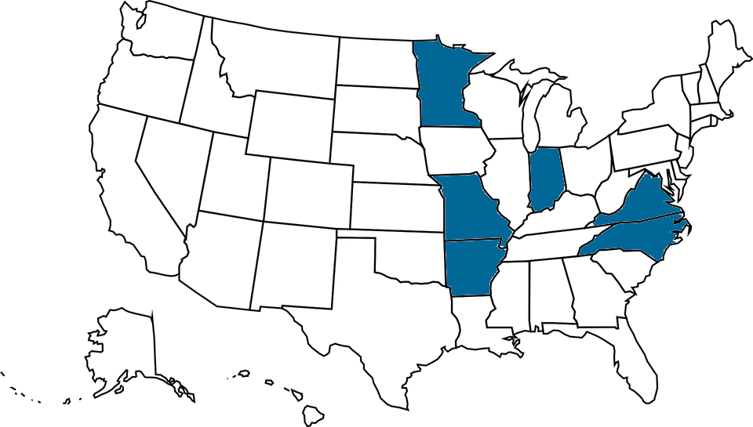
Top Producing States in 2017
  Minnesota
  North Carolina
  Arkansas
  Indiana
  Missouri
  Virgina

Slide 12
Egg, Eggs and More Eggs
Egg Colors
Egg Sizes
Egg Freshness
Egg Parts
Egg Hatching

Slide 13
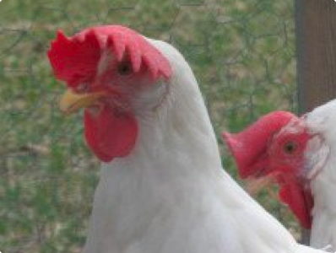
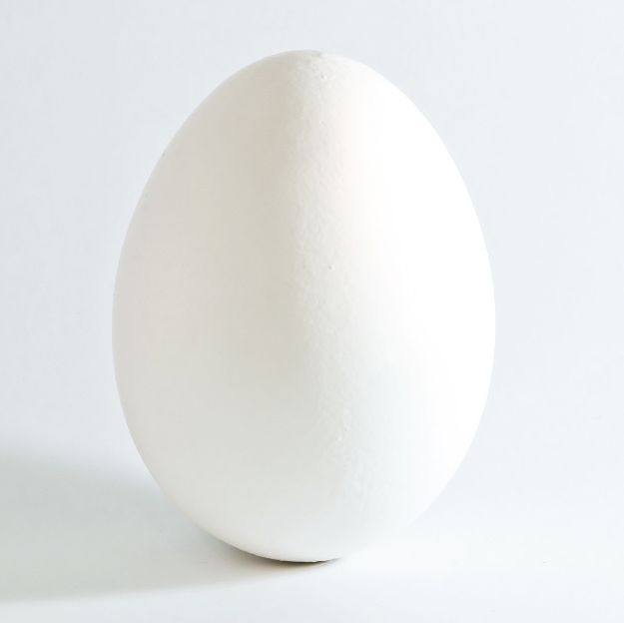
Egg Colors

Slide 14
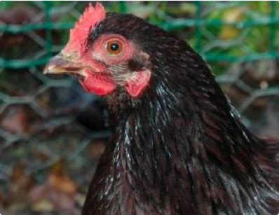
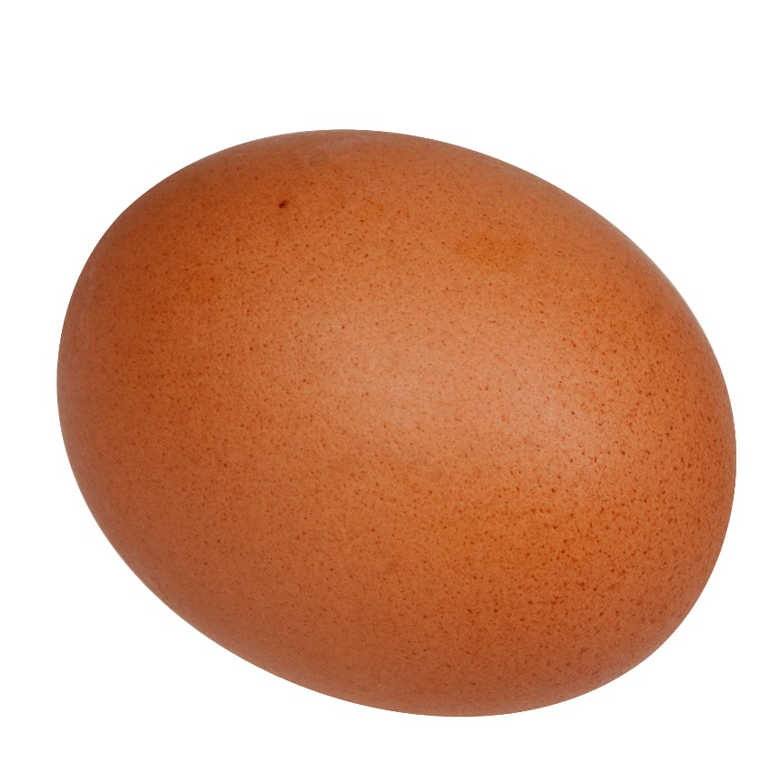

Slide 15
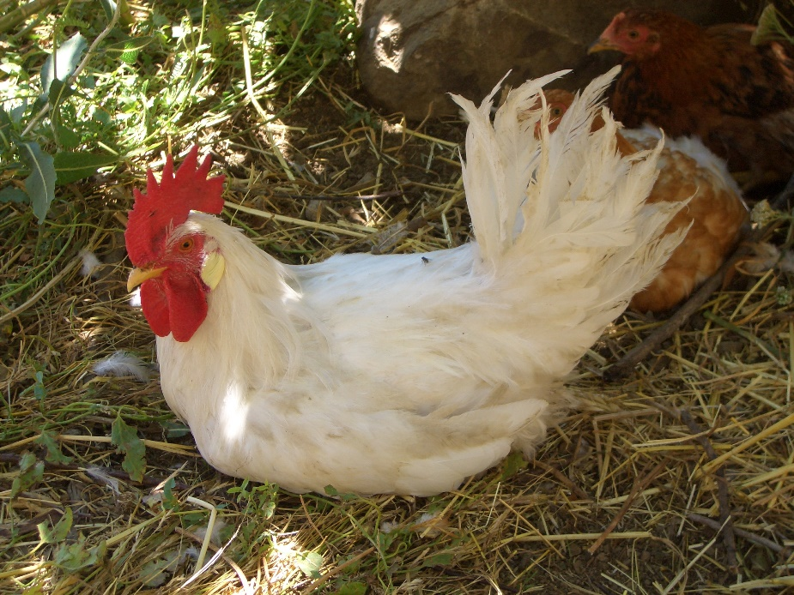
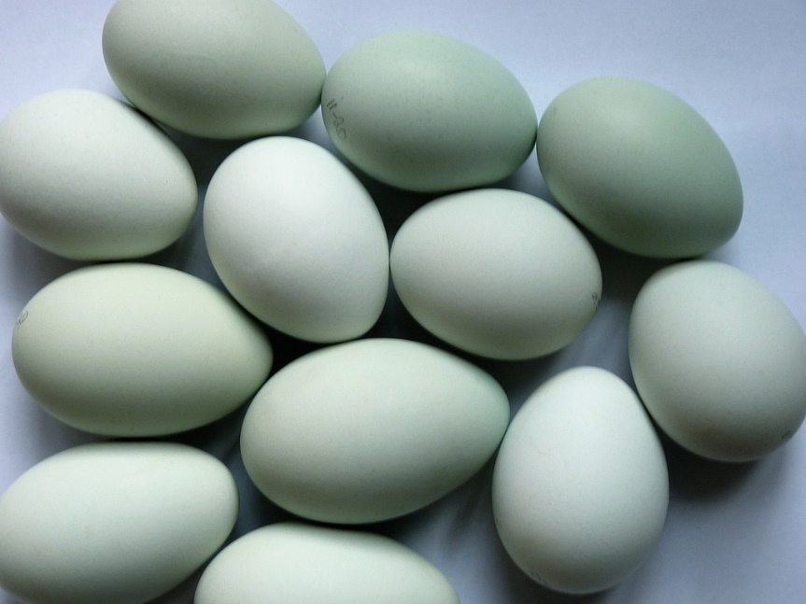

Slide 16
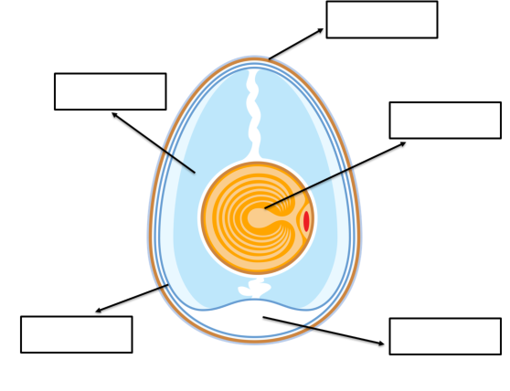
Egg Parts
Shell
Egg White
Yolk
Shell Membrane
Air Cell

Slide 17


Fertilized vs. Unfertilized
could become a chick
Not possible to have a chick

Slide 18

Chick Embryo Development

Slide 19
Habitat
“The place or environment where a plant or animal naturally or normally lives and grows.”

